Slide 1

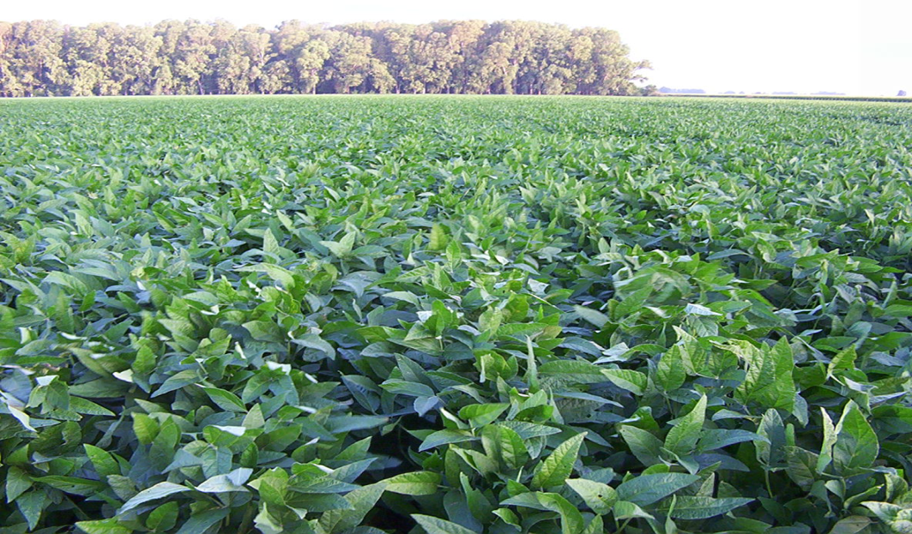

NON GMO IP FOOD GRADE SOYBEAN
Final Product Specifications
November 2014
www.kumagro.com

Slide 2
FOOD

Slide 3
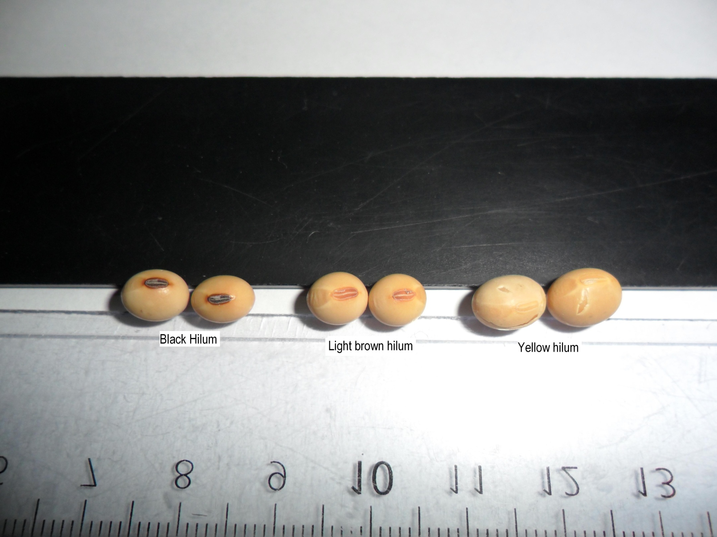
HILUM COLOR

