Slide 1
SMART*PLAYER

Slide 2
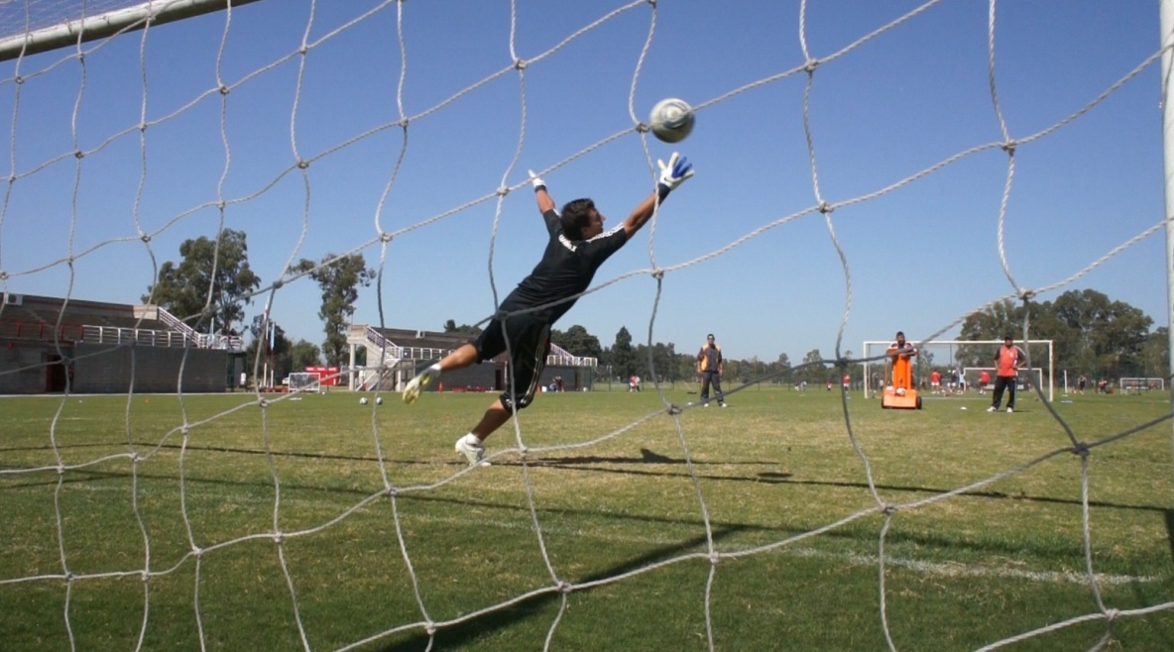
GOALKEEPER TRAINING
. Jobs reaction.
. Security jobs hands.
. Jobs passing game, with use of front and side centers.
. Speed work.
. Shot of middle and long distance, with or without barrier.

Slide 3
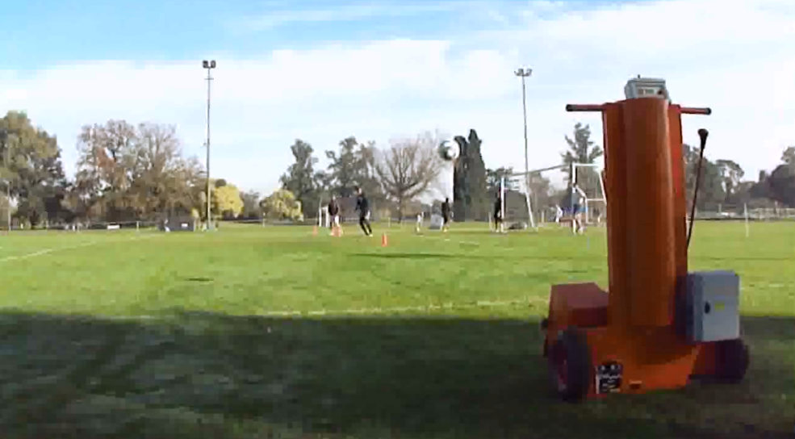
OFFENSIVE TRAINING
. Launch of lateral and frontal balls, with exercise: definition header and volley kick.

Slide 4
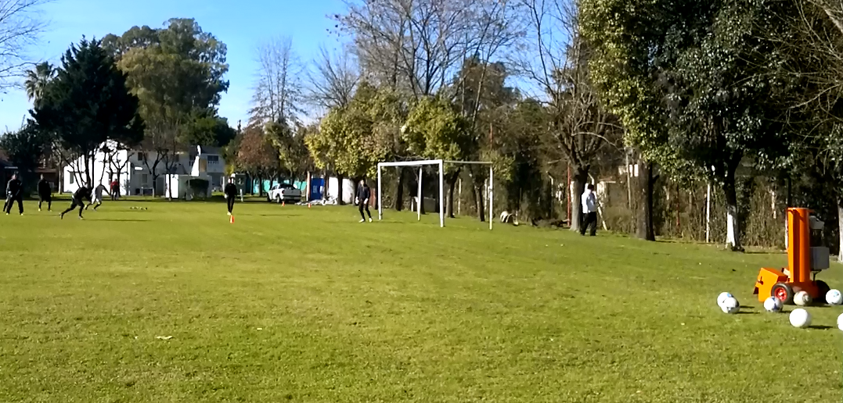
DEFENSIVE TRAINING
. Front and side rejections from corners.
. To exercise jump defenders and synchronization, regarding the progress of the ball.

Slide 5
OFFENSIVE AND DEFENSIVE WORK (T.D.)
. Works with stationary ball:
Free throws
Corners
Outside
Note: It is important to use the stationary ball in training works because our Smart*Player, has no margin for error in the centers work more accurately and thus saves time training.

Slide 6
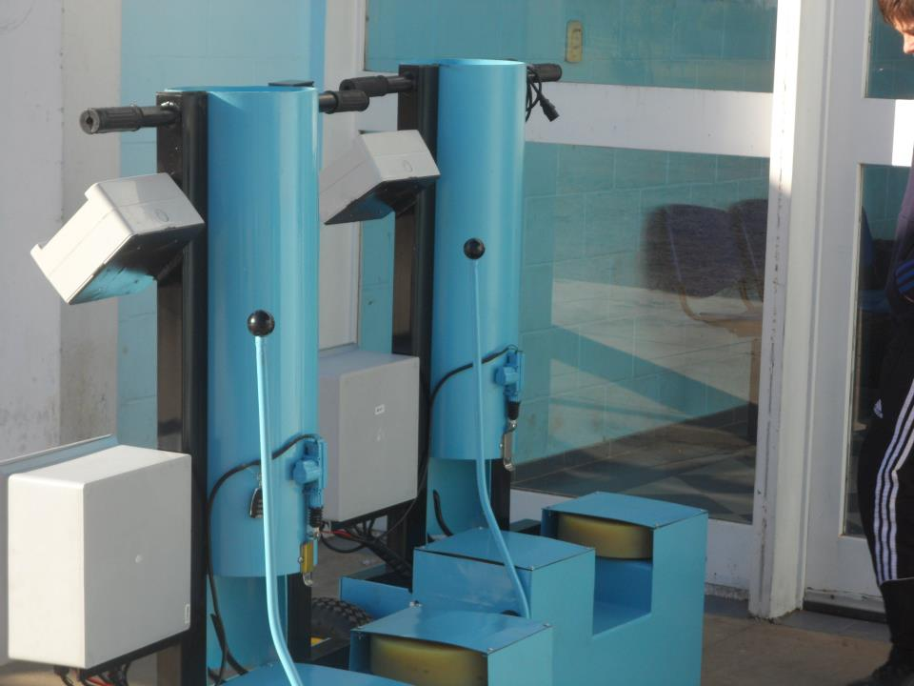
SMART*PLAYER

Slide 7
SMART*PLAYER FEATURES
. Power: achieves top speeds of almost 200 km / h
. Angulo: shoots balls between 0º to 45º
. Routines: You can repeat the same shot and always at the same point, or programmed randomly, varying: power, fate and effect.
. Effect: synchrony is achieved by the 2 wheel drive, with which the ball is fired.

Slide 8
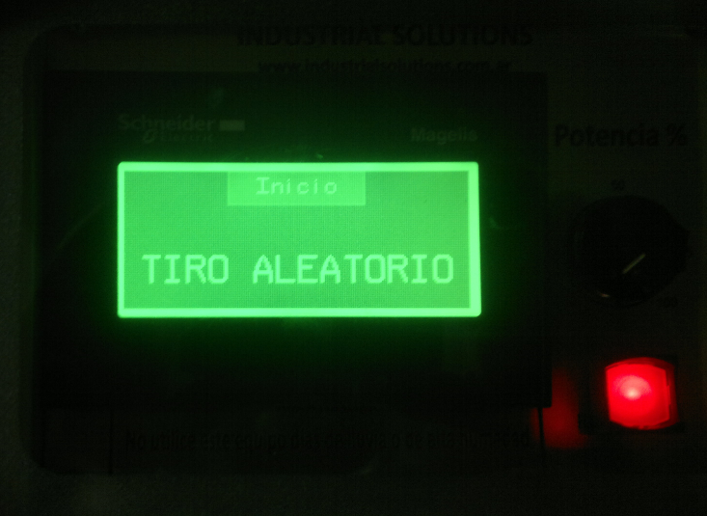
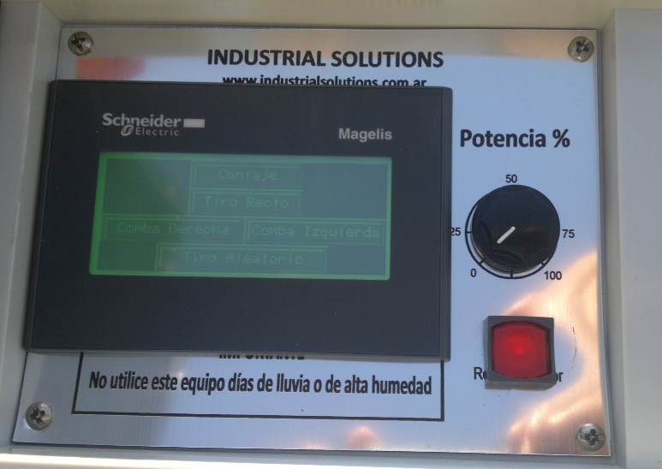
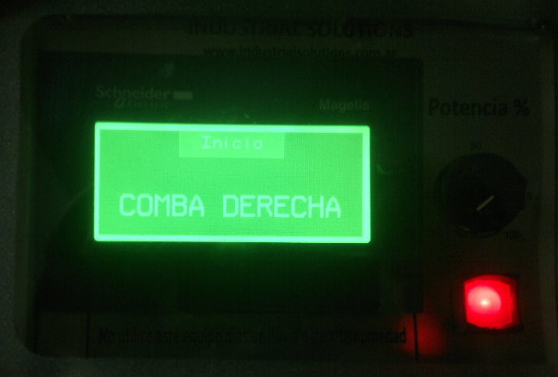
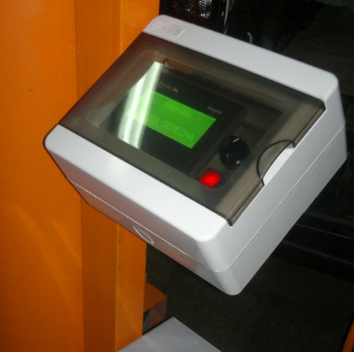
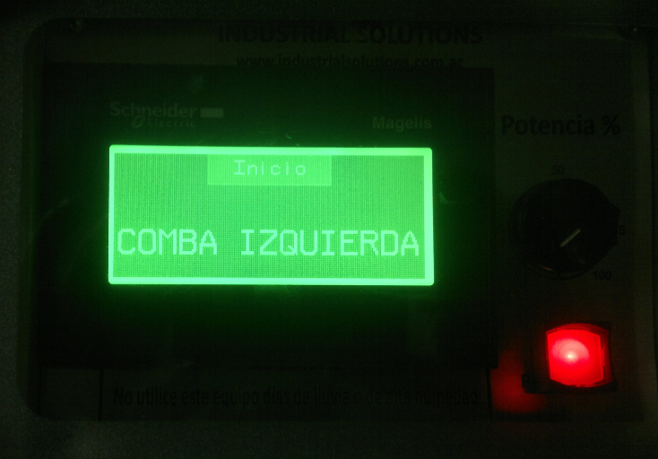
DIGITAL DISPLAY

Slide 9
TECHNICAL SPECIFICATIONS
. Net Weight: 60 kg (empty).
. Gross Weight: 80 kg.
. Dimensions: 0,40x0,30x1,40 (LxWxH) = 0.17 m3
. Transport: The unit is compact and has 2 rubber wheels for Shuttle training site.
. Shooting balls: synchronized by 2motors.
. Capacity: 5 to No. 5 soccer balls.
. Power supply: 12V battery.
. Autonomy: more than 3 hours, to recharge.
. HTS (6): 9506.91

