Slide 1
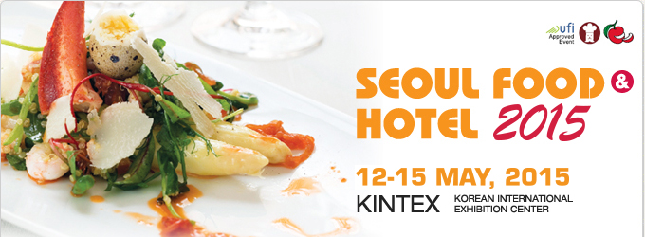
PERUVIAN COMPANIES
Exportable offer

Slide 2

GANDULES INC
Founded in 2002, GANDULES INC SAC. is a private equity company with many years of experience in the management of agricultural lands located in Jayanca and San Pedro valleys, thus demonstrating a deep commitment to agribusiness development in Peru.
GANDULES INC SAC. is now recognized both nationally and internationally as one of the most important companies in the agribusiness sector of Peru, which has fully expanded its production operations and export of its products to customers in more than 40 countries.
Currently, GANDULES INC. SAC. is an innovative company engaged in theplanting, production, processing, packing, packaging and marketing of its own products in a wide range of presentations: green peppers, green chili, jalapeno peppers, asparagus, pigeon peas, grapes and melons, among others.Its workforce ranges between 3,500 and 5,000 workers at all stages of the production chain.

Slide 3
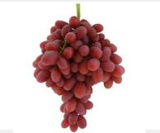
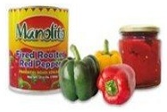
GANDULES INC
Canning & Glass
Bell Peppers
Cherry Pepper
Green Chili
Jalapeño
Banana Pepper
Chipotle
Sweety Drop
Frozen
Peppers
Jalapeño
Mango
Collection Sweety Pepp
Regular Sweety Pepp | Roasted Sweety Pepp
Golden Sweety Pepp | Inka Pinquante
Hottypepp | Tricolore Sweety Pepp
Red Boatypepp | Triangle Pepp
Green Boatypepp
Fresh
Grapes
Melon
Peppers

Slide 4
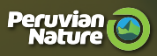
PERUVIAN NATURE
Peruvian Nature is a one-of-a-kind Peruvian company created in 2001 dedicated to the production and marketing of dehydrated products that serve as raw material for the food production and manufacturing industries for direct use by the consumer.
Peruvian Nature exports to:
  North and Central America: USA, Canada, Guatemala and Mexico.
  South America: Colombia, Uruguay and Brazil.
  Africa: South Africa
  Asia: Japan, Korea, Taiwan and Malaysia
  Europe: Germany, England, Spain France, and the Czech Republic.

Slide 5
PERUVIAN NATURE
Fruit
Apple
Banana
Camu Camu
Lucuma
Golden Berry
Vegetables
Carrot
Capsicum
Green Asparagus
Panca Chili Pepper
Purple Corn
Marisol Chili Pepper
Sacha Inchi
Sweet Potato
Squash
White Asparagus
Yacon
Herbal Medicine
Artichoke | Graviola
Cocoa | Hercampuri
Caigua | Huanarpo Macho
Cat´s Claw | Maca
Chancapiedra | Mesquite
Chuchuhuasi | Noni
Bragon´s Blood | Tahuari
Copaiba
Grains
Cañihua
Kiwicha
Quinoa
Peruvian Nature also has finished products as capsules and doypacks

Slide 6
AMAZON HEALTH PRODUCTS
Amazon Health Products is a Peruvian company that follow the principles of Bio Trade including the conservation and sustainable use of biodiversity, the fair distribution of benefits, and socio economic sustainability. We are directly involved in all stages of production to guarantee provision and quality competitively
Amazon Health Products exports to:
  North and Central America: USA and Canada.
  Asia: Japan, China, Hong Kong, Taiwan and South Korea.
  Europe: Germany, Spain, France and Netherlands.
  Oceania: Australia and New Zealand

Slide 7
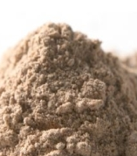
AMAZON HEALTH PRODUCTS
Products
Achiote
Camu Camu
Cocoa
Dried Golden Berries
Maca
Sacha Inchi Oil
Sacha Inchi Powder
Sacha Inchi Snack

Slide 8
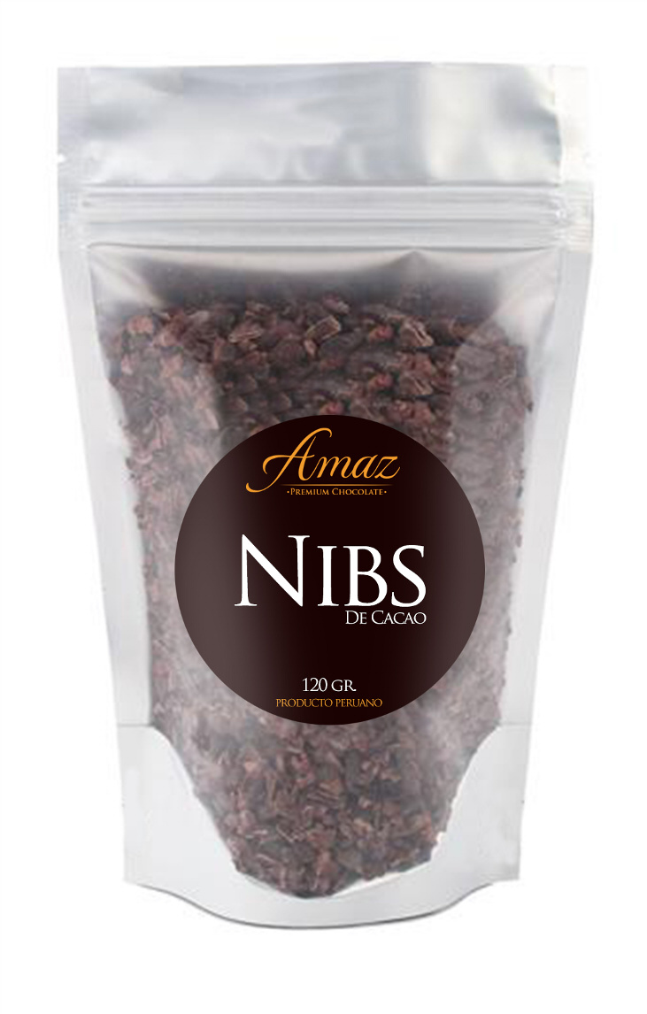
AMAZ FOOD
In early 2012 born AMAZ FOODS, focused on achieving the dream of developing healthy food products of premium quality, in order to generate sustainable markets.
AMAZ FOODS, has a multidisciplinary team oriented research and manufacture of innovative products made from cocoa and chocolates; using technology that allows you to meet the requirements of quality, environmental and bio-commerce with the international market.
Amaz Food exports to:
  Europe: France
Products:
  Chocolate Bar
  Couvertures
  Cocoa pieces
  Cocoa paste
  Chocolate cup

Slide 9
AMAZ FOOD
Amaz Dark
Golden Berry Dark
Pecan Dark
Coffee Dark
Cacao Intense
Dark Chocolate
Amaz Tradition
Intense Cocoa | Pecan & Caramel
Milk Chocolate | Moka & Caramel
Cappucino | Golden Berry
Coconut Delight | Bitter

Slide 10

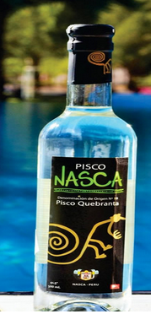
DESTILERIA CASTRO
Pisco Nasca is a high quality pisco, since it is made ​​from selected grapes passed through a careful process . Its aroma , body and quality has been rewarded and recognized internationally
Starting from 1960´s in the region of Lunahuana-Cañete. Nowadays the vineyard “Fundo Paraiso “ property of Destileria Castro, count 12 acres of grapes (Moscatel, Torontel and Quebranta).
Pisco Nasca exports to:
  North America: USA and Canada.
  Asia: Israel.
  Europe: Germany
Products:
  Pisco Quebranta
  Pisco Acholado

Slide 11

INKA CROPS
Inka Crops, is a Peruvian company founded in 1998 with the firm intention of giving value and promote the finest products of our culture and gastronomy in the world.
Today 14 years later, with exports worldwide, being a company that is specialized in the production and marketing of gourmet snacks, offering a wide variety of natural products made from raw materials of the highest quality from the rich valleys of Perú.
Amazon Health Products exports to:
  North and Central America: USA, Canada, Costa Rica and Panama.
  South America: Chile, Colombia, Brazil and Venezuela.
  Asia: Japan, Kuwait and United Arab Emirates
  Europe: United Kingdom and Italy
  Oceania: Australia and ew Zealand

Slide 12
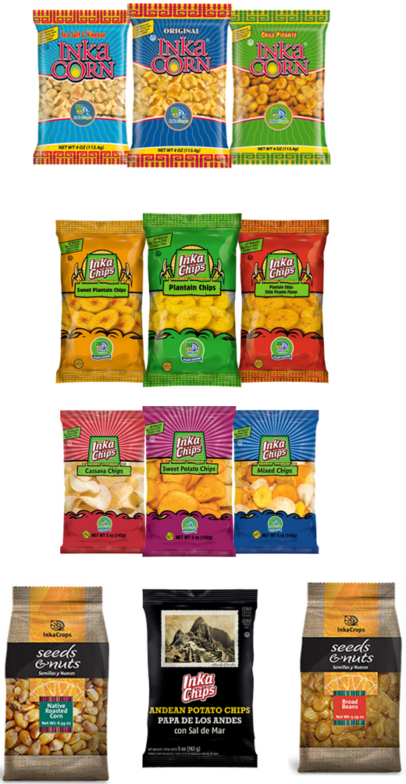
INKA CROPS
Products :
  Giant roasted corn
  Plantains Chips
  Chips
  Potato Chips
  Broad Beans
  Native Corn
Products
Mahi Mahi
Giant Squid
Scallops
Silverside
Hake
Mackerel
Squid
Anchoveta

Slide 13
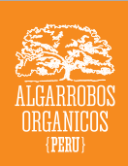
ALGARROBOS ORGANICOS
In 2007, Algarrobos Organicos was created with the purpose of recovering the ancestral knowledge of the dwellers of the Andean, Coastal and Amazonian region in order to grow the best products possible for Peru and for the world. Following old traditions, we grow, process and market within organic standards and systems. We began our operations only producing mesquite, becoming the first company Peru with certified organic mesquite.
Algarrobos Organicos exports to:
  North America: USA, Canada and Mexico.
  Asia: China and Taiwan.
  Europe: Germany, Portugal, Spain, France, Austria, United Kingdom, Italy, Netherlands, Switzerland, the Czech Republic and Croatia
  Oceania: Australia and New Zealand
  Africa: South Africa

Slide 14
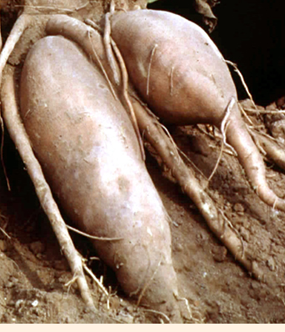
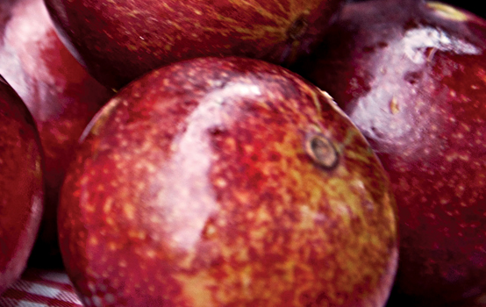
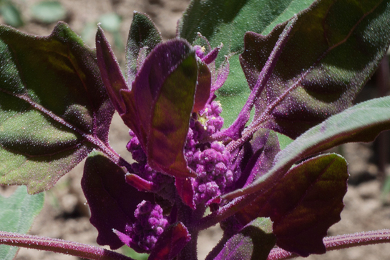
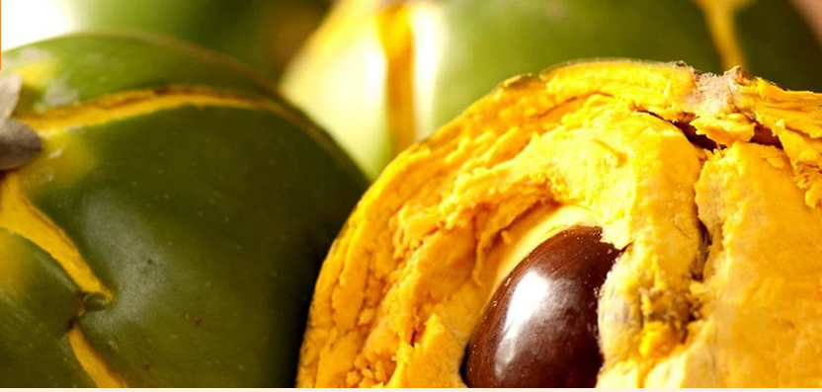
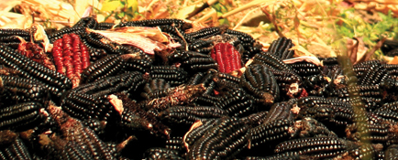
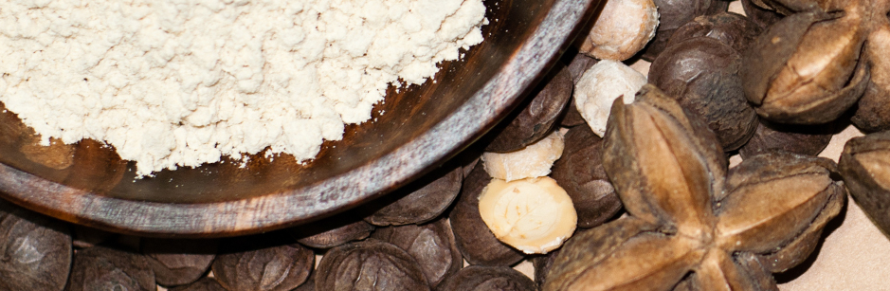
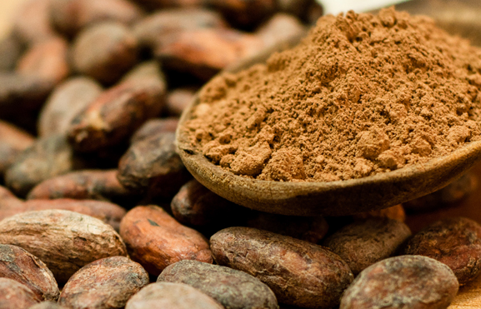
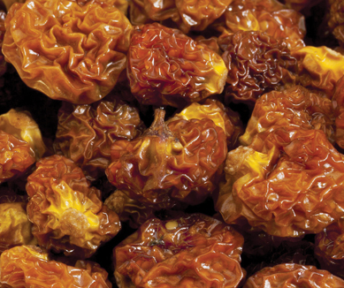
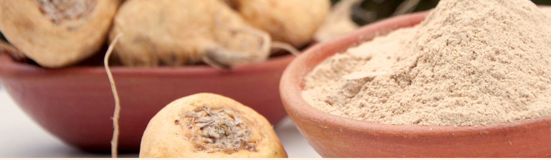
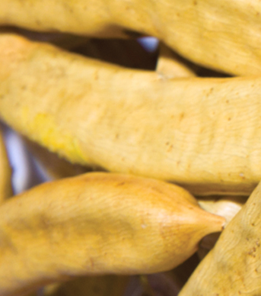
ALGARROBOS ORGANICOS
Products
Golden Berries
Mesquite
Lucuma
Maca
Cacao
Purple Corn Flour
Yacon
Quinoa
Camu Camu
Sacha Inchi Flour

Slide 15

ALTAMAR FOODS
Altamar Foods is the only company who fully observes all of the guidelines set to protect our environment. We are production and commercial specialist dealing with frozen seafood. Thanks to all of the support we have received from our customers, we have become a market leader.
Alltamar Foods exports to:
  North America: USA, Canada and Mexico.
  Asia: Japan, China, Thailand and Taiwan.
  Europe: Portugal, Spain, France, Italy and Croatia

Slide 16

ALTAMAR FOODS
Products
Mahi Mahi
Giant Squid
Scallops
Silverside
Hake
Mackerel
Squid
Anchoveta

