Slide 1
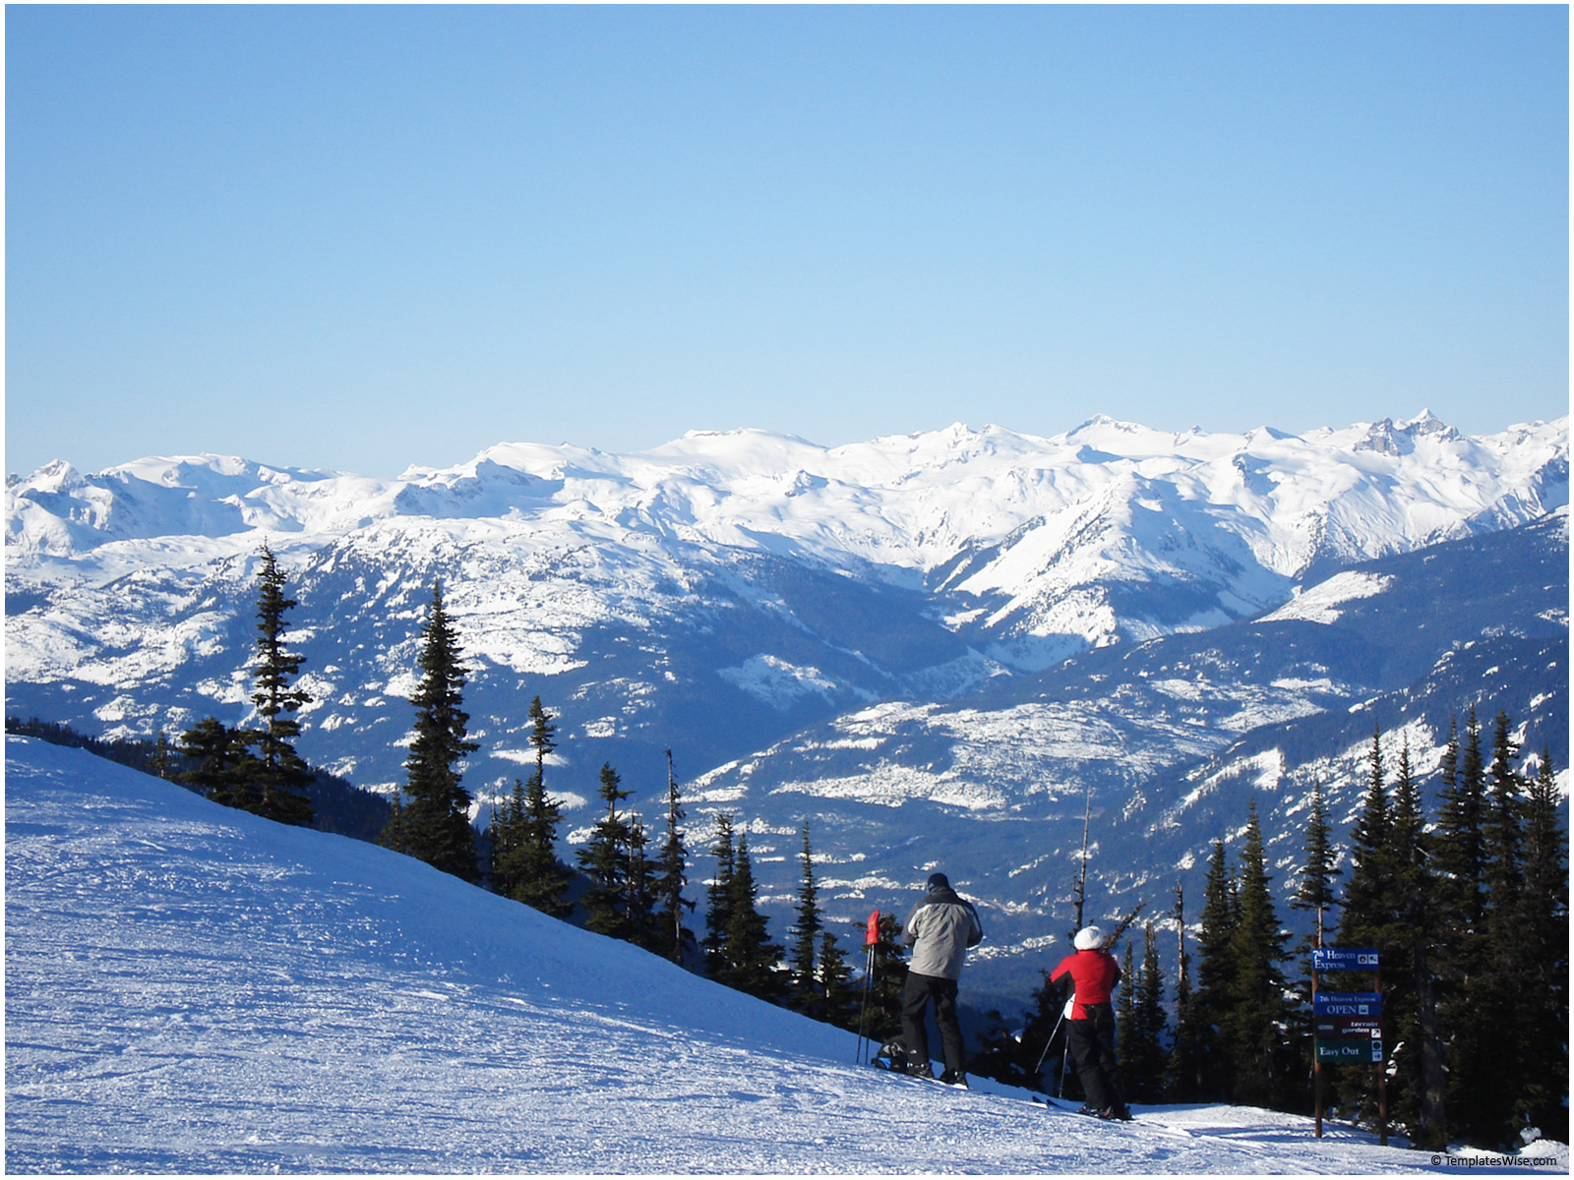
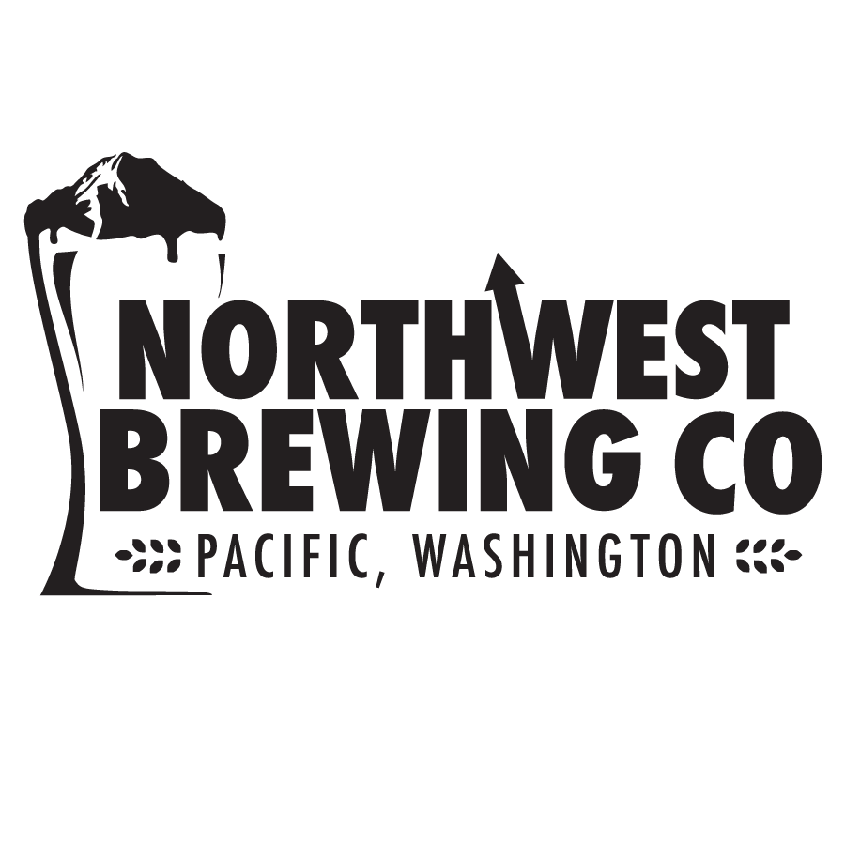
Northwest Brewing Company
Fall 2015 Package Presentation

Slide 2

History
Located just South of Seattle in Pacific, Washington, Northwest Brewing company is comprised of leadership with over 50 years of combined sales and marketing expérience from local wholesalers in the Seattle Market. We are now growing at 3 times industry rate and are 100% focused on selling and marketing our beers which is partially why we are outperforming the catagory and then couple that with great unique beers feel we add value to your assortment vs the same old variations of the same flavors and styles.
Since our inception Northwest has taken the approach of doing things right even if it is different, we refined the recipes that had promise, and grown the portfolio with a young and enthusiastic brewing staff and veteran sales team. We now offer a line catering to all tastes and will soon cross the 9,000 bbl/yr mark.
Northwest takes a decidedly different approach to its beers and their presentation versus many of our craft peers. Bottle and can sales are every bit as important as draft, and we never assume to ‘let the beer sell itself’. Our marketing philosophy of ‘Fun, Bold and Sexy’ behind our brand pushes us to give our beers both edge and hardcore customer legitimacy, yet reach demographics just now discovering craft .

Slide 3

Product Network
Northwest Brewing is carried by the Great Artisan Beverage Distribution Network in the Pacific Northwest and Midwest. Young’s Market in Arizona and New Age in Colorado
Northwest Beers are now available statewide in Washington, Idaho, Oregon, Colorado, South Dakota, North Dakota, Minnesota, Montana and Arizona
Package options include almost all of our products in 22oz bottles, 5 offerings in 6 pack 12oz bottles and our top selling IPA and Pale in 16oz cans.
All Northwest Beers are strongly pillared in their marketing and package appearance, preventing cannibalization and driving their brand identity over the Northwest name itself.
Our corporate vision statement is « making craftbeer fun, bold & sexy », we are different than most craft brewers in the fact that we are focused on selling beer… not just making it!

Slide 4

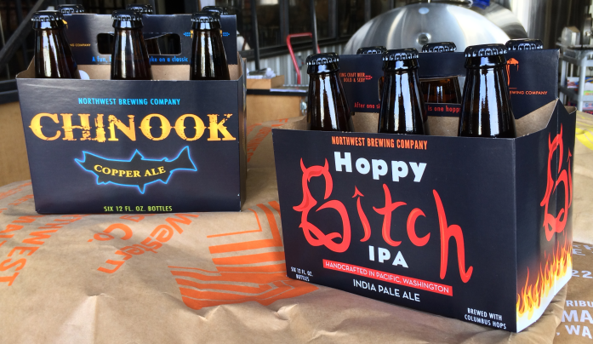
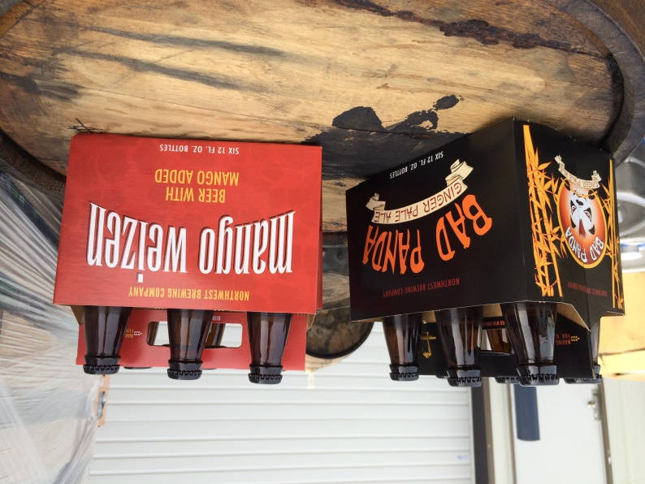
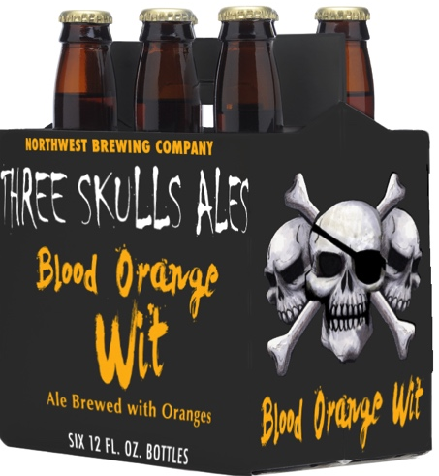
6 Pack Bottles
Since launching at the beginning of 2014, Northwest Brewing 6 packs have immediately become our best selling skus on a per placement basis.
Designed, brewed and branded by women, Hoppy Bitch has quickly become a popular bar call among 20 somethings with its styling, and our flagship comprising over 30% of brewery sales. Carried by the majority of grocers in Western Washington, the carrier also features a ‘family friendly’ end graphic. 6.5% ABV, 65 IBUs
Chinook Copper Ale is our food-friendly offering featuring more upscale styling and a Dark Pale Ale profile. 5.5% ABV, 30 IBUs. Our offering’s of a Ginger Pale Ale, Mangoweizen and Blood Orange Wit bring value to your assortment as they are unique and sought after by our consumers.

Slide 5
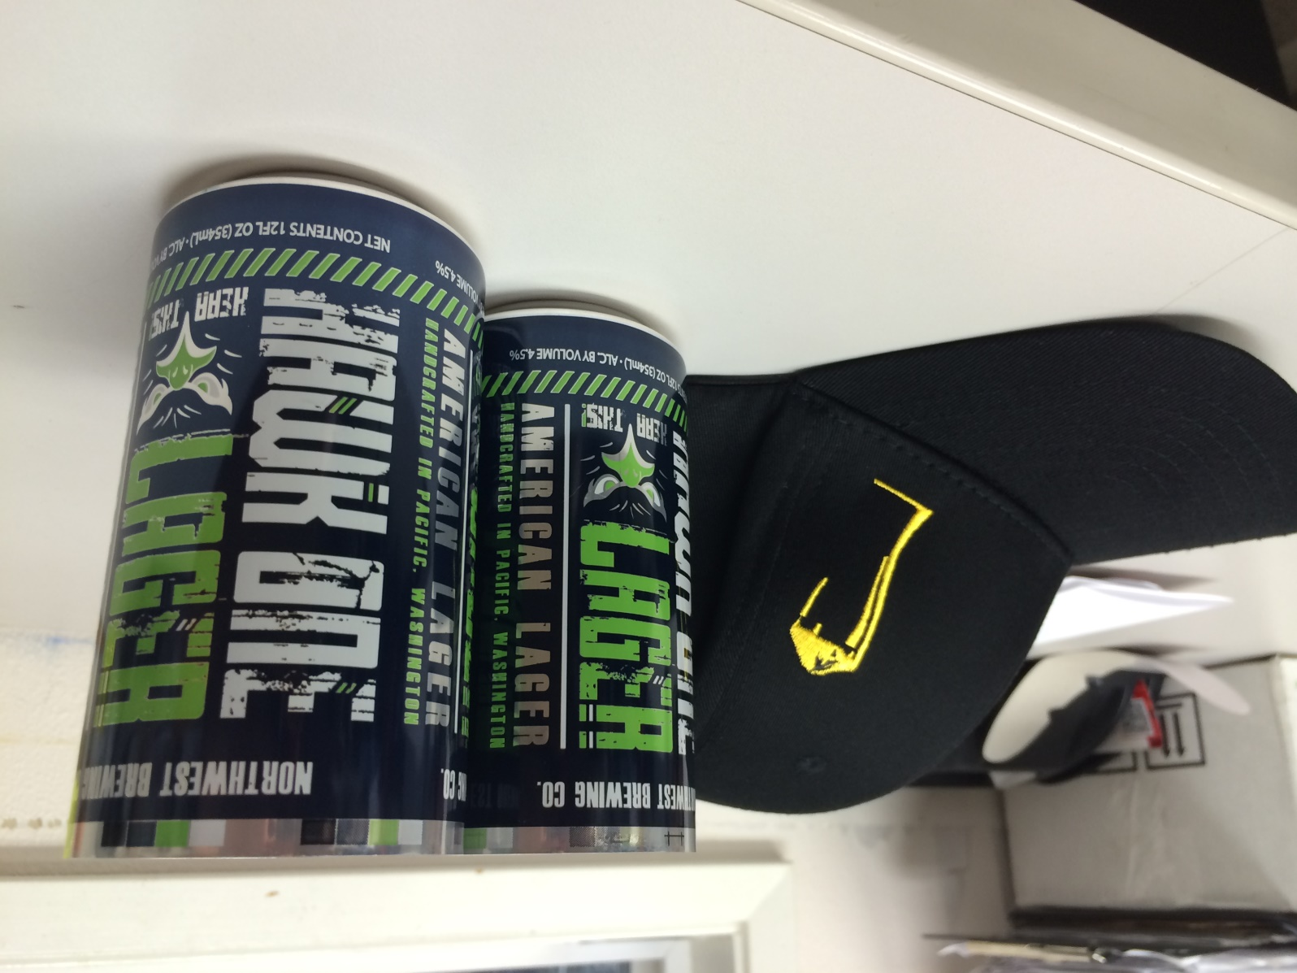
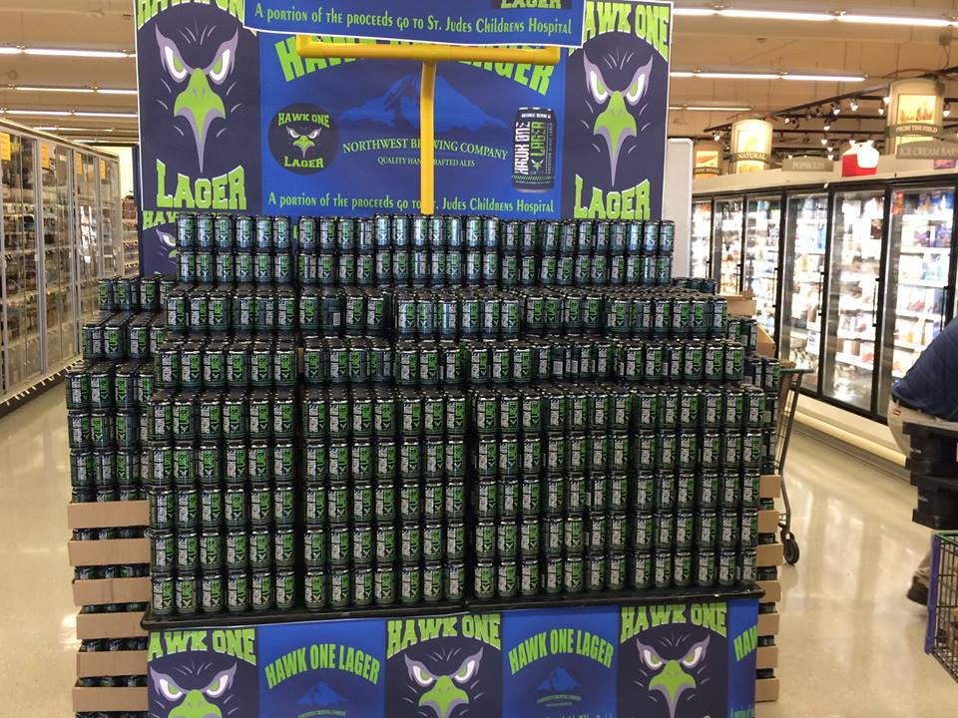
Hawk One 6 Pack Cans
In February, 2014, Northwest Brewing took its already strong relationship with the Hawk One Tailgating team to a new level with the inception of Hawk One Lager on draft.
In August we have launched Hawk One in a 12oz 6 pack can configuration with a charitable focus with the club to donate $1 of every case. We are already overwhelmed with interest from grocery and specialty stores.
With the success of the Seattle football team this brand is poised to have
  Another great year in sales and distribution
With bold packaging that screams ‘display me’, We are focused on pushing our brewery’s new equipment to capacity to supply as much Hawk One as possible.
By the start of the season we hope to have
` a 12 pack case.

Slide 6
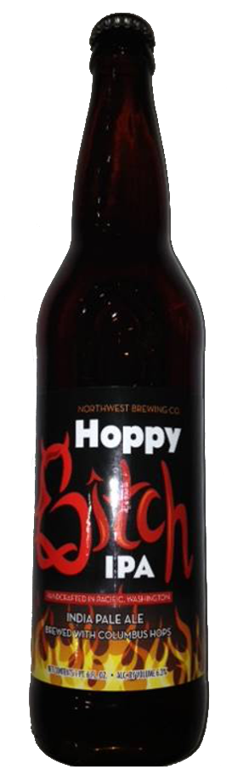
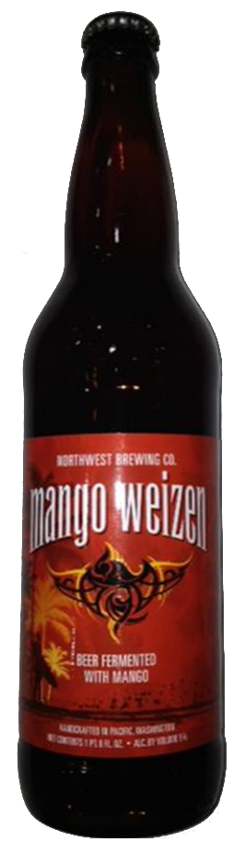
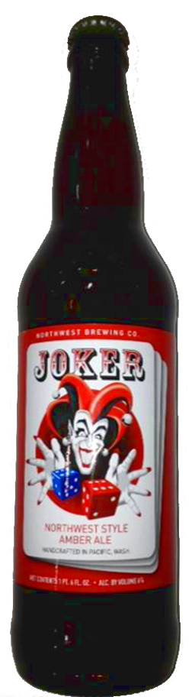
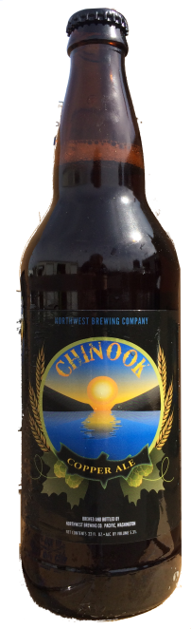
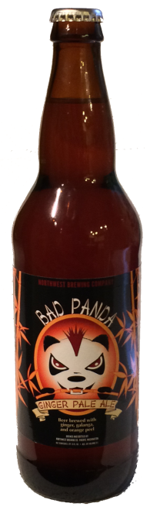
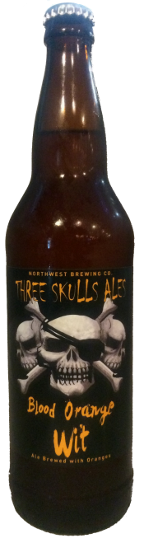
22 Ounce Bottles
Hoppy Bitch IPA, Mango Weizen and Joker Amber 22oz are all in distribution with at least 3 major grocers apiece in Western Washington.
Since the beginning of 2014, these bottles have seen a combined tripling in shelf space, spurned on by their heavy popularity on draft
We are seeing great movement on Chinook 6 packs and Bad Panda 22s in specialty stores. With Blood Orange Wit now our fastest growing draft, we expect large increases on our full suite of 22s going in to 2015.

Slide 7
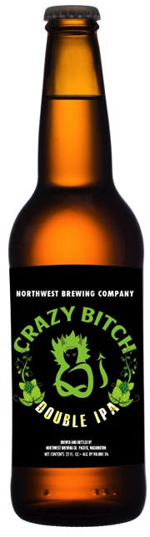
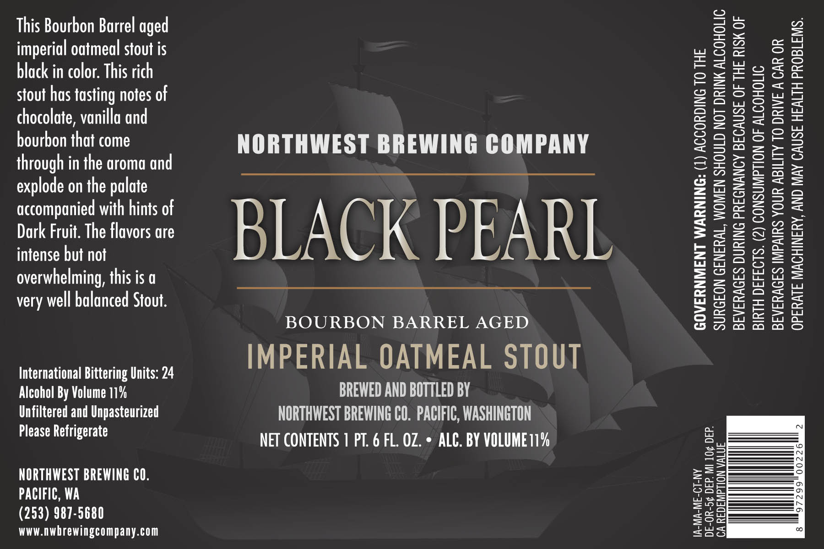
New Offerings
Our priorities continue to be to add value to your
assortment and Black Pearl Bourbon Barrel Aged
Stout is an award winning beer now available in
22 oz bottles that does just that.
Crazy Bitch Double IPA is our most expensive
beer we produce
but it is worth it to
the consumers face
when they enjoy this
fantastic IPA that
uses copious amounts
of hops to create a
fantastic ale.

