Slide 1


Slide 2
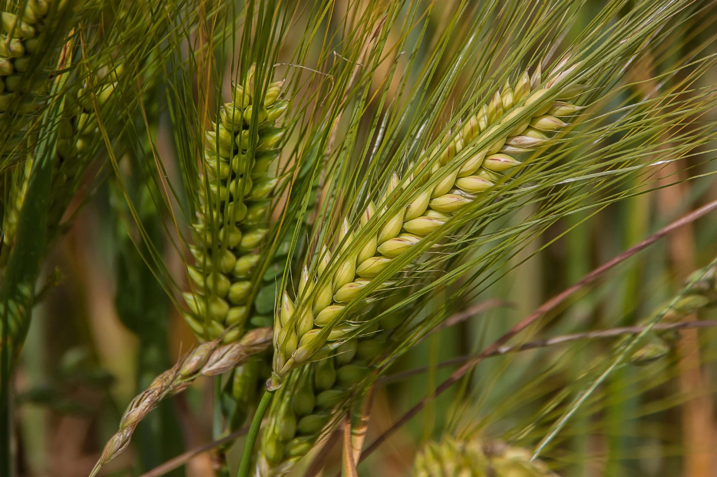
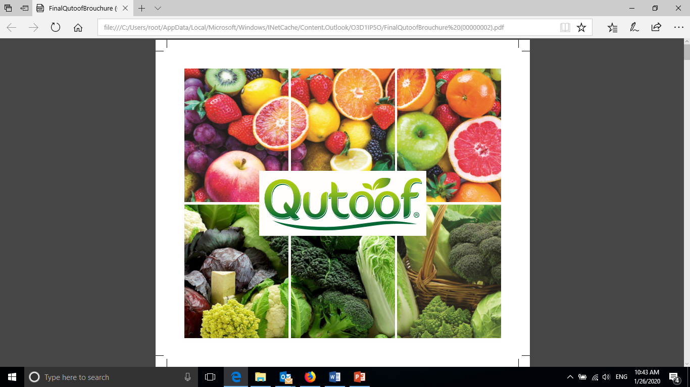
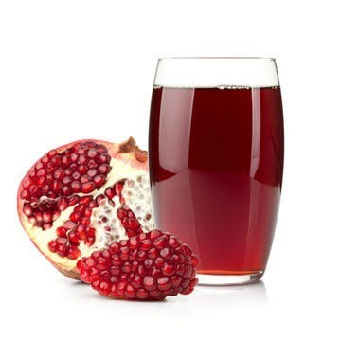
Who we are ?
Cairo 3A is the market leader in the Middle East and Africa in Grains trading, is a group of integrated companies that are engaged in the supply of agricultural commodities across the MENA region. The nature of the group’s business entails trading, stevedoring, storage facilities, as well as transportation, distribution , poultry , oil production & juicing.
Cairo3A for Agricultural and Animal production is part of the Cairo3A mother company, is an Egyptian company specialized in Agro industries, fresh and processed. We help our customers deliver full range of FRESH, HEALTHY , SAFE fruits and vegetables to consumer everyday.
The one and only
We are proud to be the one & the only in the Middle East and Africa to specialize in producing Pomegranates concentrate including and not limited to Mangos, Strawberries, Apricot & Peach.in accordance with the AIJN (Association of the Industry of Juices and Nectars) standards as well as the full range of fruits concentrates and purees.

Slide 3
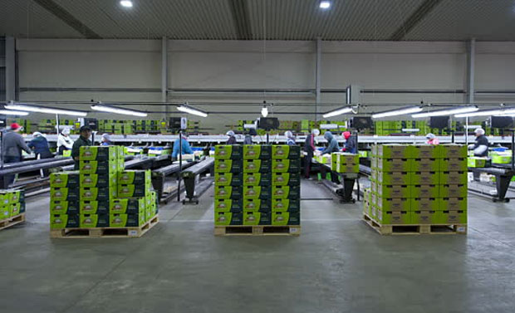
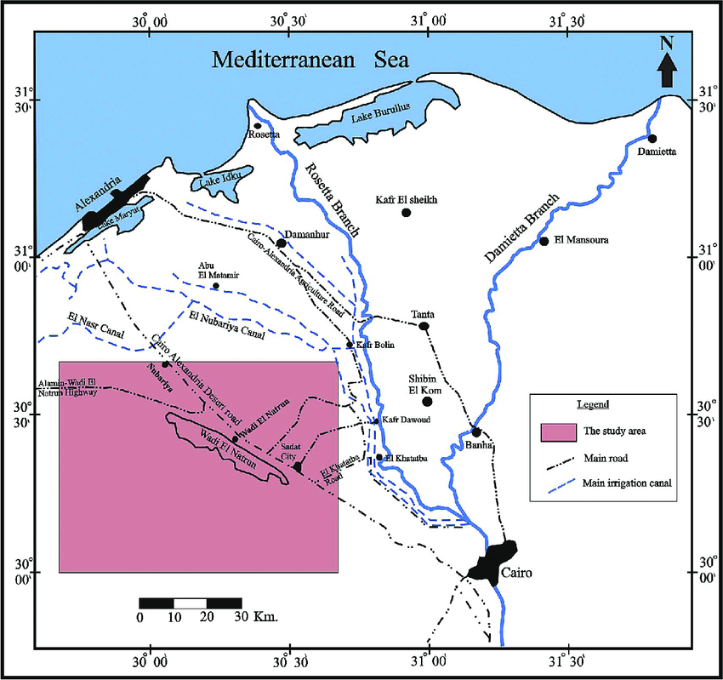
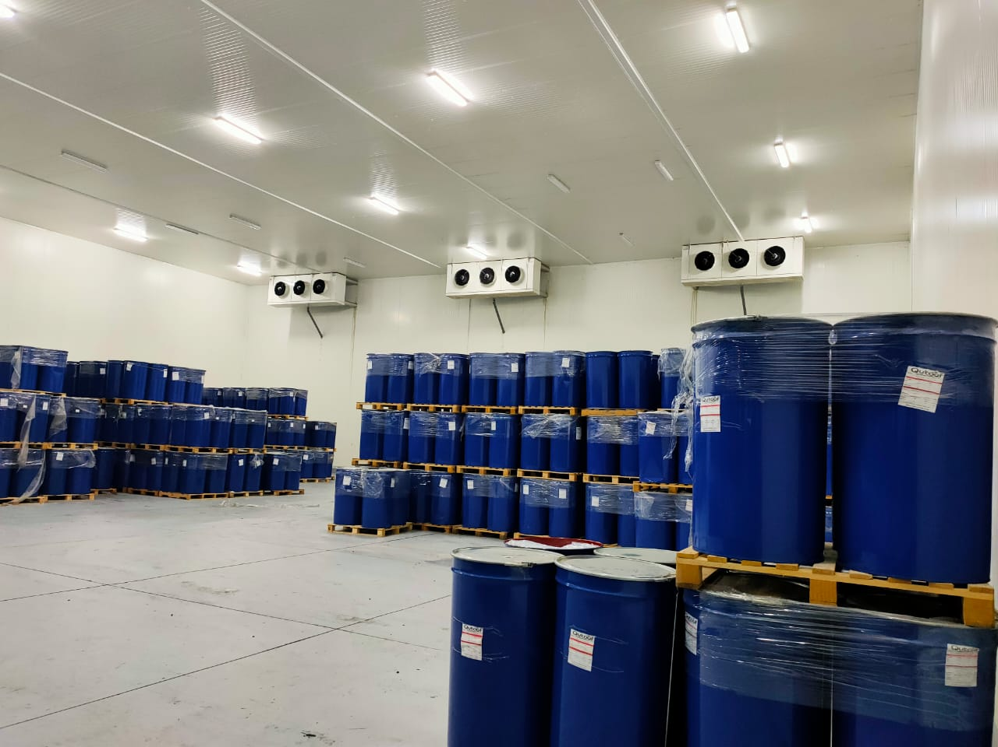
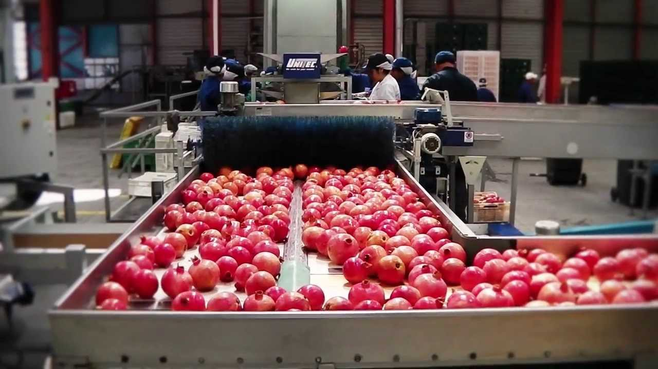
Our Facilities
Farm: Located at Wadi el Natron Alexandria desert road, on an area of 2500 acres arable land, our cultivates include Grapes, Pomegranates, Peaches , Nectarines & Mangos and are Global Gap, Grasp, Smeta & Sedex certified fruits, the agricultural management in Cairo 3A is based on the latest methods in the agricultural processes. our fresh fruits are pesticides free applying reliable pest control methods.
Packhouse : Located inside our farm in Wadi Natron, with capacity of 80 tons per day includes 4 lines for grapes & one-line for Stone fruits certified by FSSC22000
Cold Store: Cairo 3A owns one of the biggest cold storage facilities in the Middle East & Africa to insure fresh quality fruits and vegetables to our clients . Our facility includes: 3 cold rooms , 2 freezing rooms, 2 precooling & 1 fast freezing tunnel

Slide 4




Quality Assurance

Slide 5
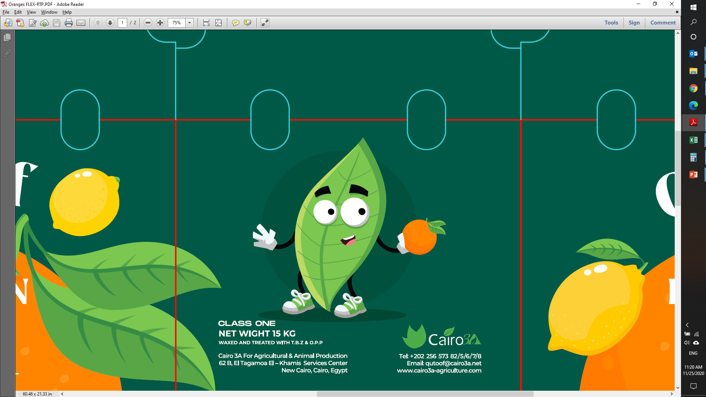
Citrus
Oranges
Lemons
Easy peelers
Grapefruit

Slide 6
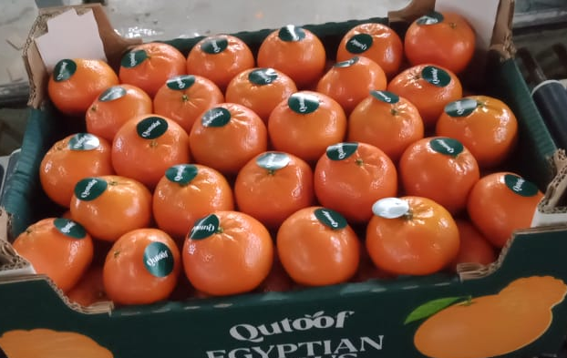
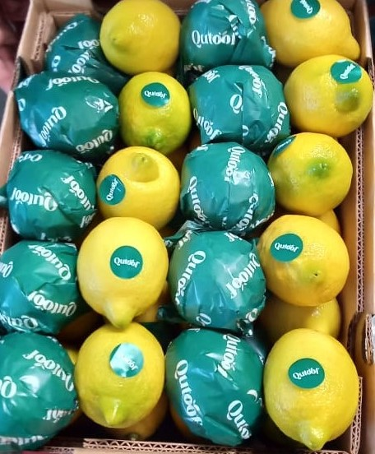
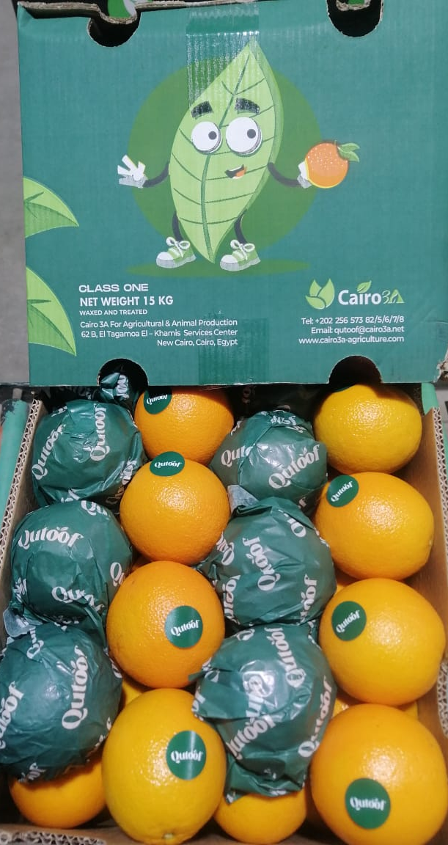
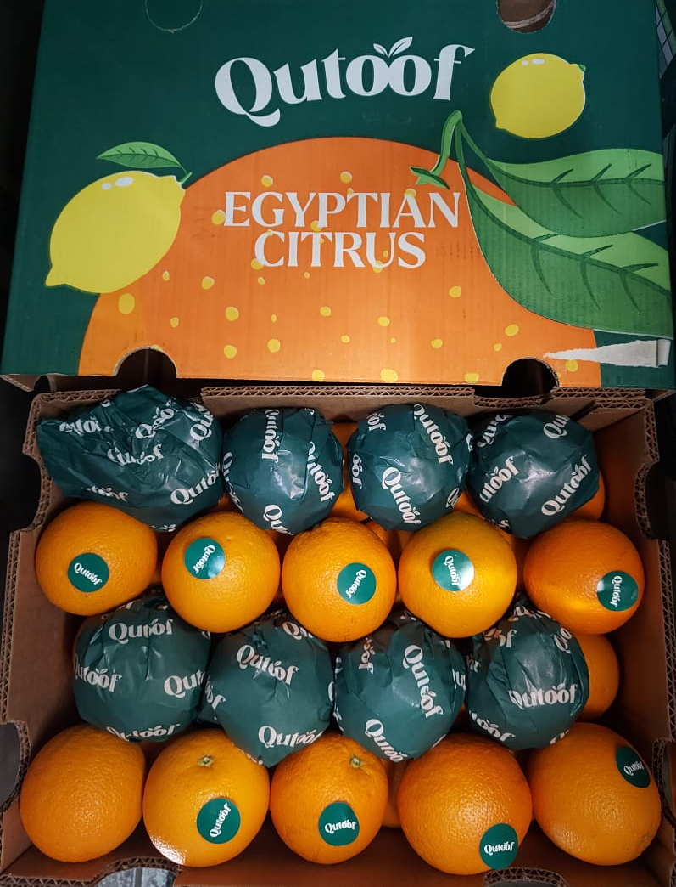
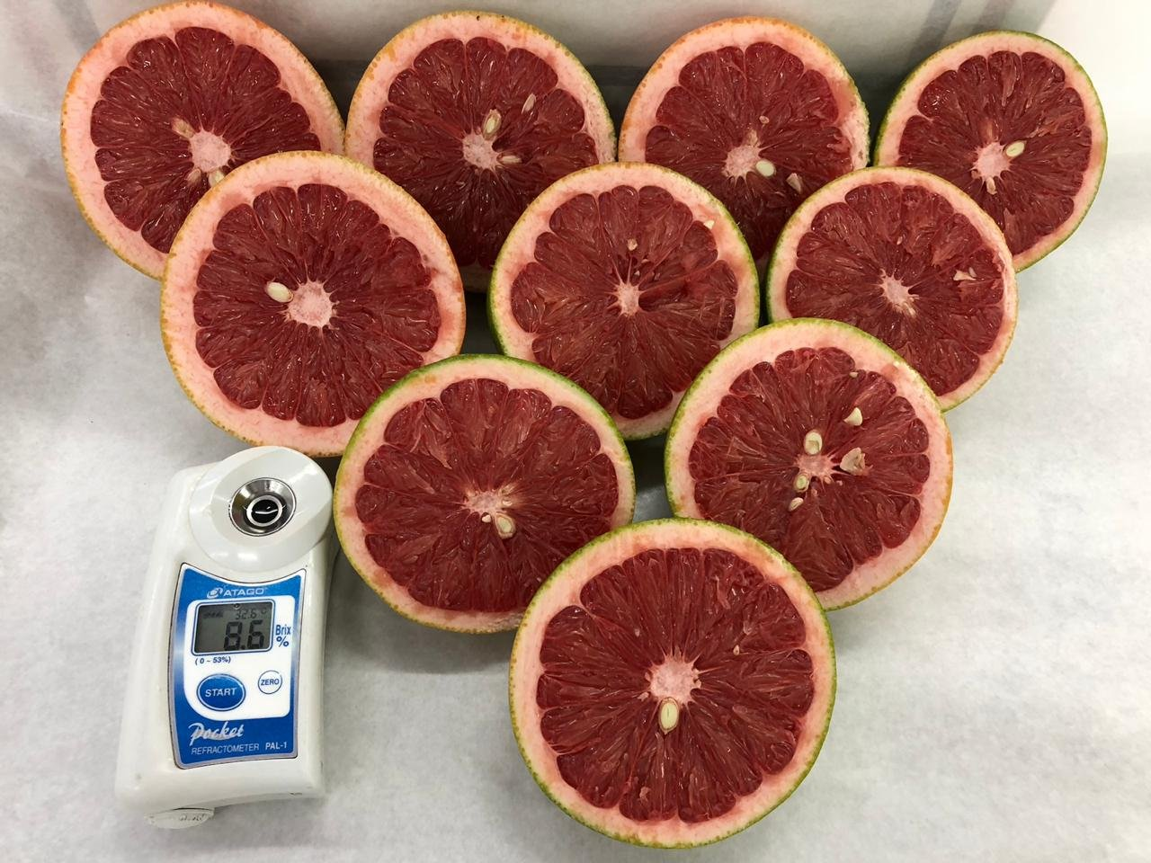

Slide 7



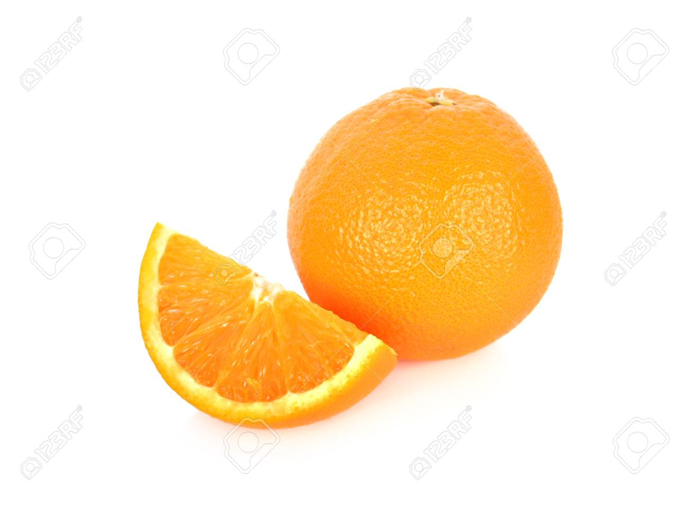
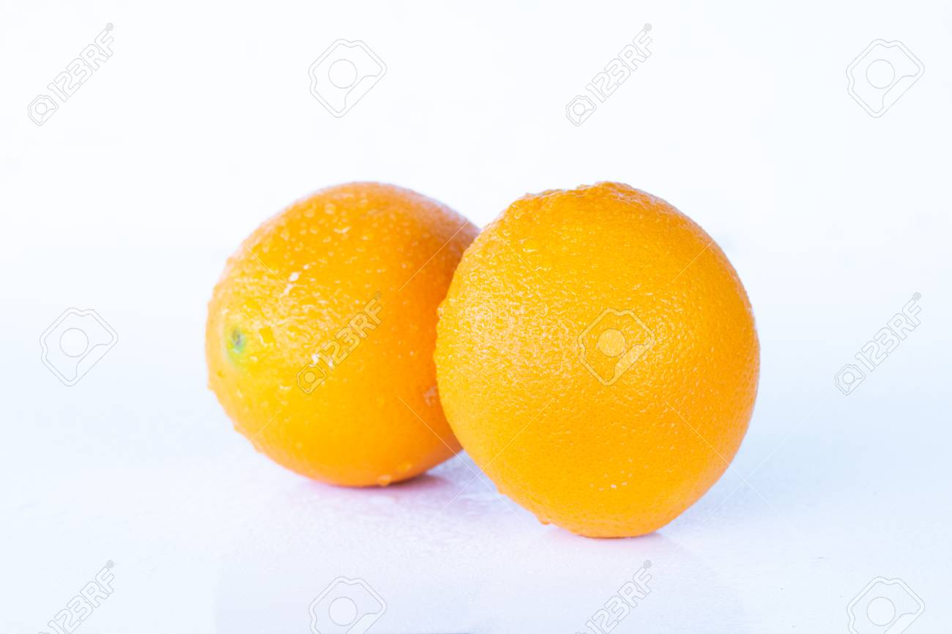
Citrus Calendar
SKUs | Nov | Dec | Jan | Feb | Mar | Apr | May
Lemon
Grapefruits
Fremont
Murcott
Navel
Valencia

Slide 8
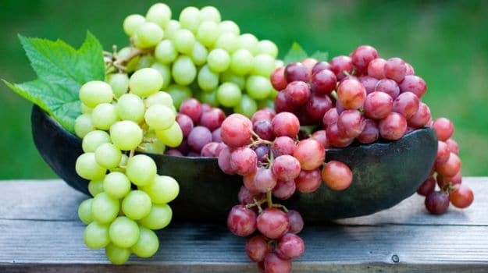
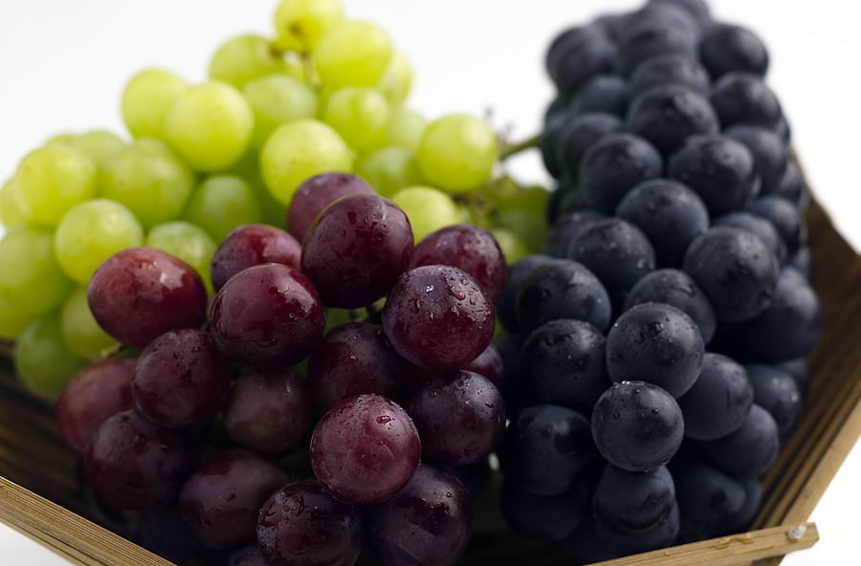
Table Grapes
Prime
Sugraone
Flame
starlight
Evans Delight
Autumn Royal
Red Globe
Crimson

Slide 9
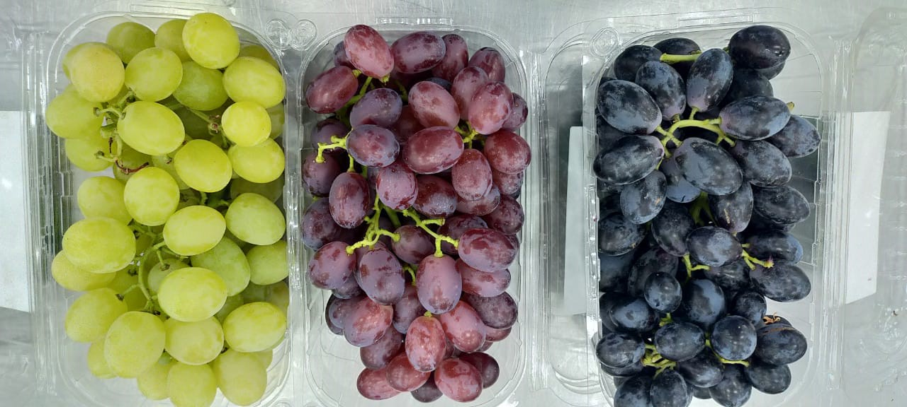
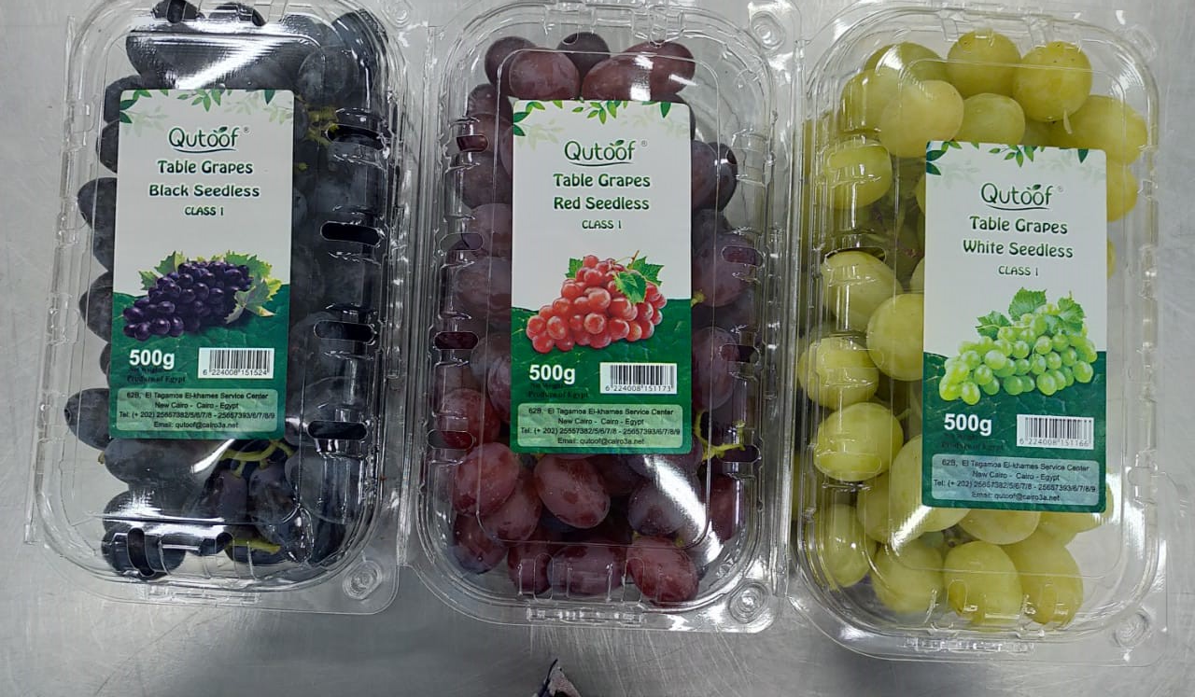
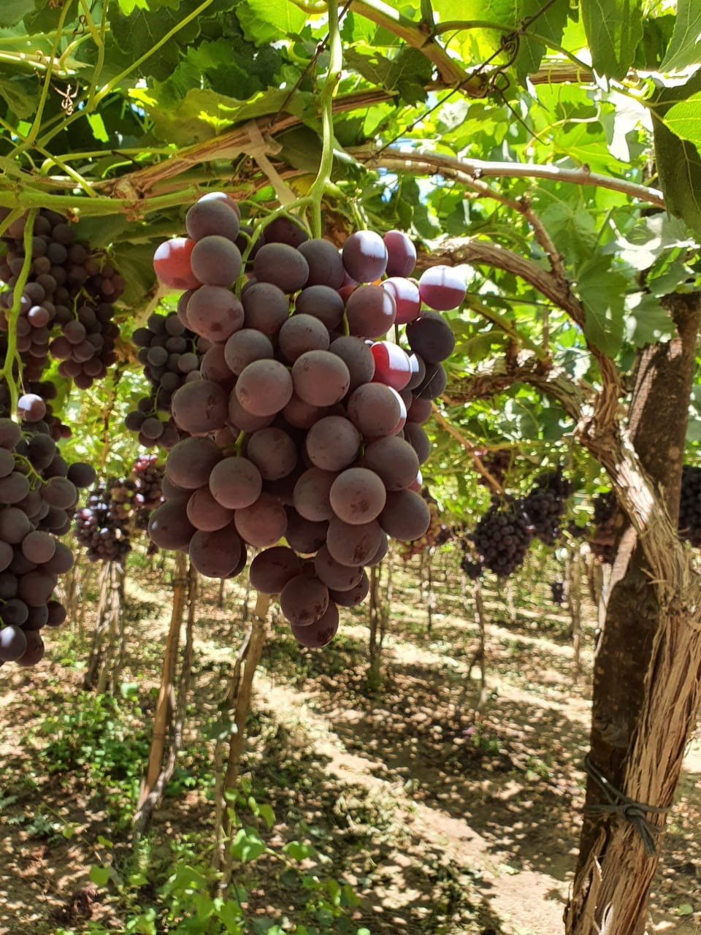
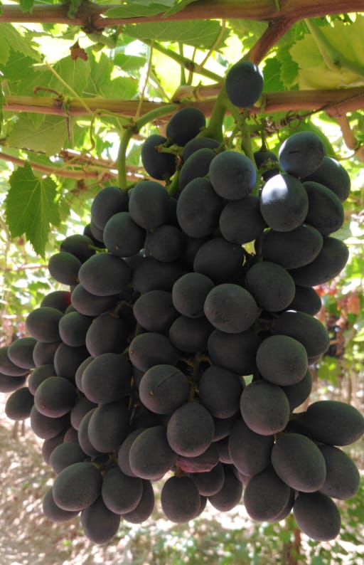
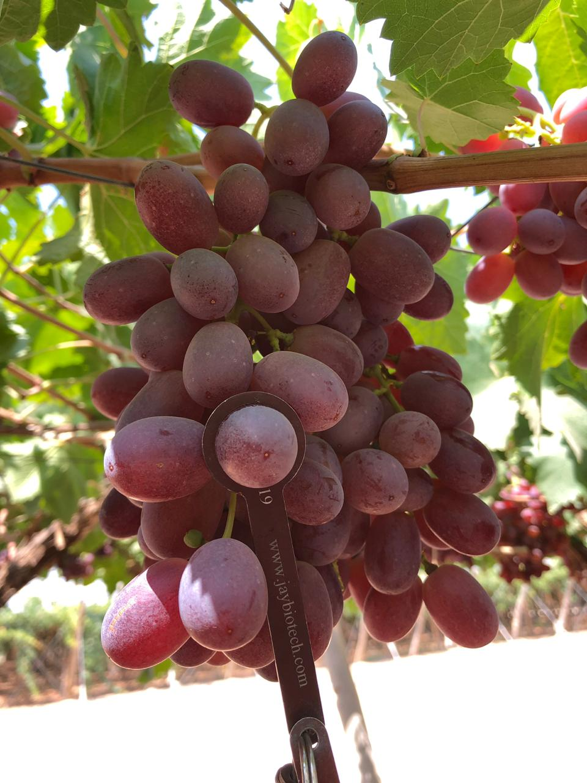

Slide 10
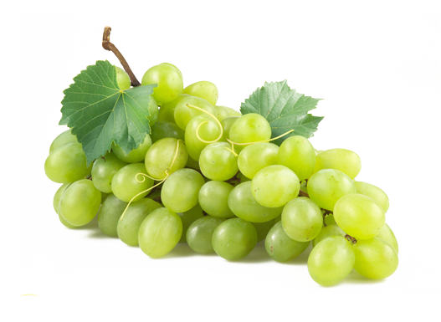
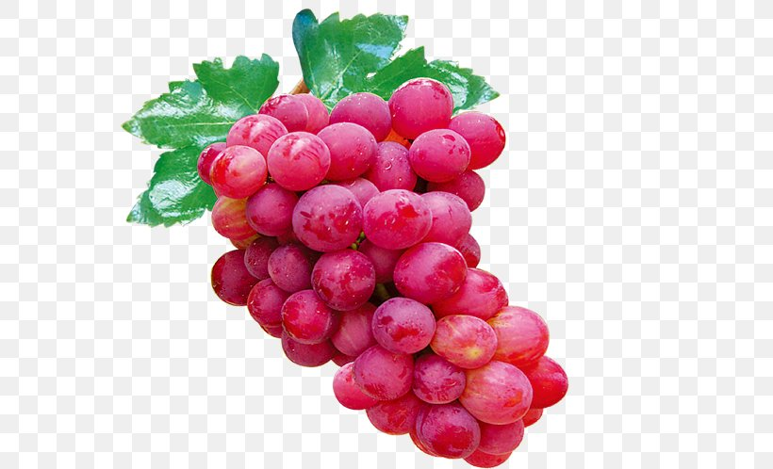
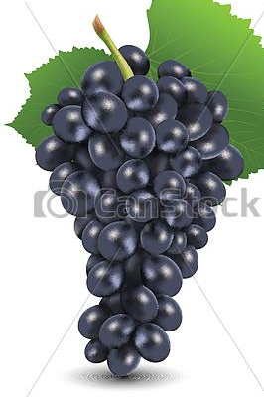
Grapes Calendar
Variety | May | June | July | August | Sep
Prime
Sugraone
Flame
Starlight
Autumn royal
Red Globe
Crimson

Slide 11
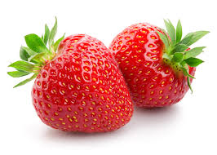
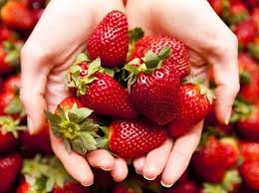
Strawberries
Fortune
Festival
Sweet sensation

Slide 12

Strawberries Calendar
SKUs | Nov | Dec | Jan | Feb
Sensation
Fortune
Festival

Slide 13
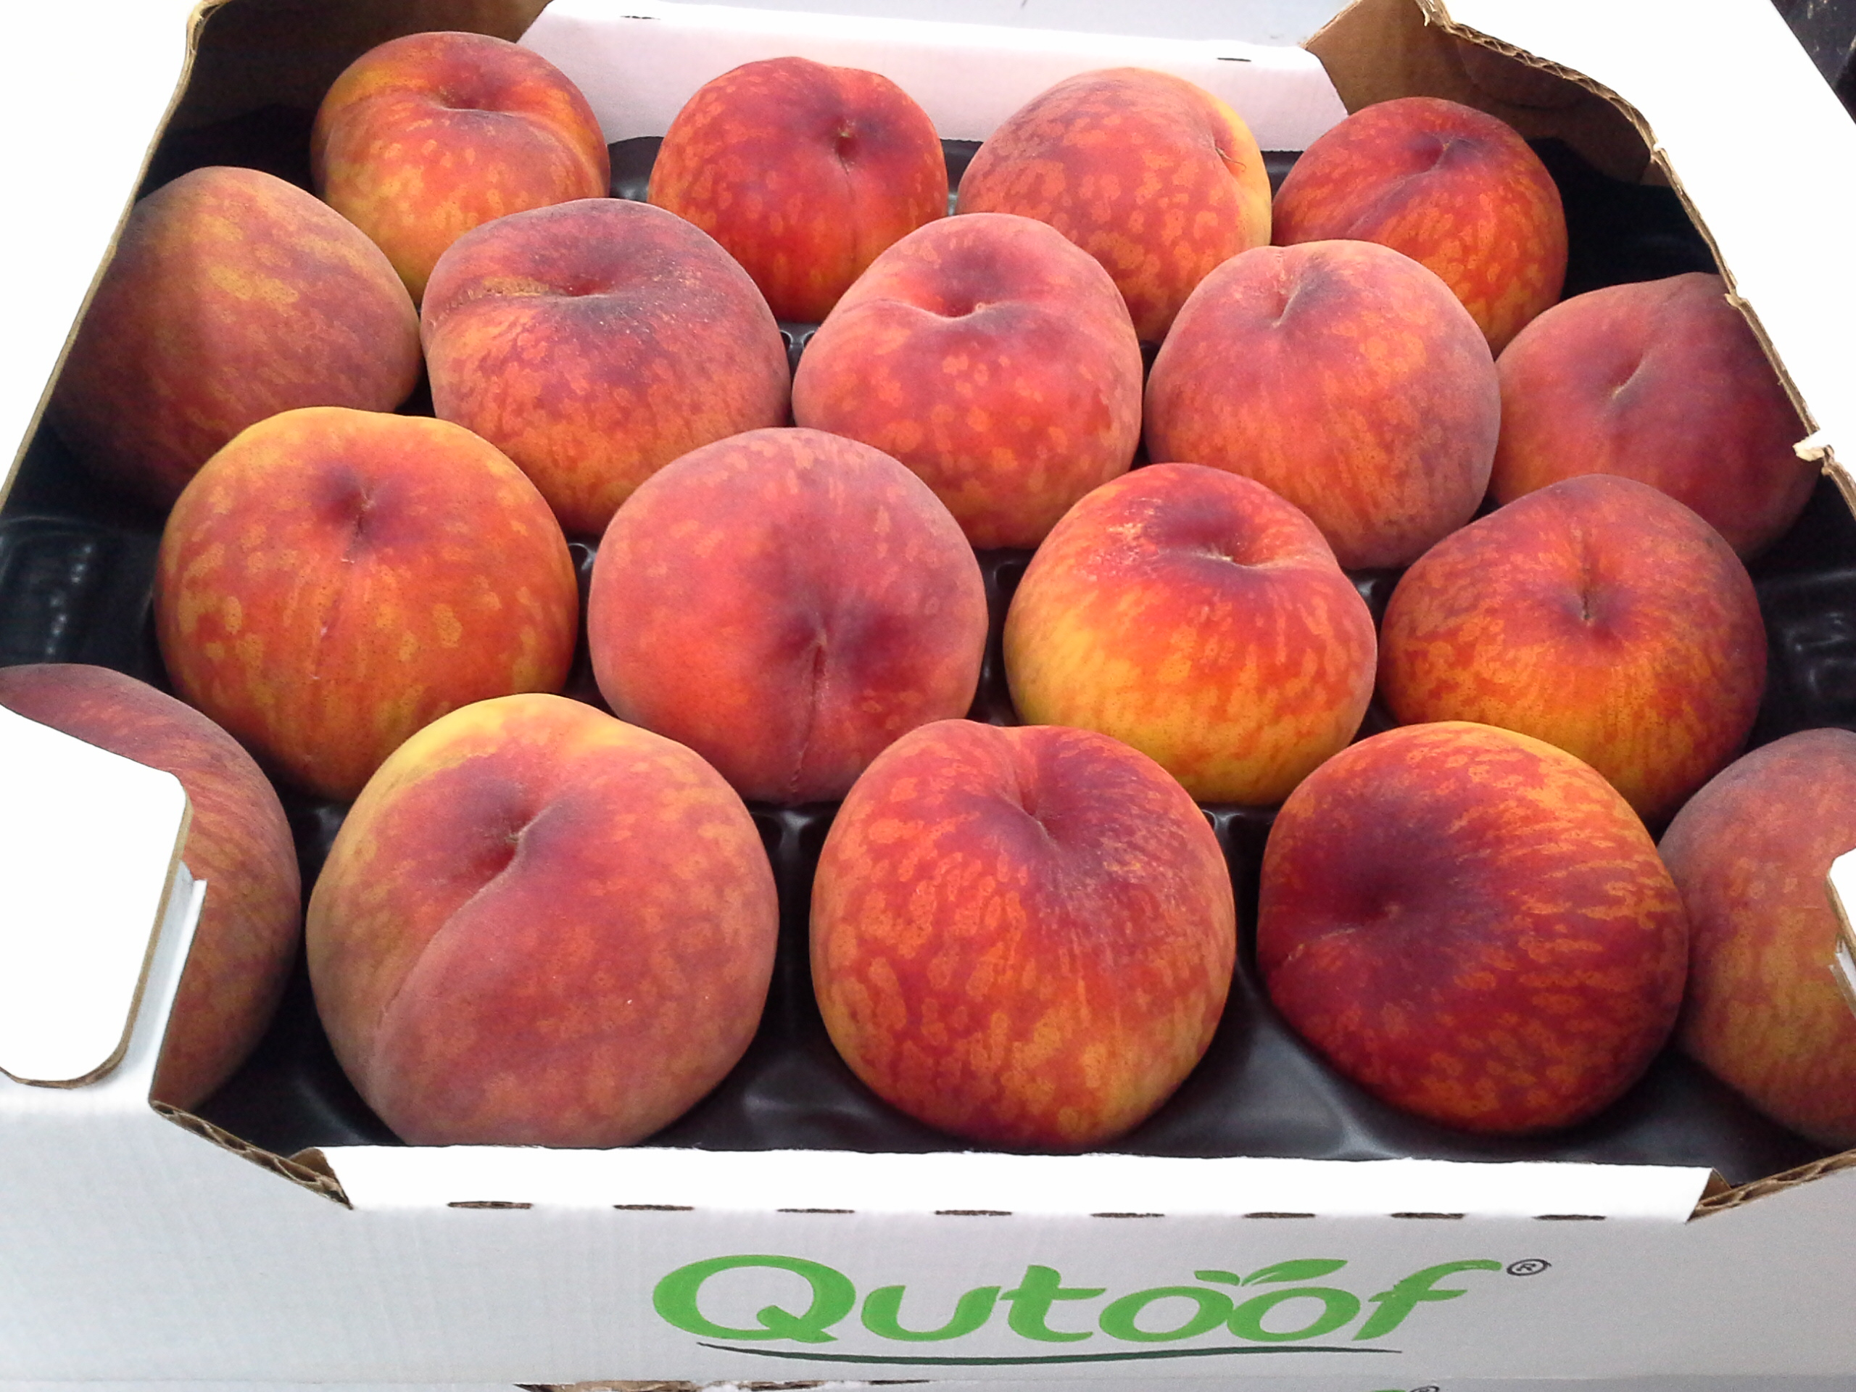
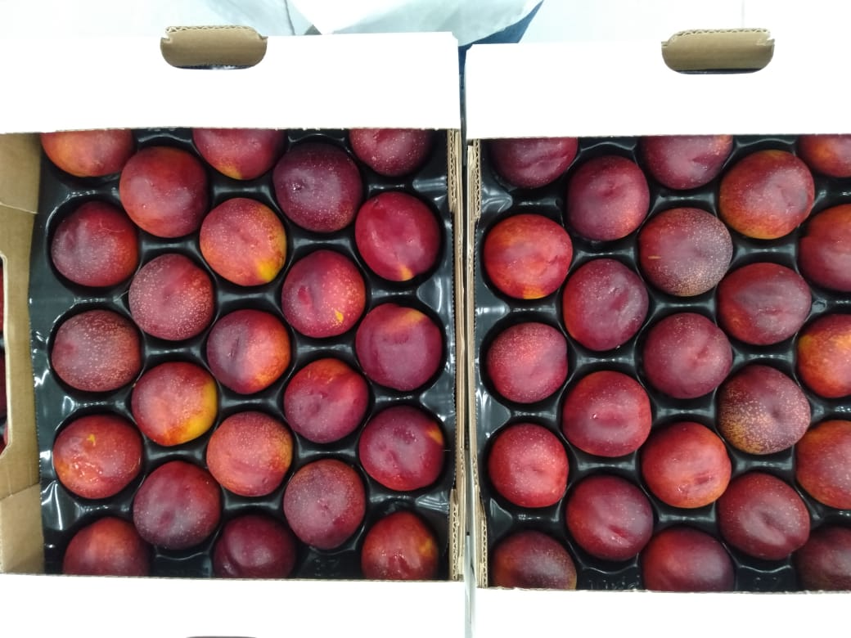
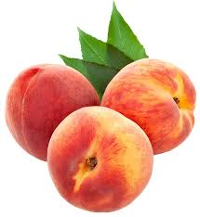
Peach
Early swelling
Florida prince
Nectarine
Sun wright
Stone Fruit | Apr | May

Slide 14
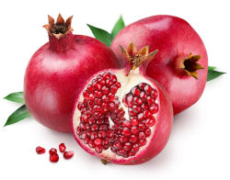
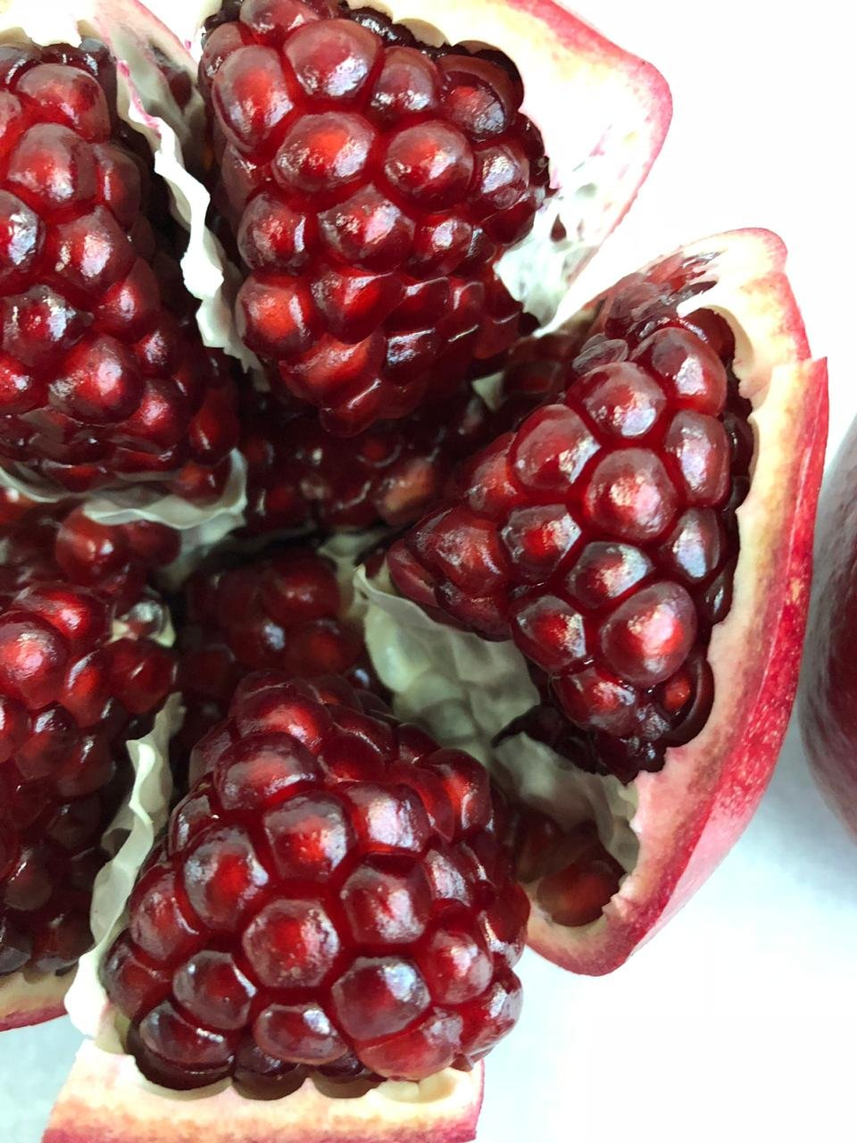
Pomegranates
116
Wonderful

Slide 15
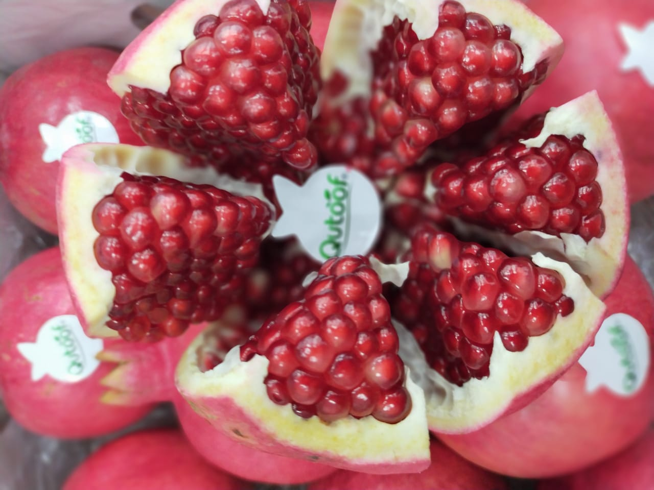
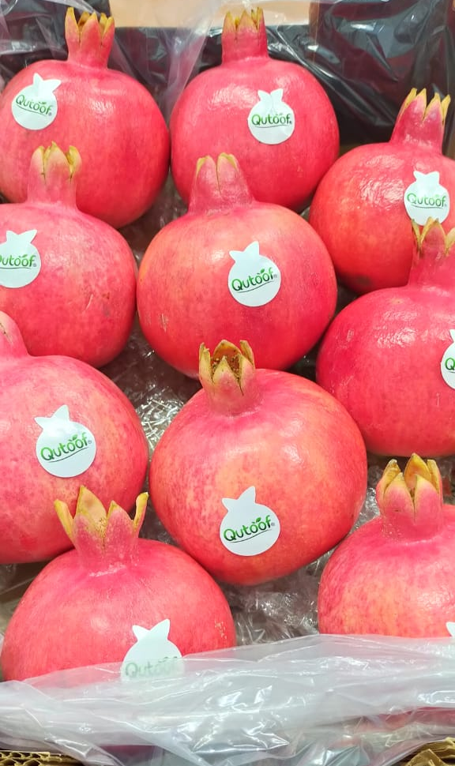
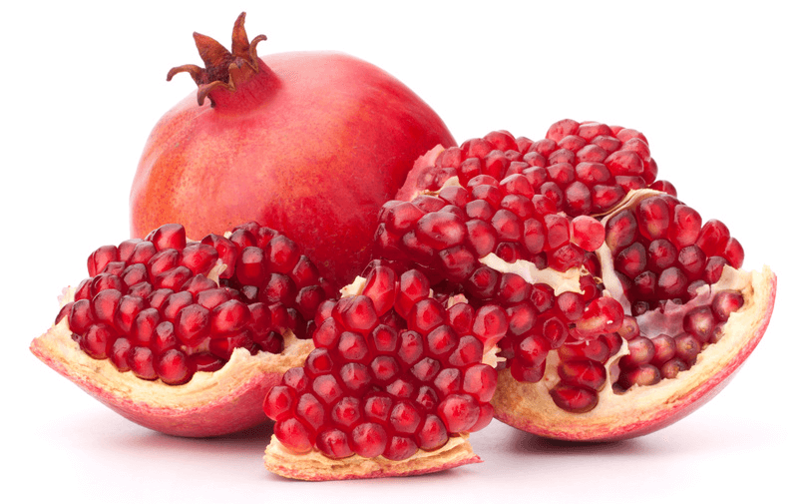
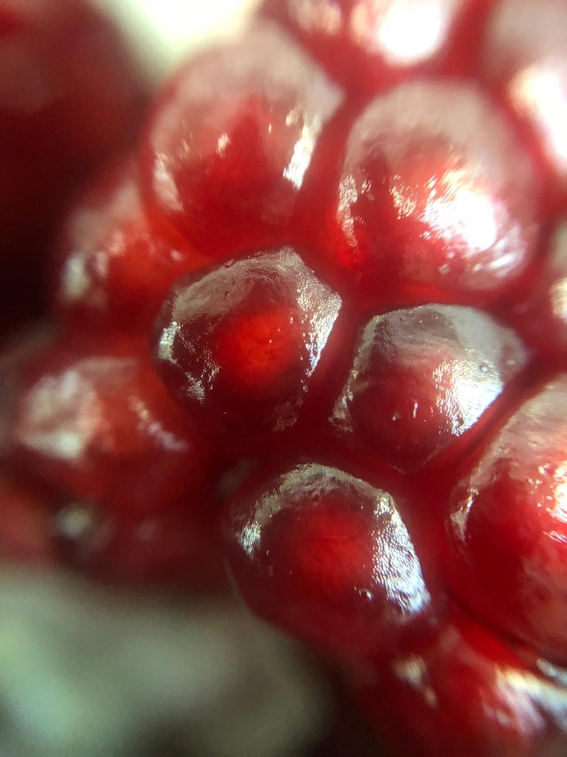
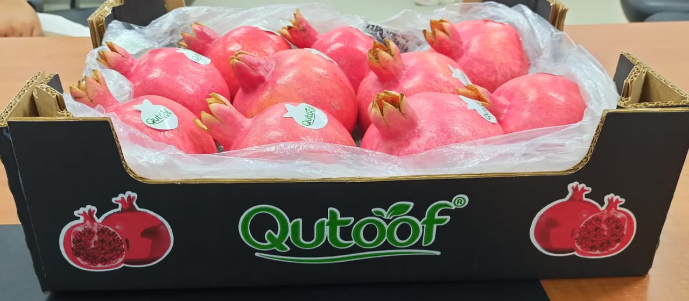
Pomegranates Calendar
SKUs | Sep | Oct | Nov
116
Wonderful

Slide 16
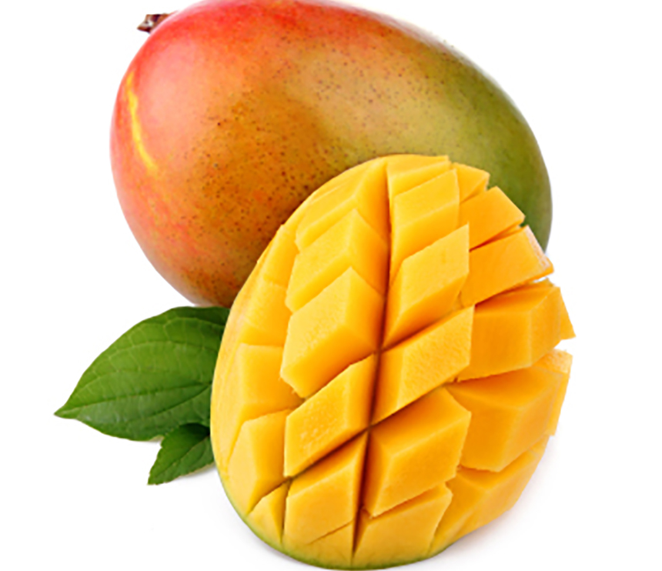
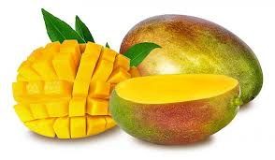
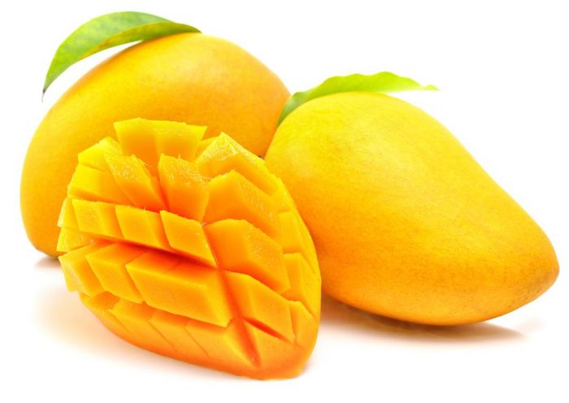
Mangos
Keit
Kent
Naomi
Haidi
Mangos | July | Aug | Sep | Oct

Slide 17
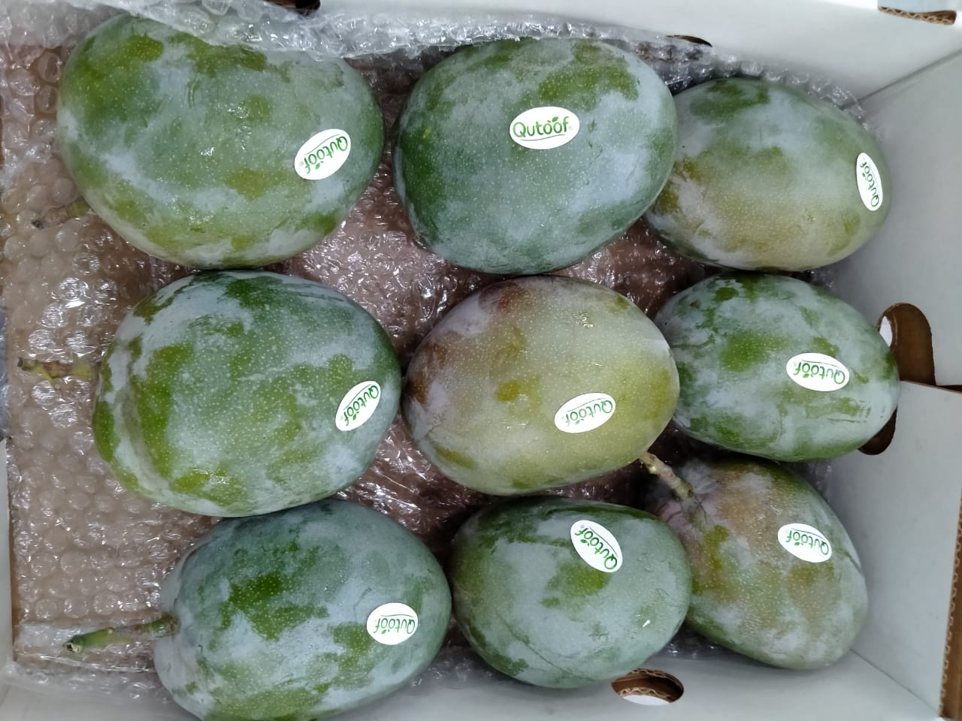
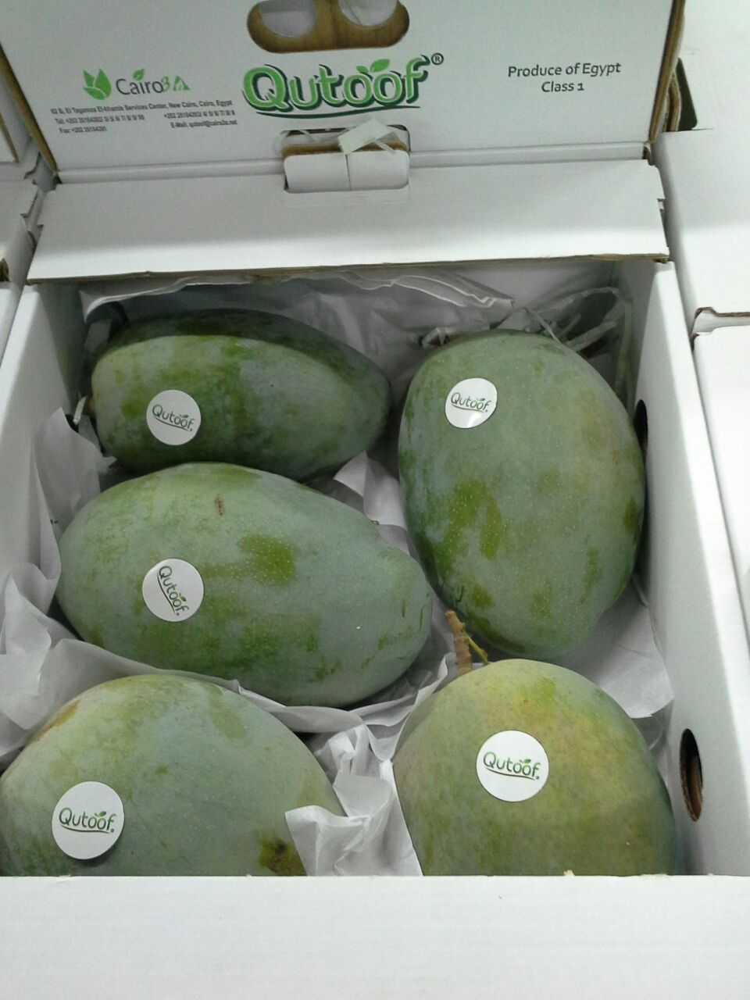
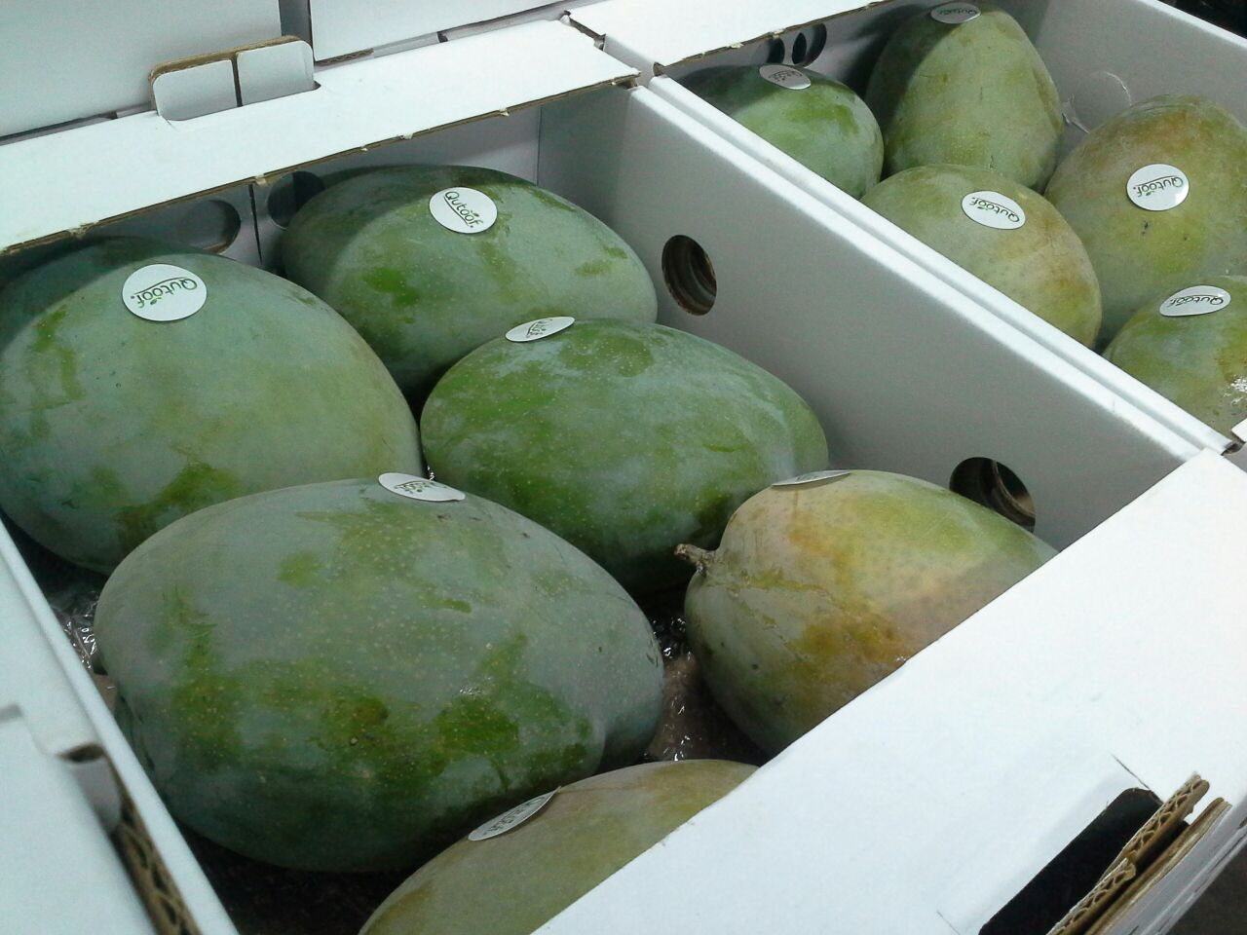

Slide 18
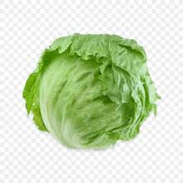
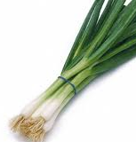
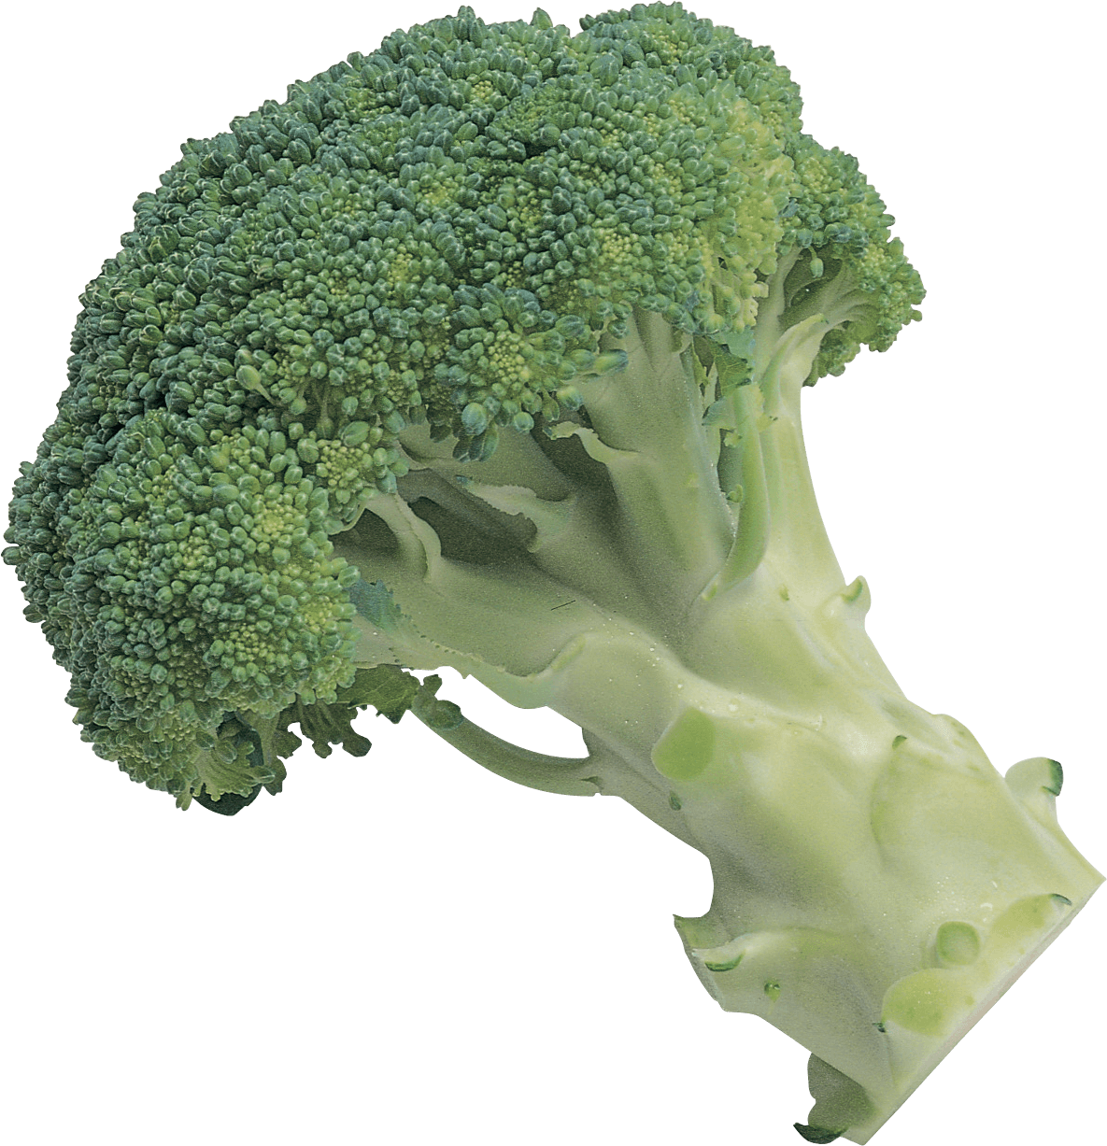
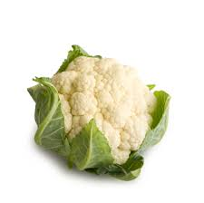
Vegetables
Lettuce
Spring onions
Month | Dec | Jan | Feb | Mar
Availability
Month | Oct | Nov | Dec | Jan | Feb | Mar
Availability
Broccoli
Cauliflower
Month | Dec | Jan | Feb | Mar
Availability
Month | Dec | Jan | Feb | Mar
Availability

Slide 19
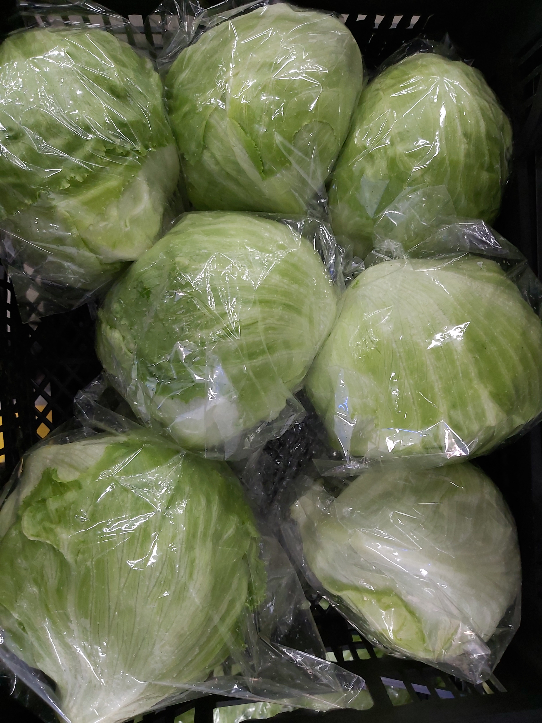
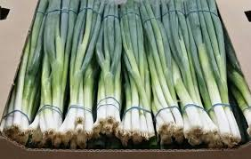
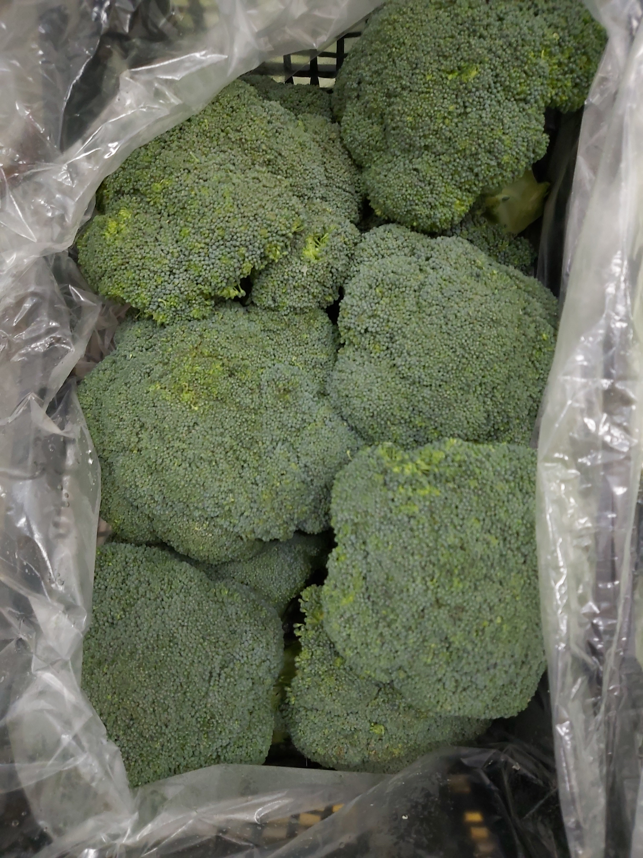


Slide 20


Aly EL Gamil
CEO
Cairo 3A
aly.elgamil@cairo3a.org
+20-1002222740
Eman Fouad
Export Manager
Cairo 3A
eman.fouad@cairo3a.org
+20-1066633128
+20-1020700766

