Slide 1


Vitamin D3 Supplement for Infants/Toddler & Adults

Slide 2

Why Vitamin D Deficiency is a problem?
SEOUL, Feb. 22 (Korea Bizwire) — More than 90,000 South Koreans have visited the hospital in the last year due to a lack of vitamin D. Among age groups, women in their 50s were most vulnerable to vitamin D deficiency, which increases the risk of osteoporosis.
The National Health Insurance Service (NHIS) announced that 90,014 people visited the hospital in 2017 for a lack of vitamin D, a figure that has increased by almost 50 percent each year since 2013.
In 2017, there were 19,148 male patients with vitamin D deficiency, and 70,866 female patients.
Among age groups, the number of patients was concentrated among those in their 50s (25,839, 28.7 percent), followed by those in their 40s (17,907, 19.9 percent), and 60s (16,450, 18.3 percent).
Patients between 40 and 60 years of age accounted for as many as 67 percent of all patients. The number of female patients in their 50s was particularly high at 21,345.
“It has become customary for women to apply sun cream when they go outdoors, making them more vulnerable to vitamin deficiency since sun screen blocks the sunlight, which is needed to produce vitamin D in the human body,” said Prof. Park Se-hee at NHIS Ilsan Hospital.
“Women, after experiencing menopause, seem to take more interest in preventing osteoporosis, leading to an increased number of patients coming to the hospital to check for vitamin D deficiency.”
There were 30 percent more patients during in the winter compared to the spring. Since vitamin D is produced from ultraviolet rays, winter seems to have served as primary cause for the lack of vitamin D.

Slide 3
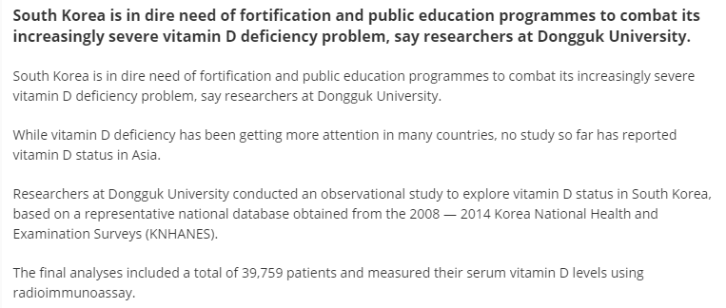
Why Vitamin D Deficiency is a problem?

Slide 4
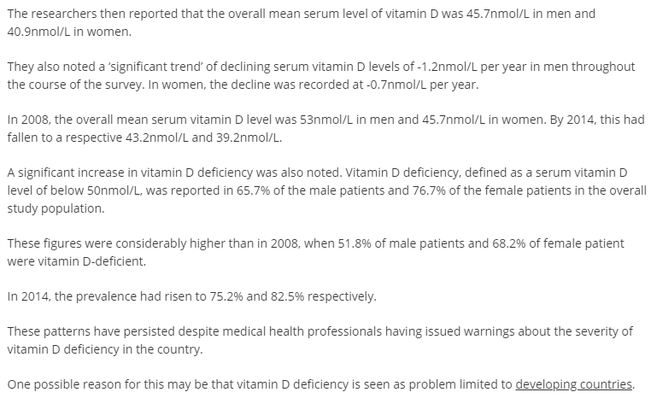
Why Vitamin D Deficiency is a problem?

Slide 5
Why is Vitamin D Important?
Vitamin D contributes to the normal function of the immune system in children. ⁵
Vitamin D is needed for normal growth and development of bone in children. ⁶
The stores of vitamin D of these babies may be particularly low at birth as their mothers’ skin may not be as efficient at making vitamin D from the amount and quality of sunlight
Vitamin D helps our bodies use calcium to build and maintain strong bones and teeth ¹
Vitamin D is known as the ‘sunshine vitamin’ because our bodies can make vitamin D from exposure to sunlight. ¹
When sunlight hits our skin, the ultra-violet B (UVB) sun rays are used to make vitamin D. ¹
You are not making vitamin D if your shadow is longer than you.²

Slide 6
Why BabyD?
In children vitamin D is important for normal growth and development of bones.⁶
BabyD is specially formulated from Birth onwards.
BabyD is an Irish Brand developed by Kora Healthcare.
BabyD boasts many features and benefits, most importantly its unique accurate oral dosing syringe.

Slide 7
Why BabyD?
BabyD has no nasties - No Sugars, No Flavours, No Preservatives, and no artificial colours. It is odourless and tasteless making is easier for your baby to take.
  Why? – Because parents are increasingly conscious of what exactly their child is consuming.
BabyD is also hypoallergenic - formulated in miglyol oil and does not contain peanuts, peanut traces, gluten, lactose, sugars, crustaceans, eggs, fish or soya beans.
  Why? When children are born there is no way of knowing what they are allergic to. Baby D eliminates this concern.
Each bottle of Baby D is secured with a child resistant cap and a tamper proof seal.
  Why? This removes the risk of your child opening and consuming more than their recommended daily allowance. Overdose can occur with Vitamin D as it accumulates in the body.
Each bottle of Baby D also has a plastic seal under the cap with only a narrow opening to allow the syringe to pass it
  Why? This means that if your bottle of Baby D topples you wont lose it’s whole contents.

Slide 8







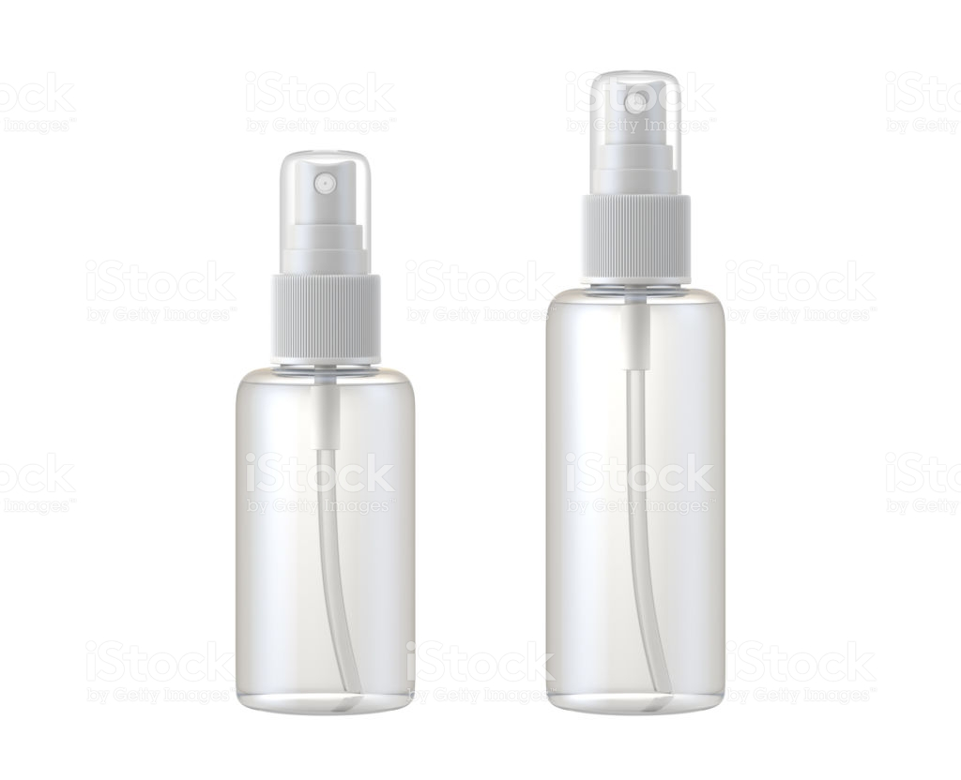
Vitamin D Range
Current Product
New Extension Available Sept 2020 (7 Sku’s)
400iu / 1000iu / 2000iu Capsule
200iu Pump
400iu Spray
Existing 30ml Bottle and Syringe
400iu / 1000iu Spray

Slide 9














Brand Exposure in Markets
9￼

Slide 10

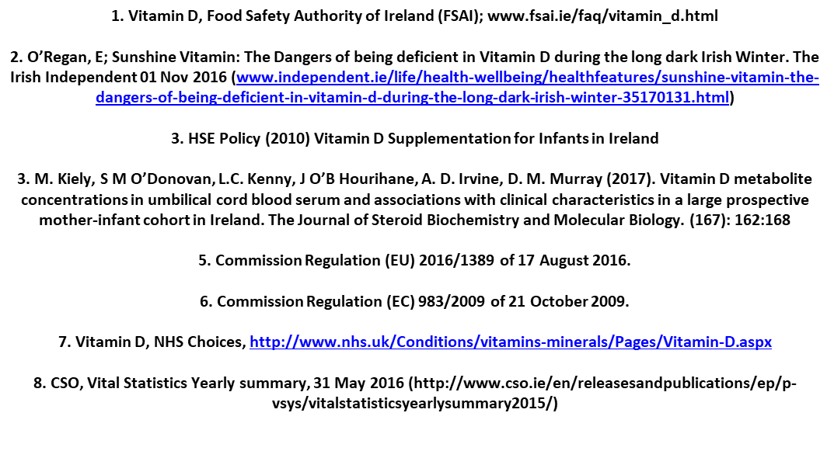
Vitamin D Range

