Slide 1

Products
By S.A.R.Tharangani
Chemistry Special – UOR
Assistant General Manager,
Best Life International Pvt Ltd
Head of The Department
Best Life Health Service Pvt Ltd

Slide 2
Range of Products
Cinnamon Drink
Spices
Jam / chutney
Virgin Coconut Oil

Slide 3
Cinnamon Drink
Cinnamon Drink
Cinnamon & Ginger
Cinnamon & Green Tea
Cinnamon & Lemon
Cinnamon & Vanilla
Cinnamon & Strawberry
Cinnamon & Rose

Slide 4
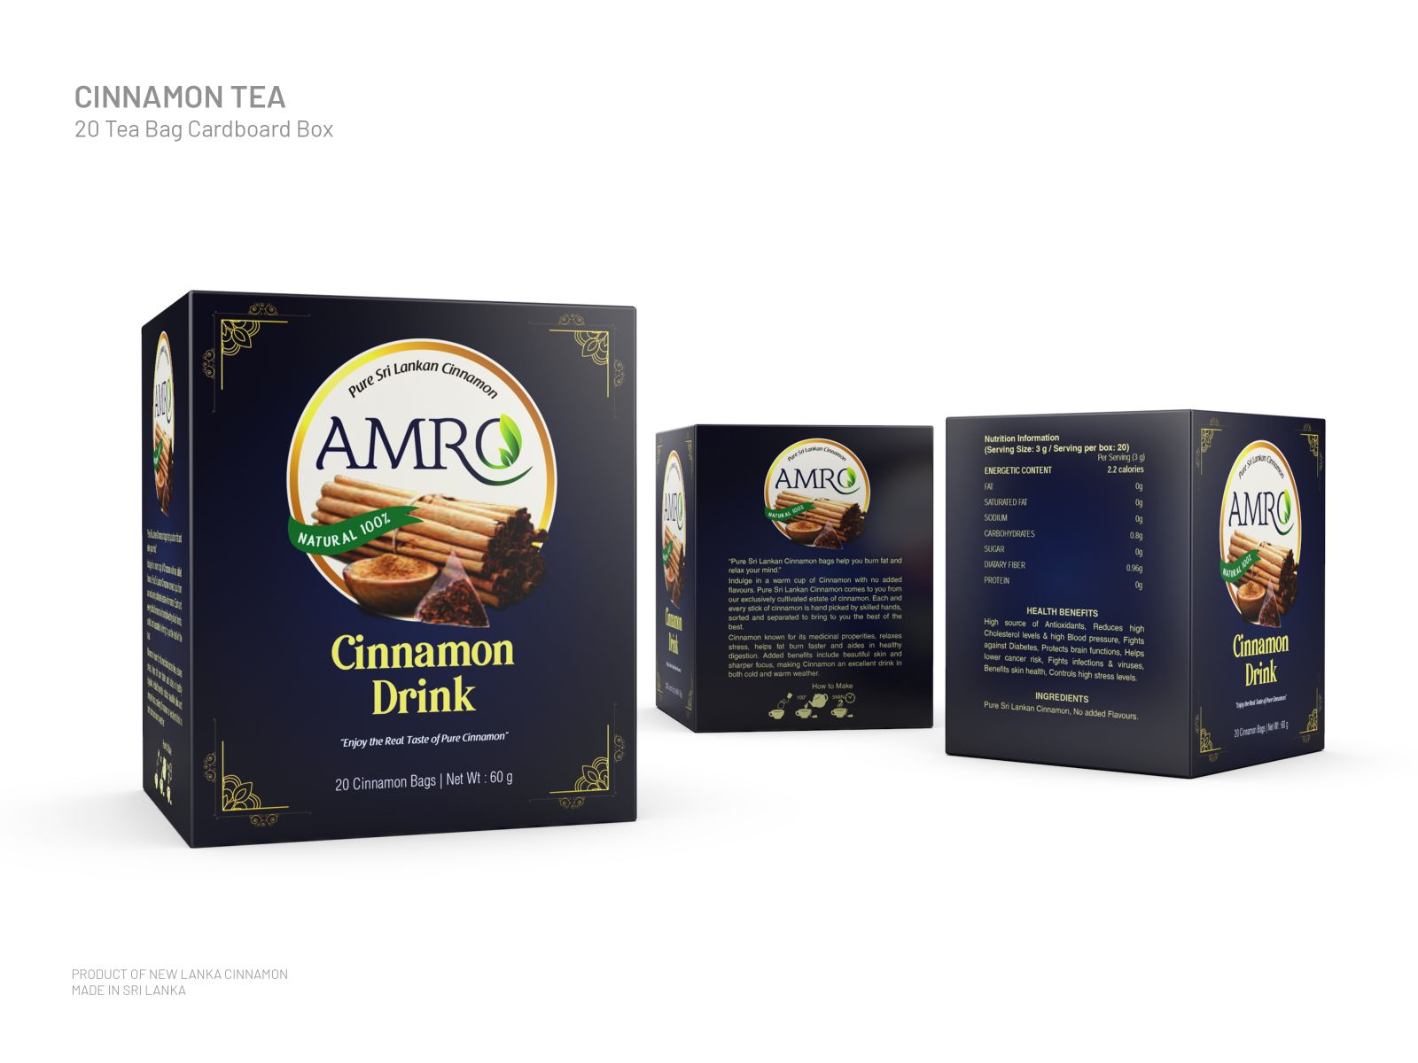
Cinnamon Drink

Slide 5
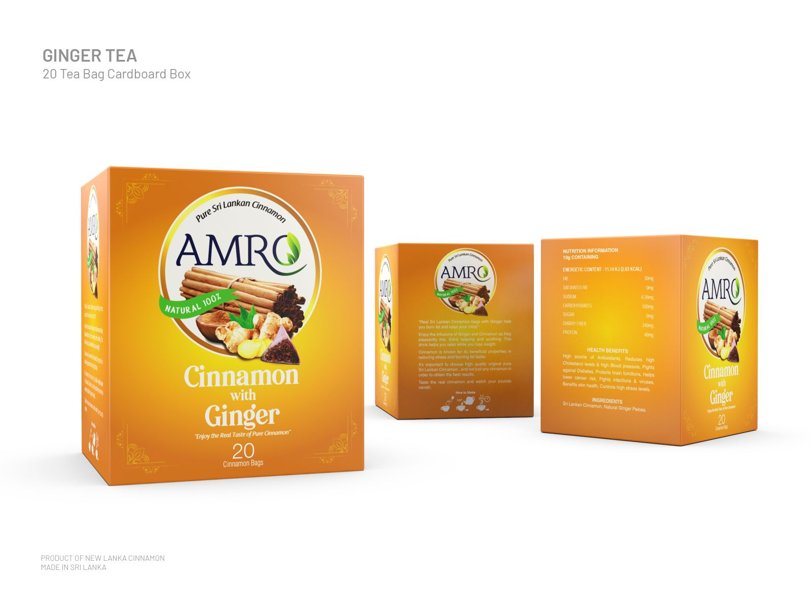
Cinnamon & Ginger

Slide 6
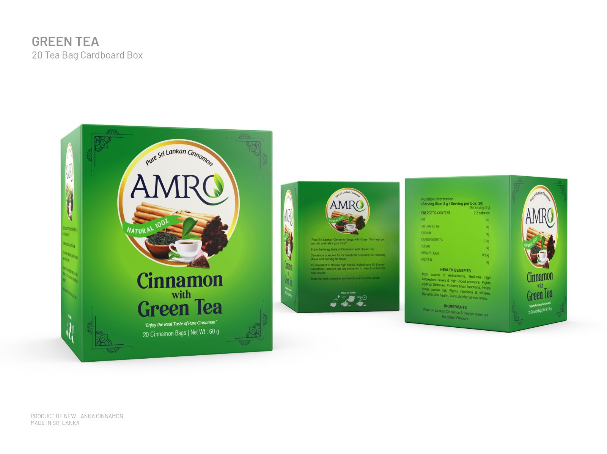
Cinnamon with Green Tea

Slide 7
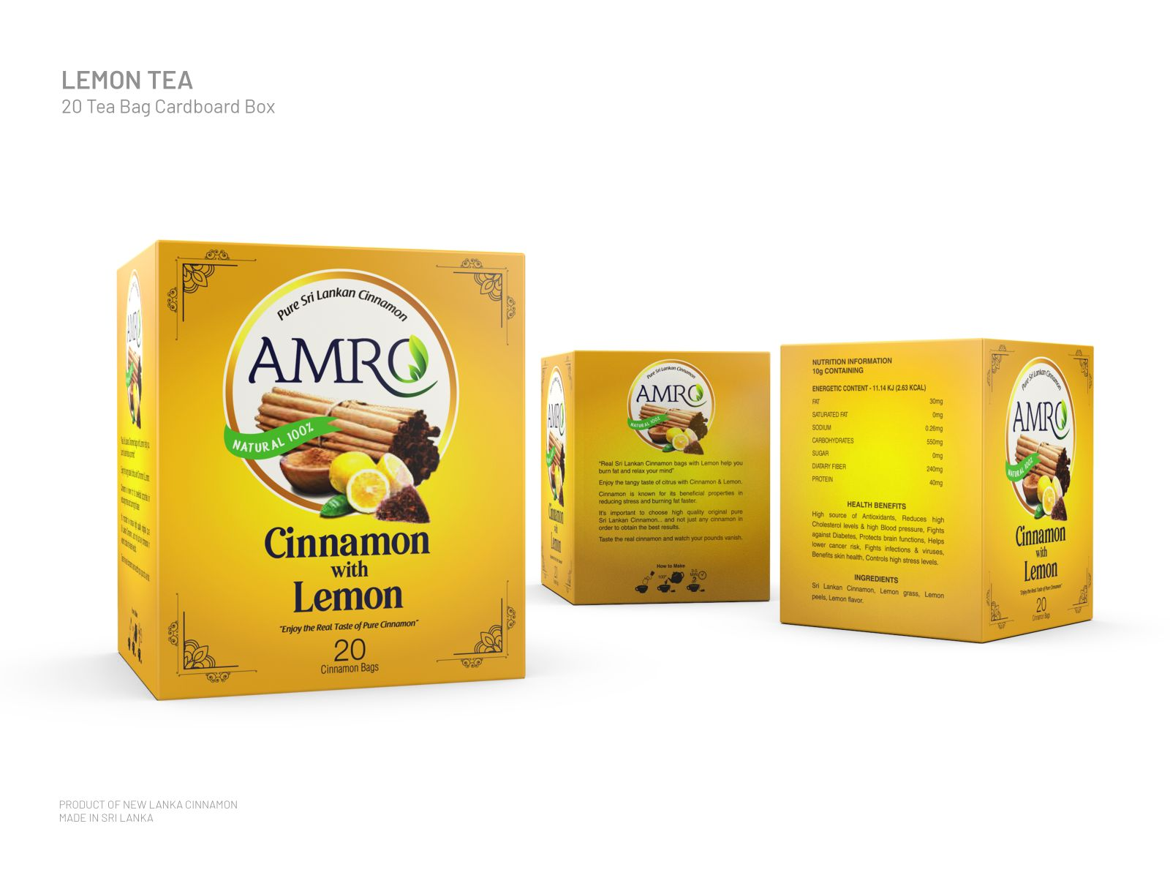
Cinnamon with Lemon

Slide 8
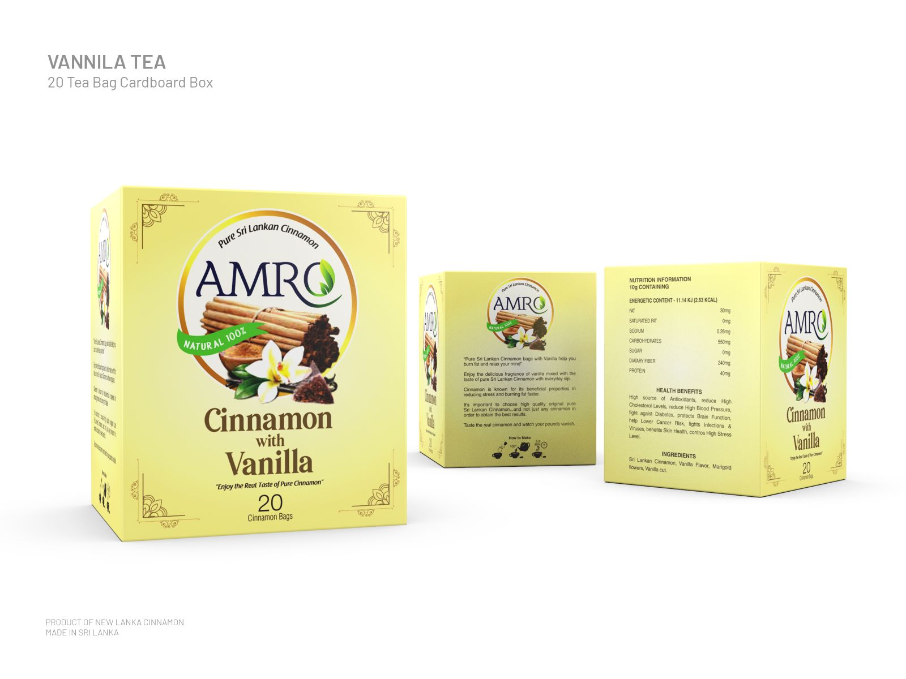
Cinnamon with Vanila

Slide 9
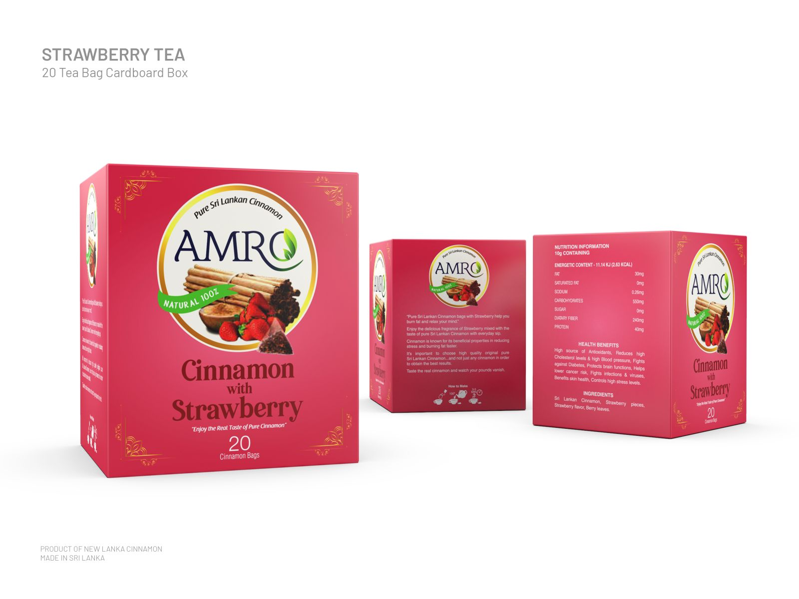
Cinnamon with Srawberry

Slide 10
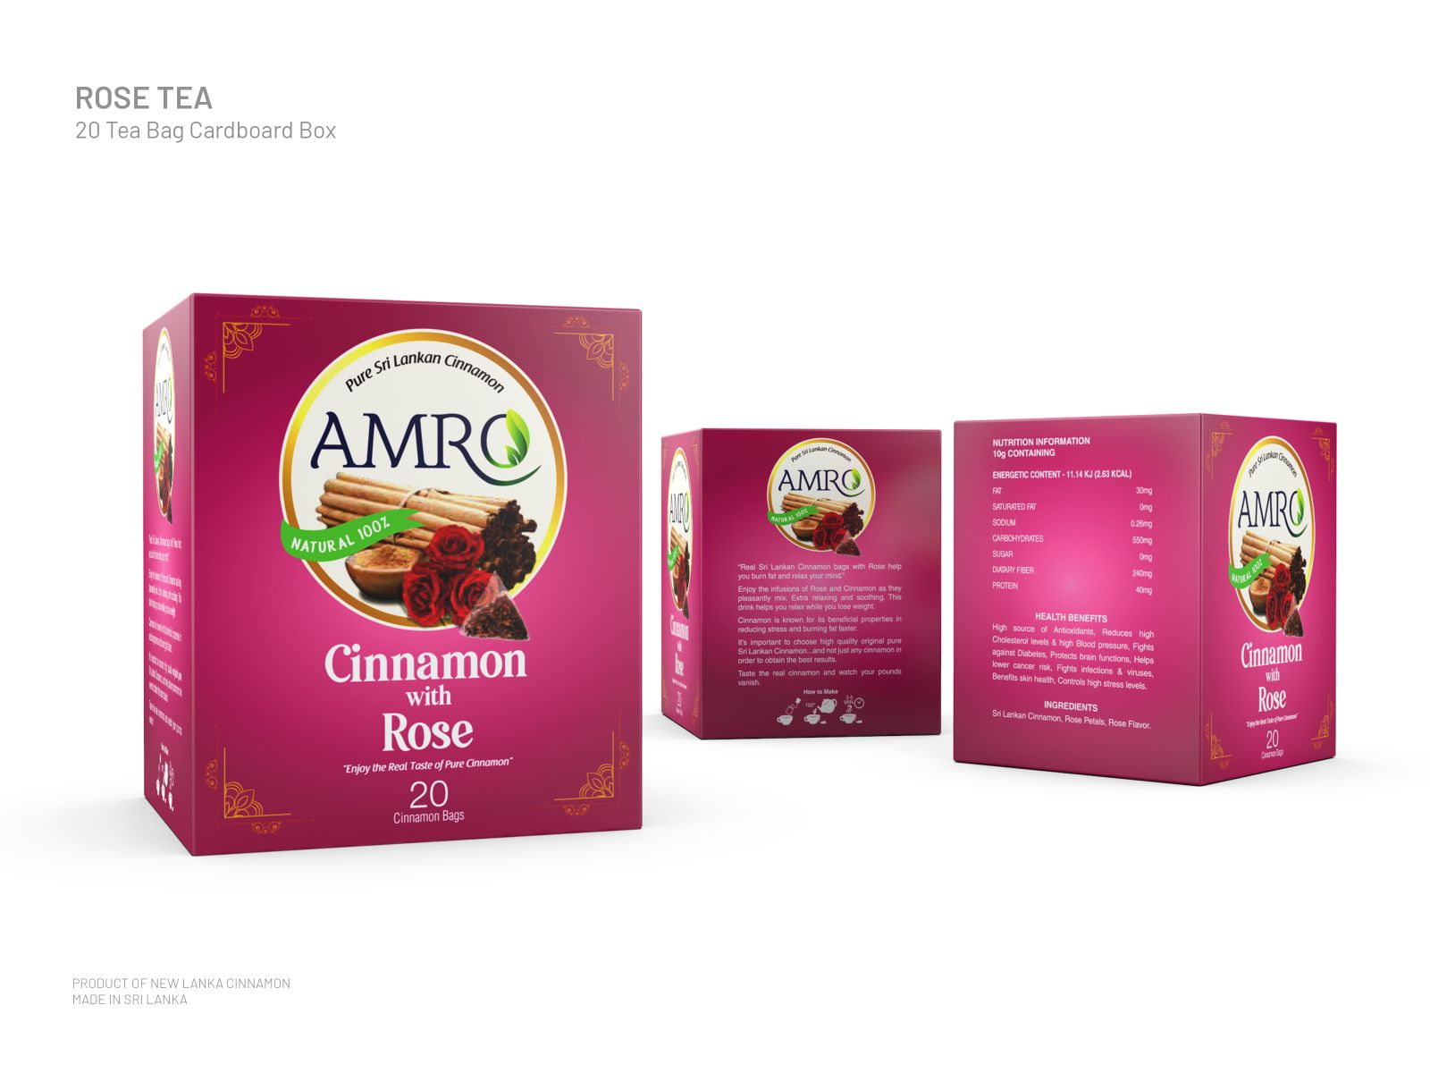
Cinnamon with Rose

Slide 11
Spices
Pepper
Black Pepper
White Pepper
Chilli
Curry Powder
Coriander
Cinnamon
Cloves

Slide 12
Pepper
Black Pepper
  Pepper Whole
  Pepper Pieces
  Pepper Powder
White Pepper
  Pepper Whole
  Pepper Powder

Slide 13
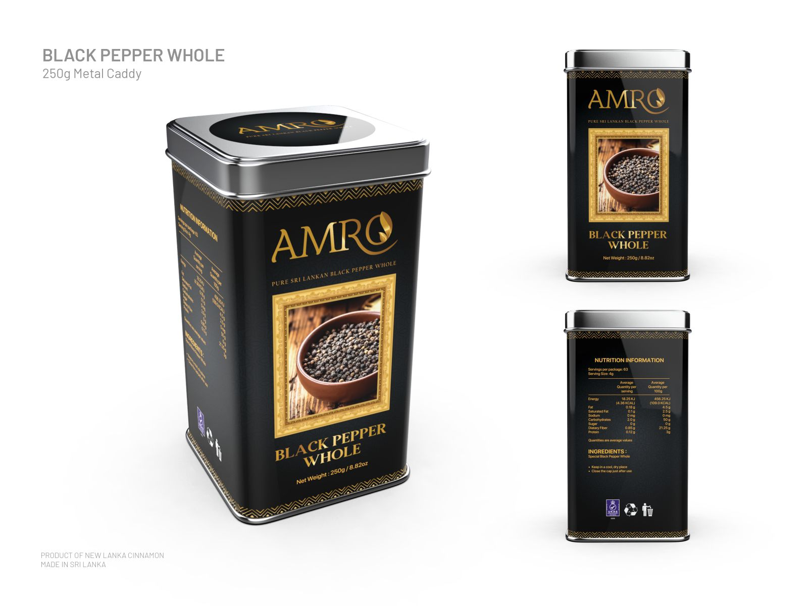
Black Pepper Whole

Slide 14
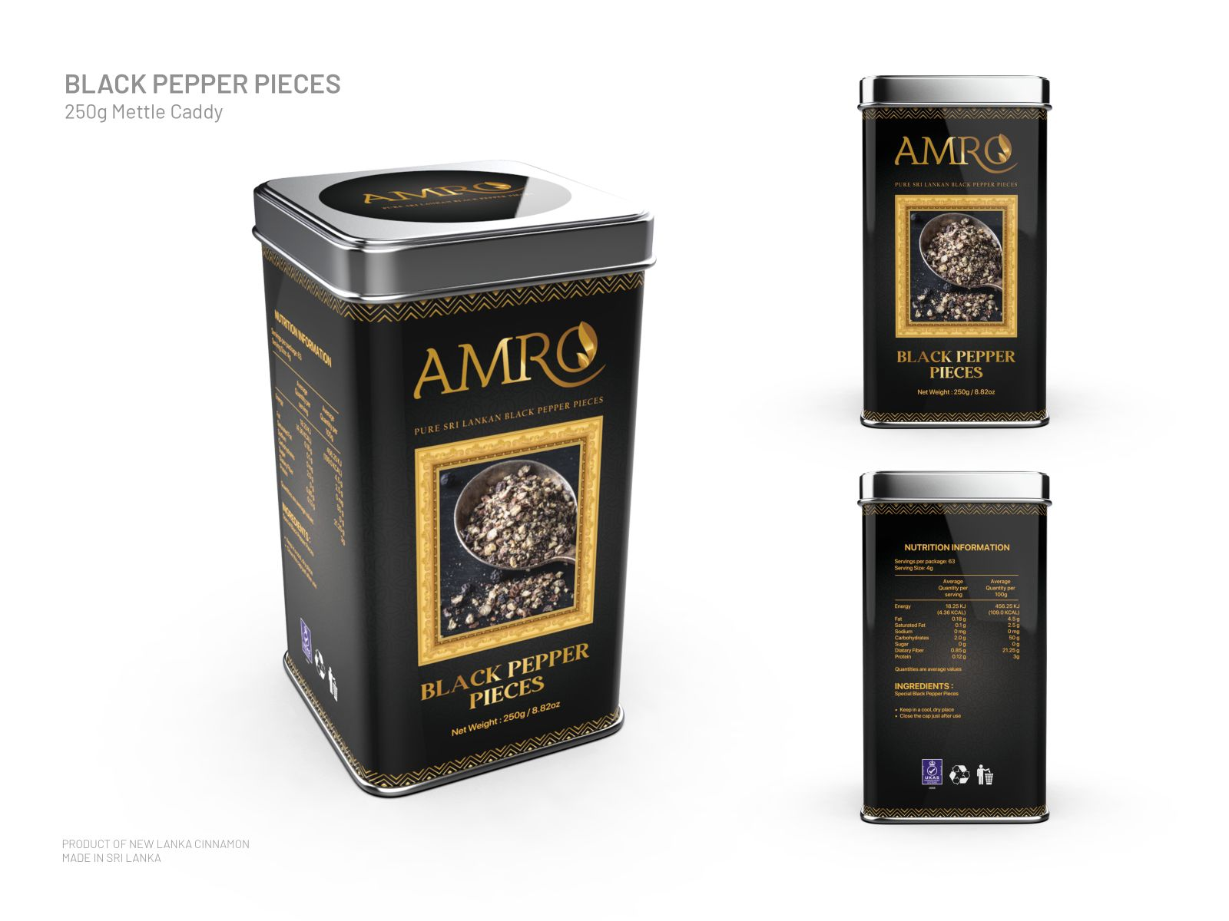
Black Pepper Pieces

Slide 15

Black Pepper Powder

Slide 16
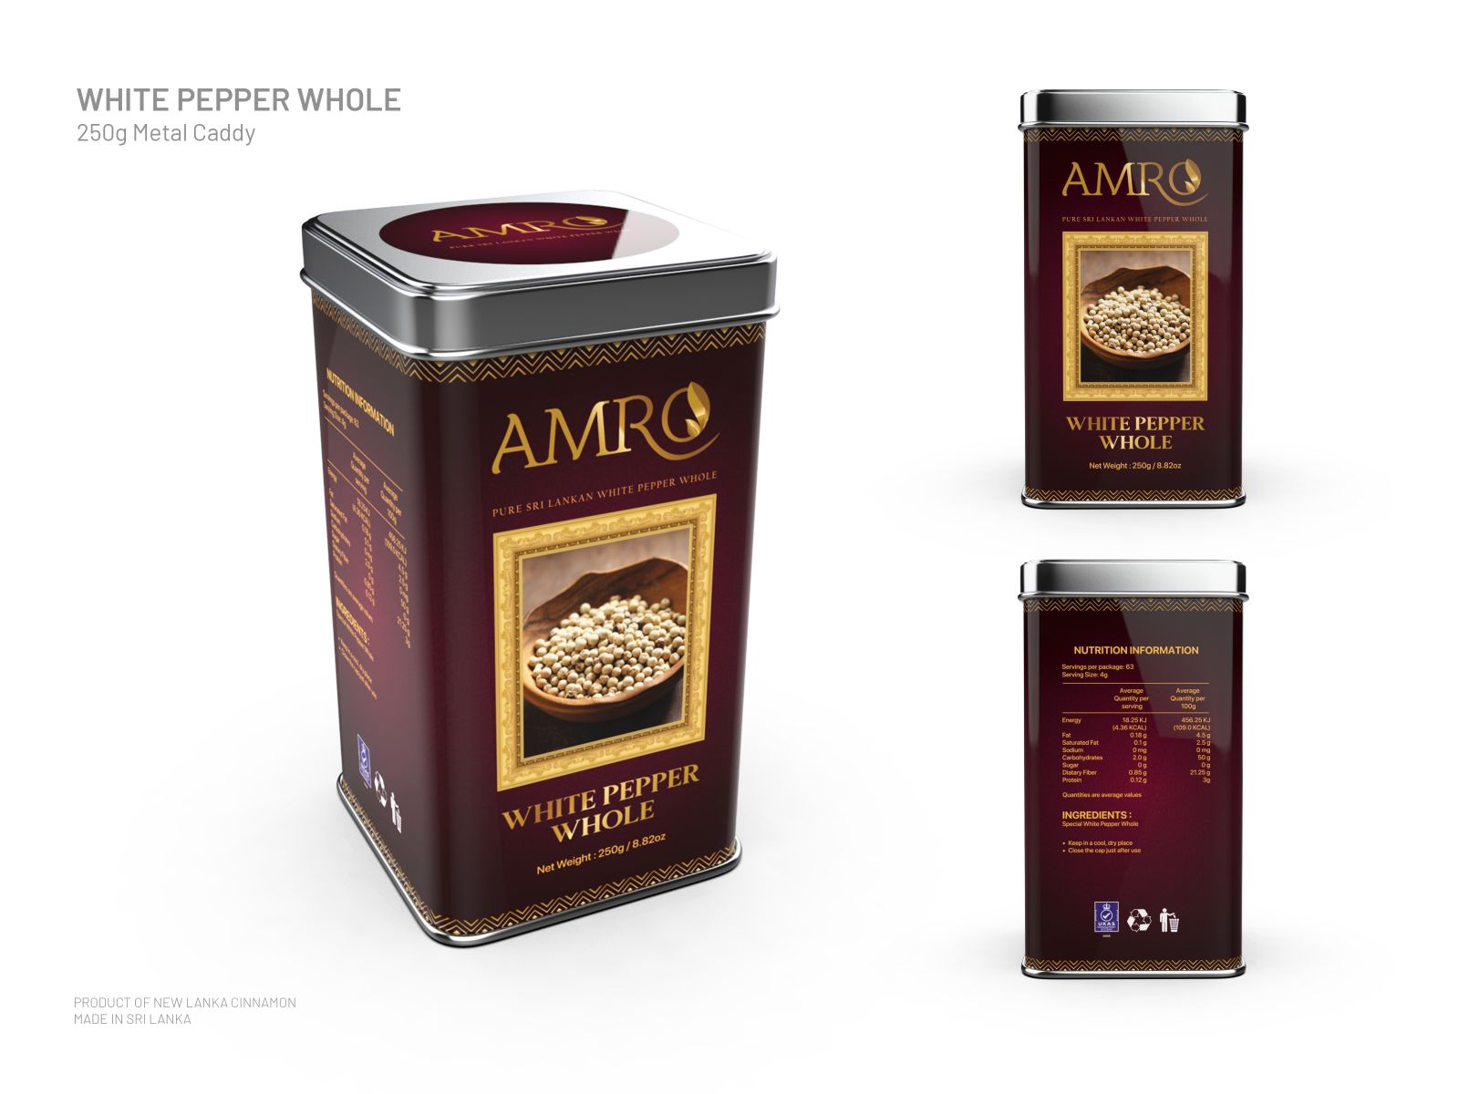
White Pepper Whole

Slide 17
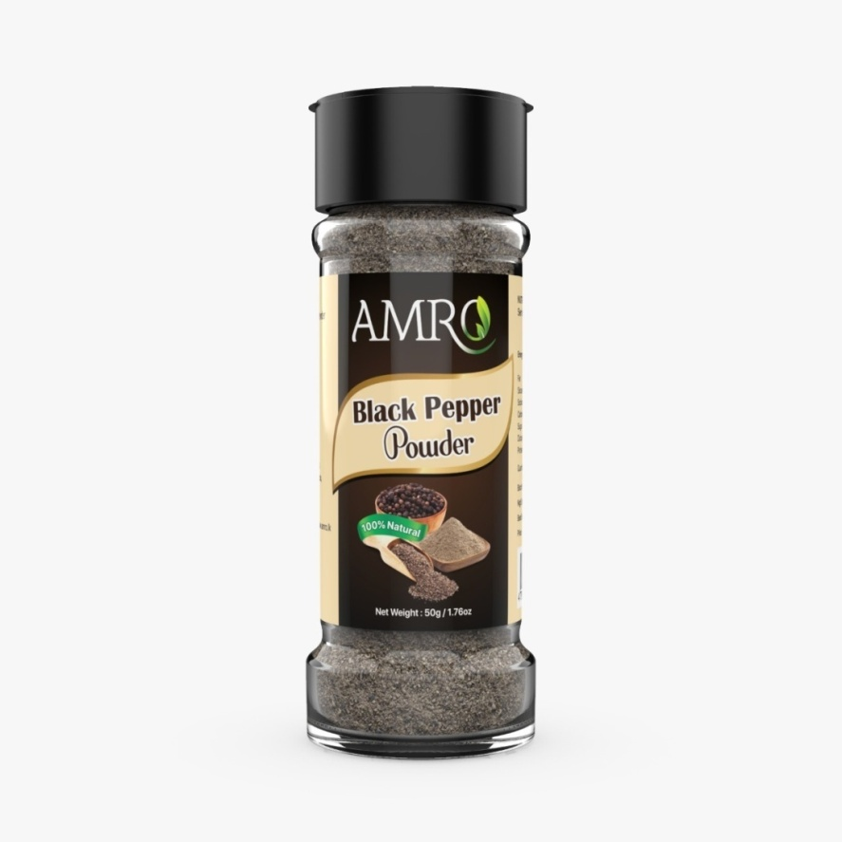
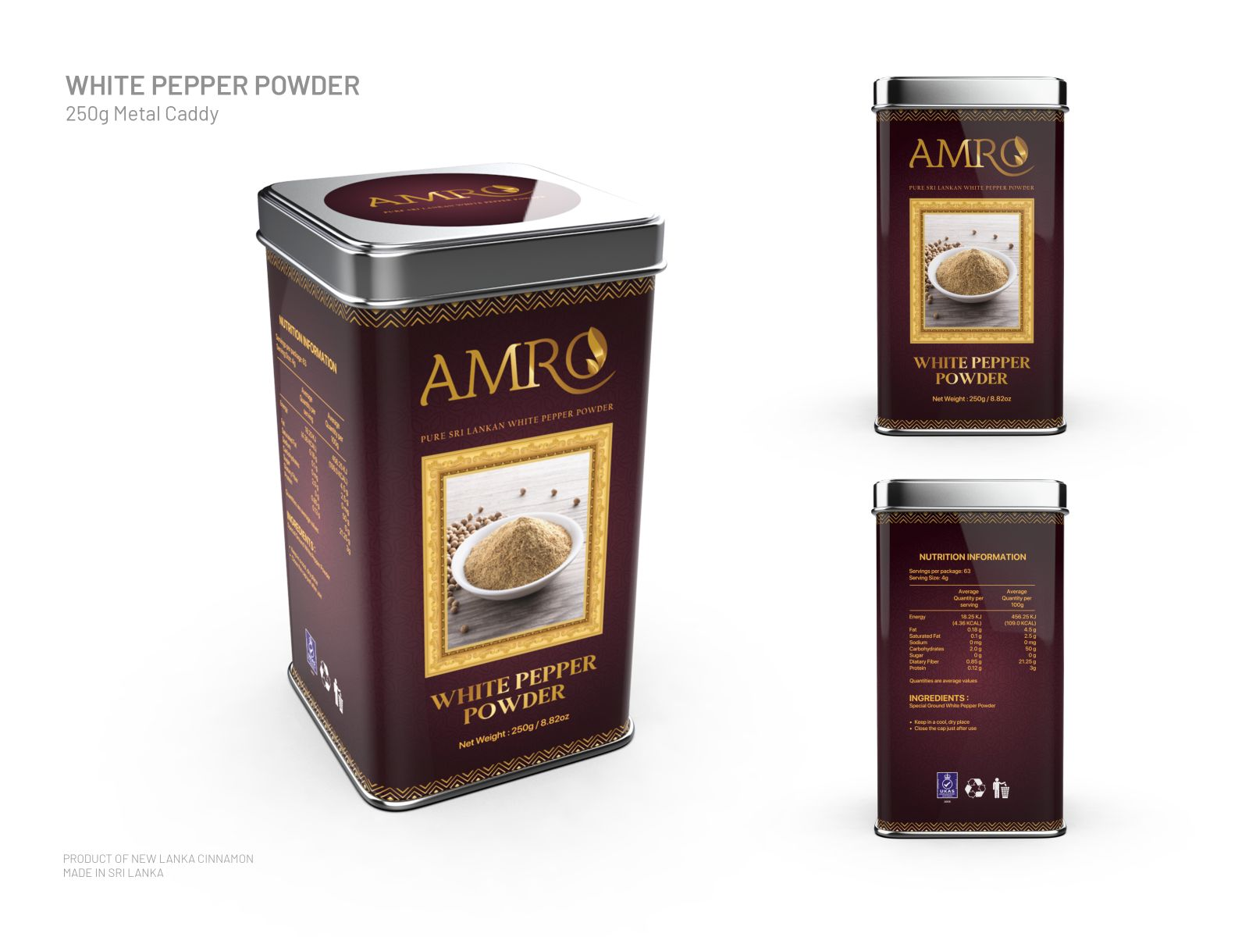
White Pepper Powder

Slide 18
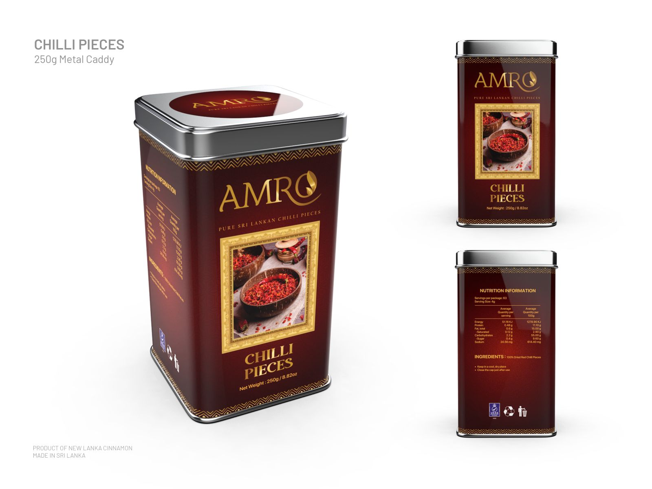
Chilli Pieces

Slide 19
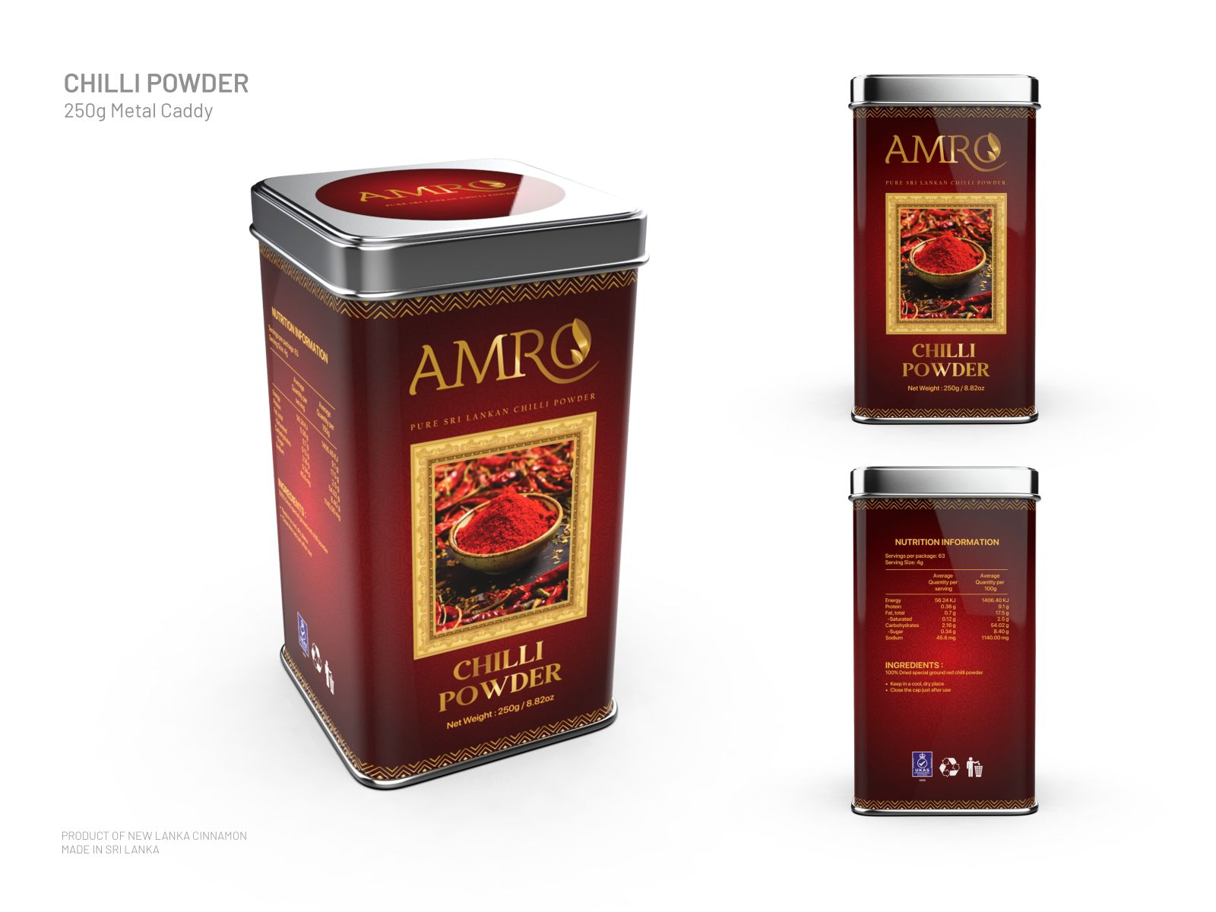
Chilli Pieces

Slide 20
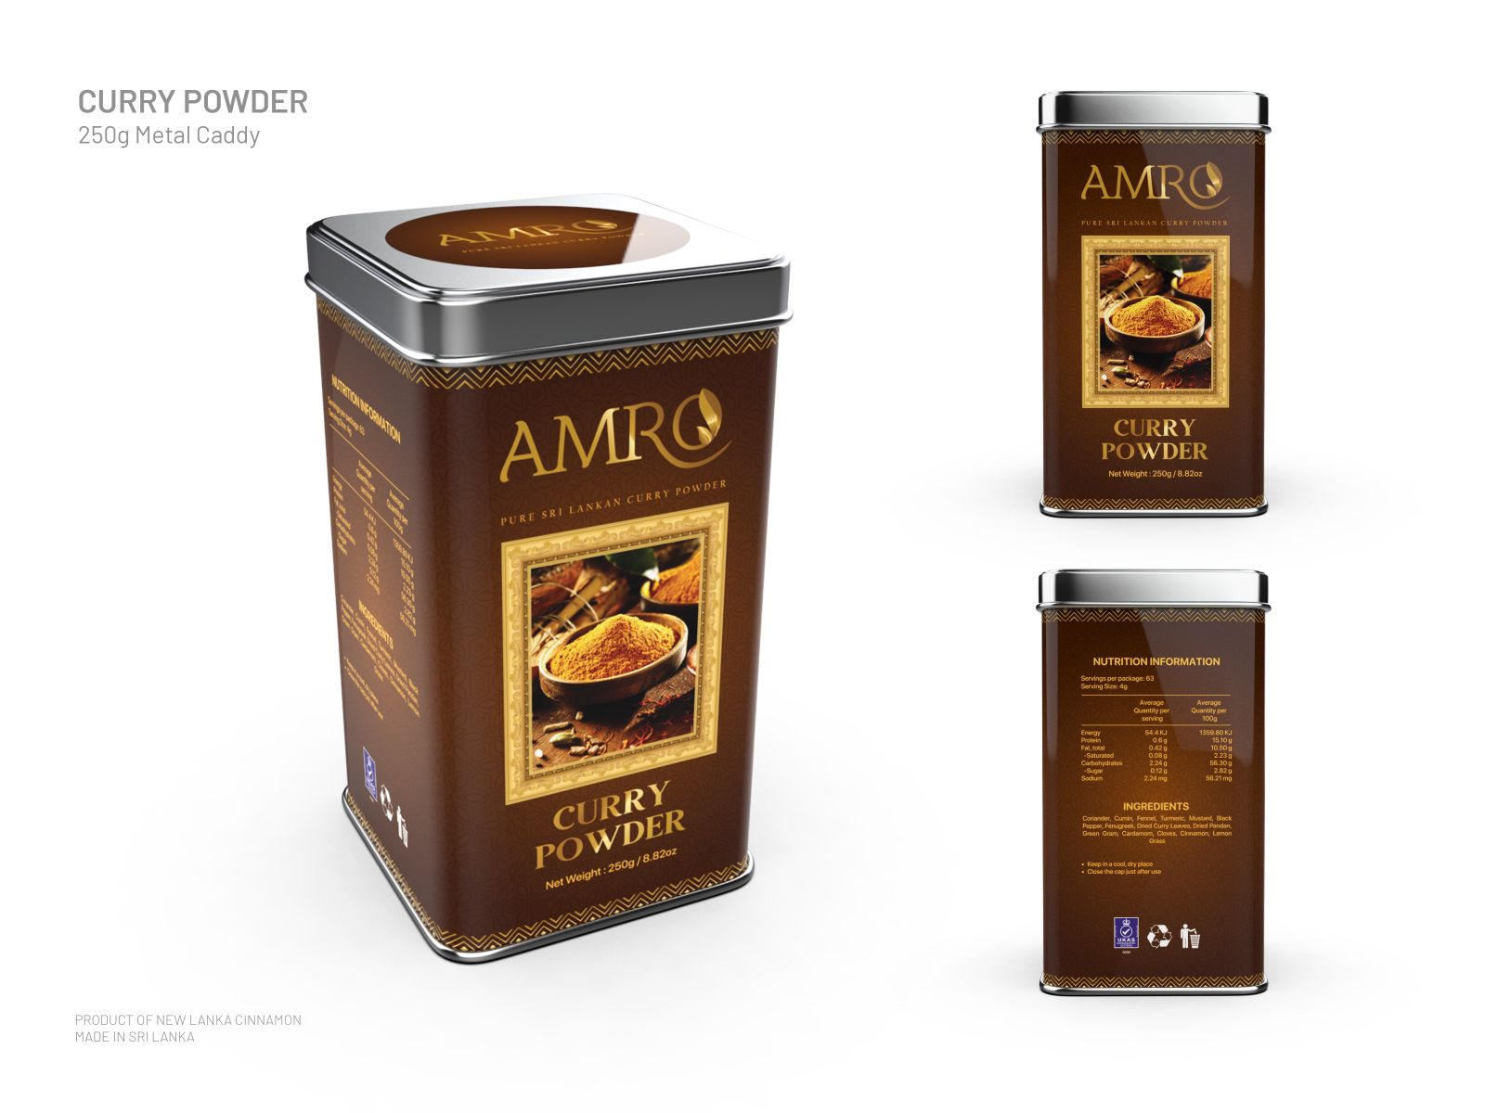
Curry Powder

Slide 21
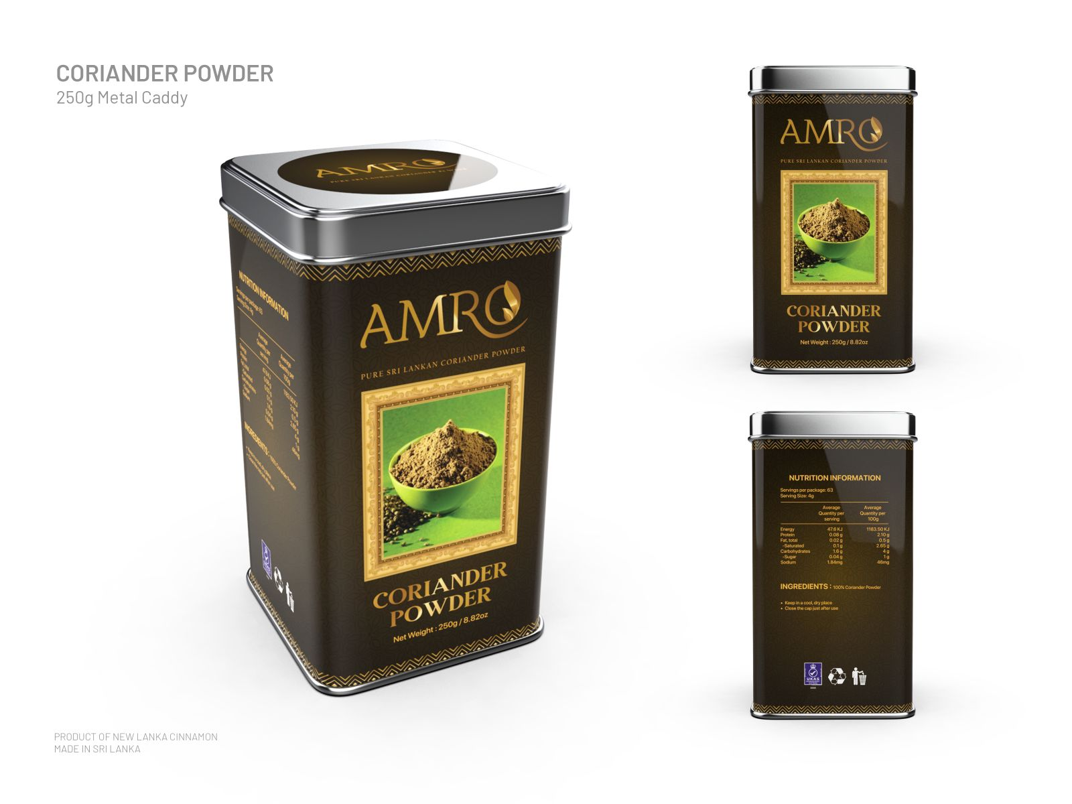
Coriander Powder

Slide 22
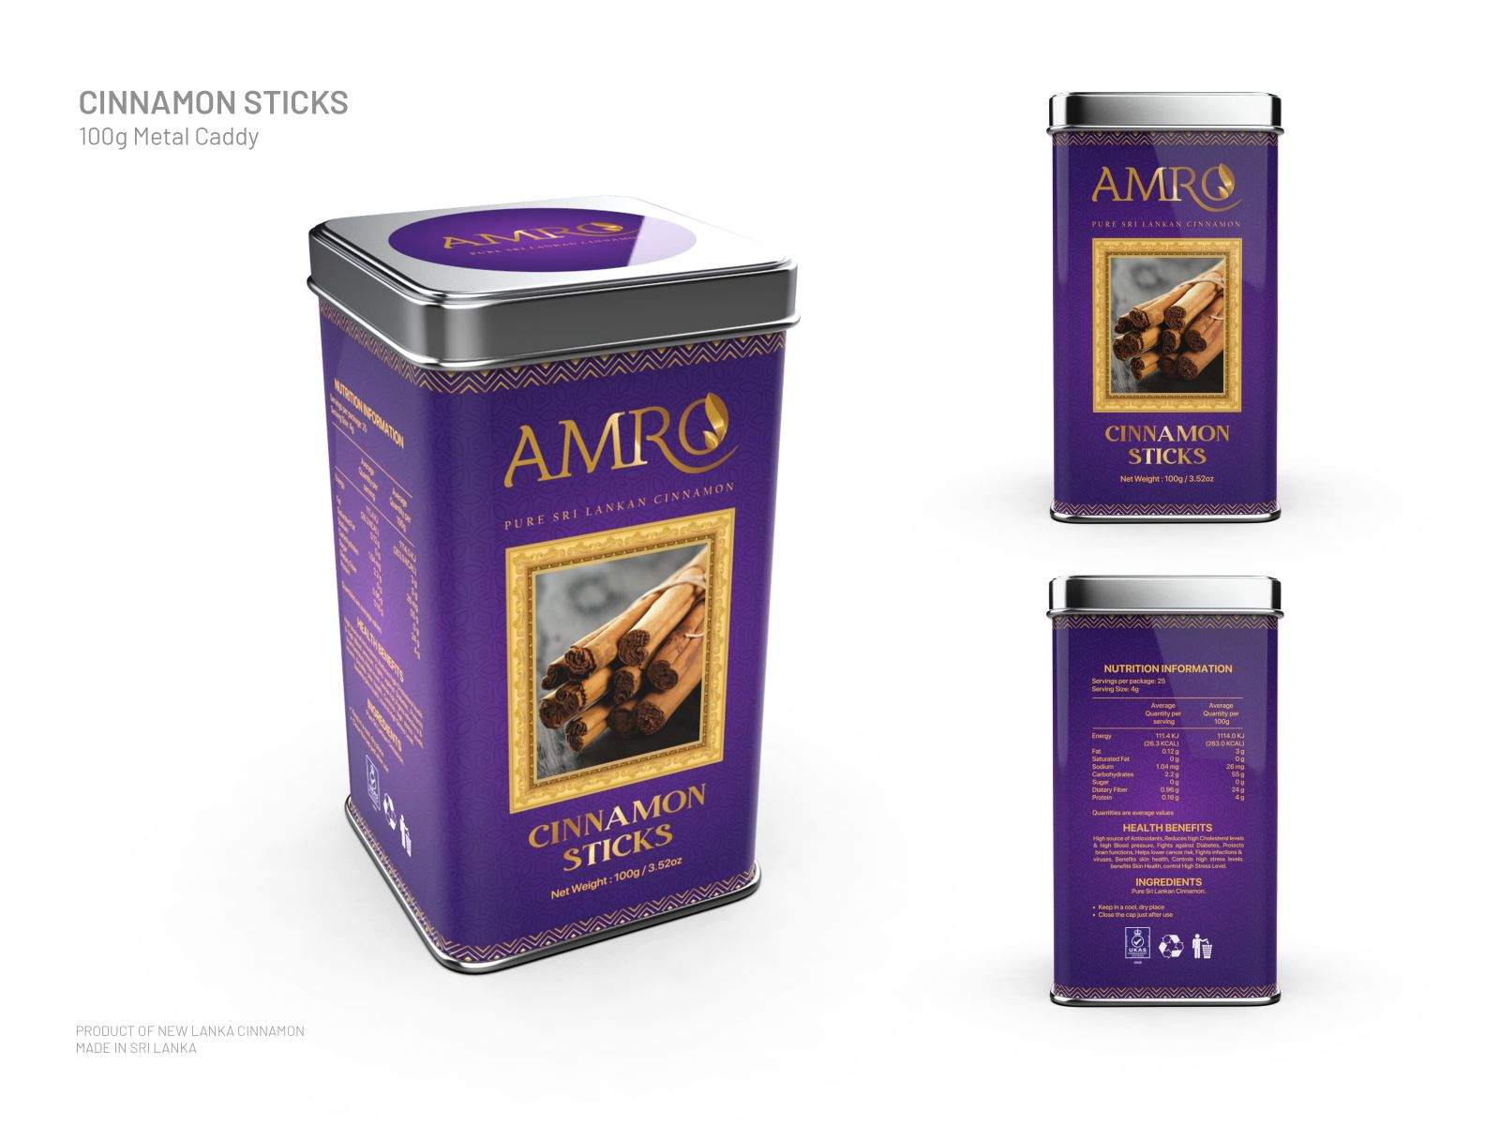
Cinnamon Sticks

Slide 23
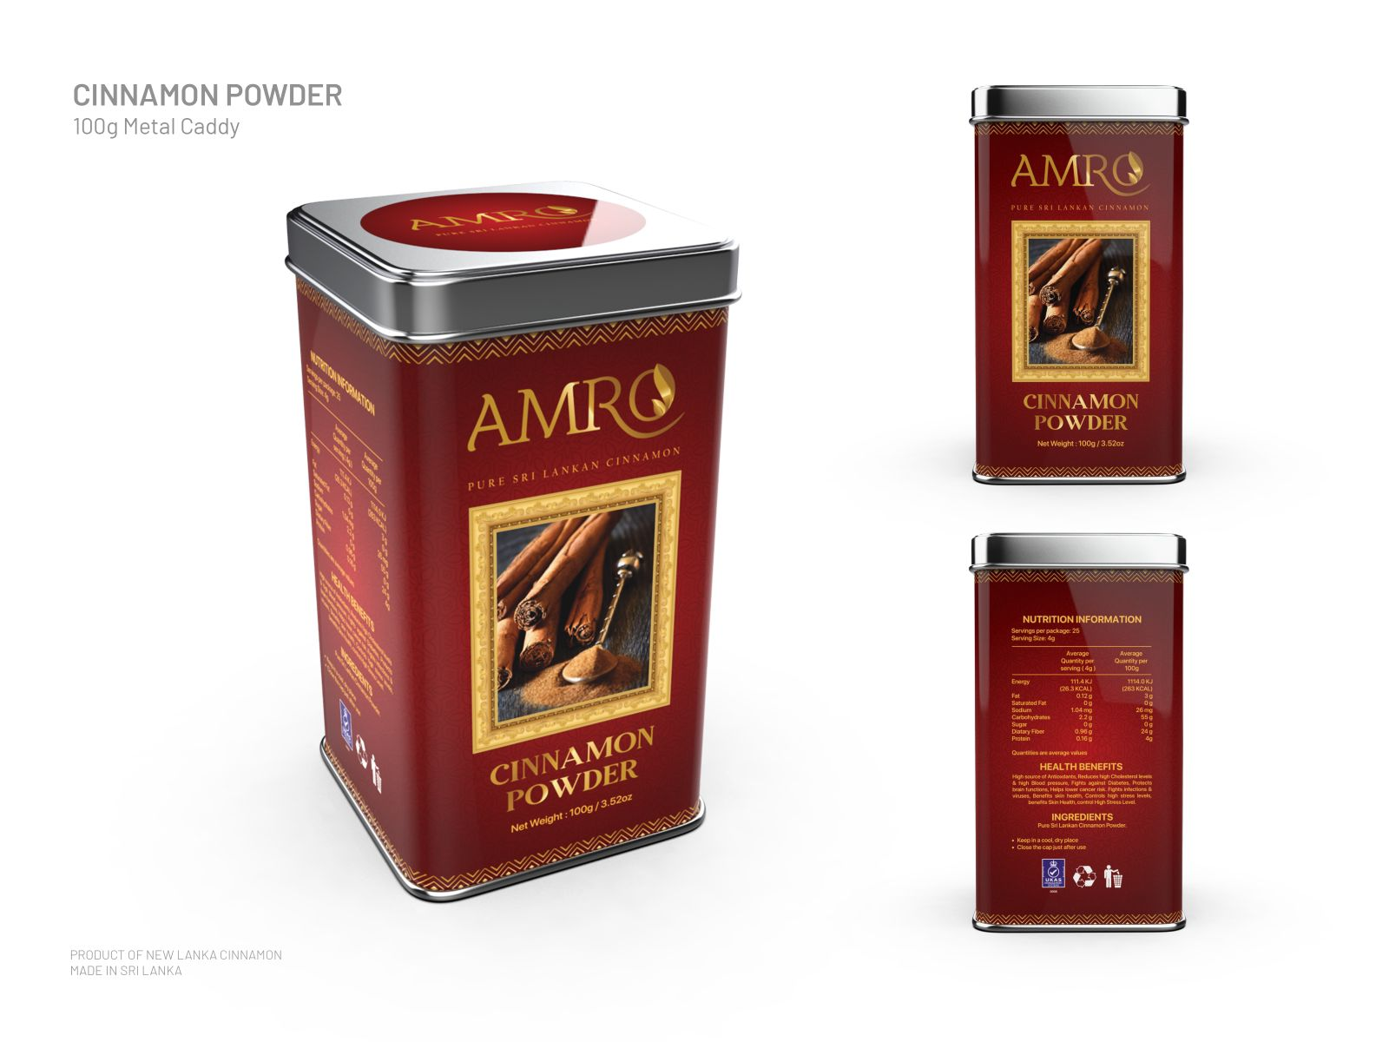
Cinnamon Powder

Slide 24
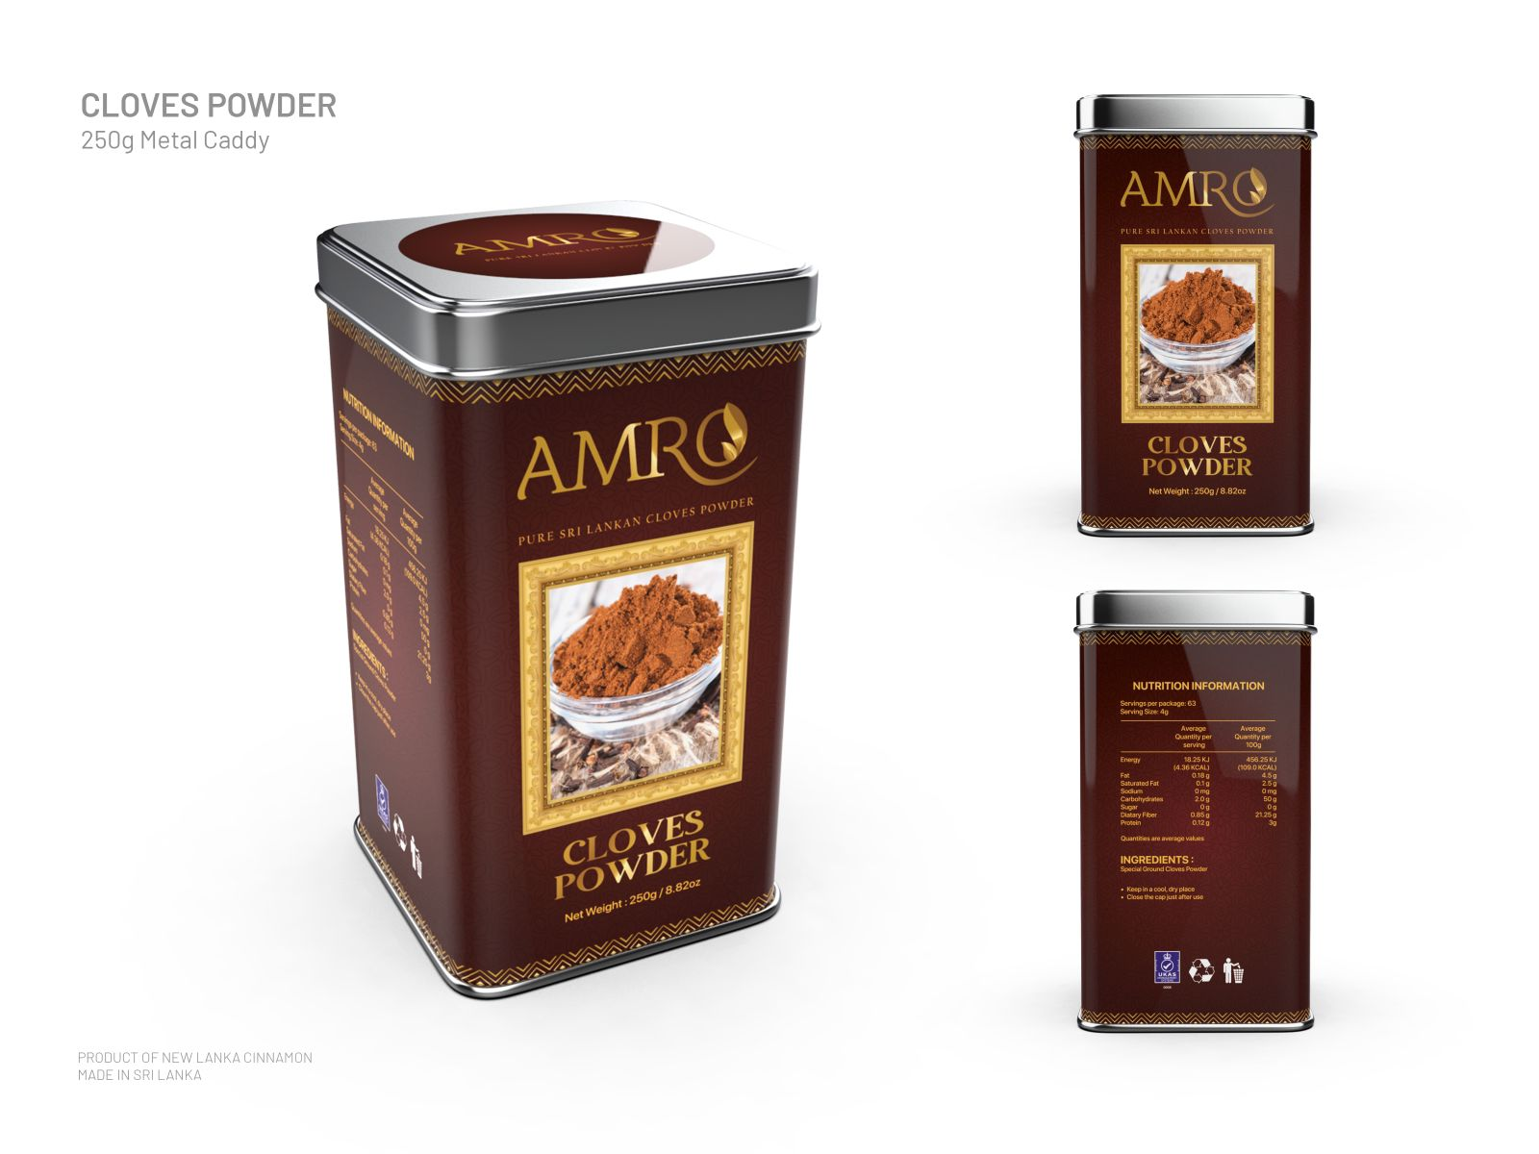
Cloves Powder

Slide 25
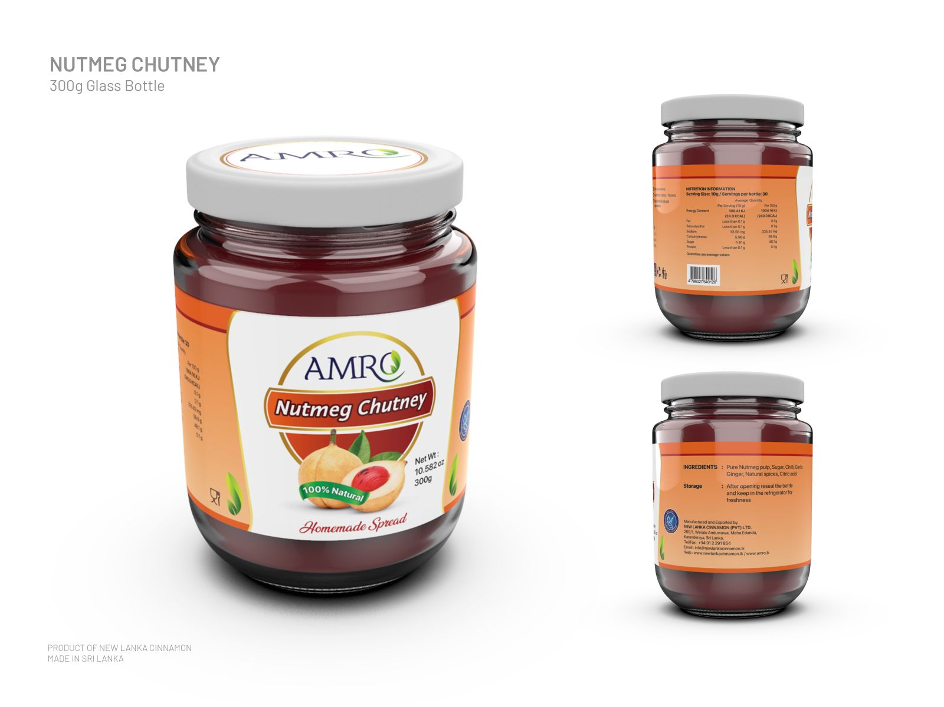

Jam/chutney
Nutmeg
  Jam
  Chutney

Slide 26
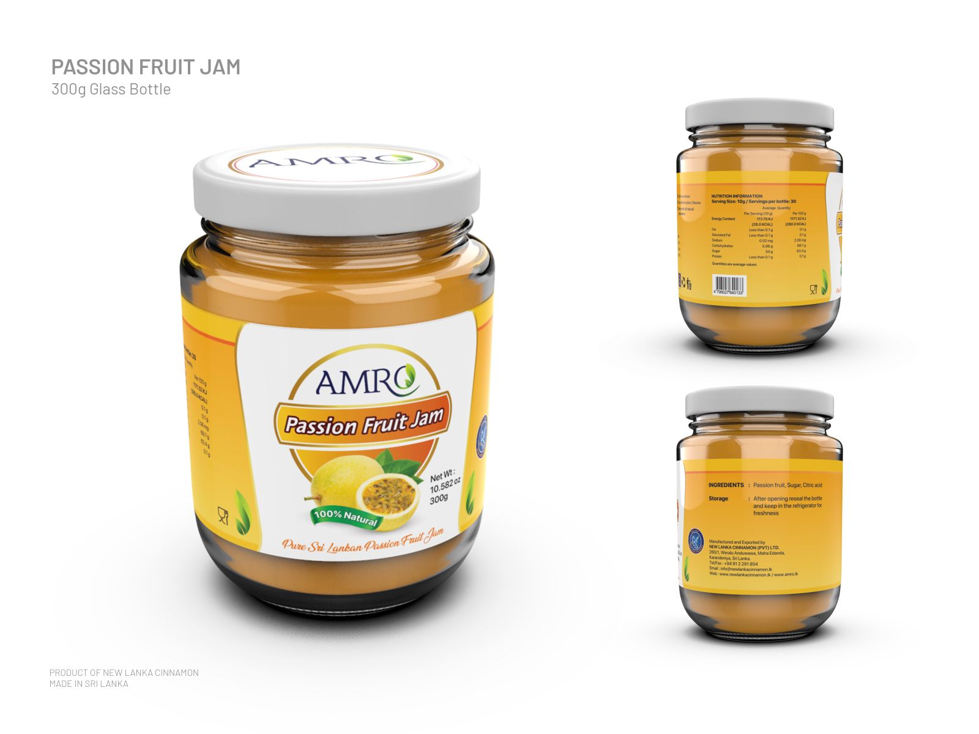
Passion Fruits Jam

Slide 27
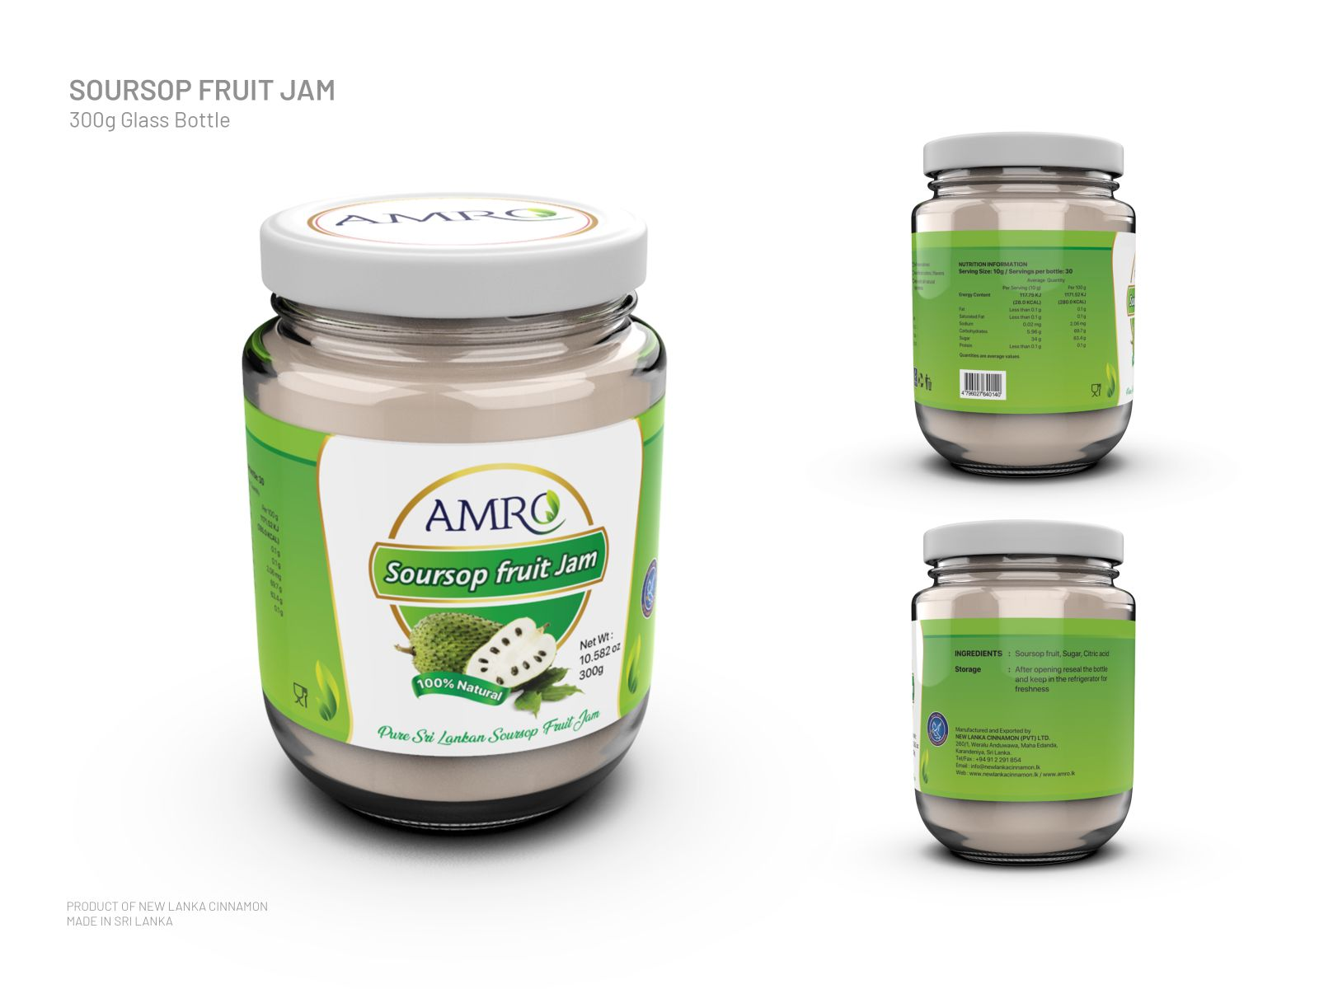
Sour sop Jam

Slide 28
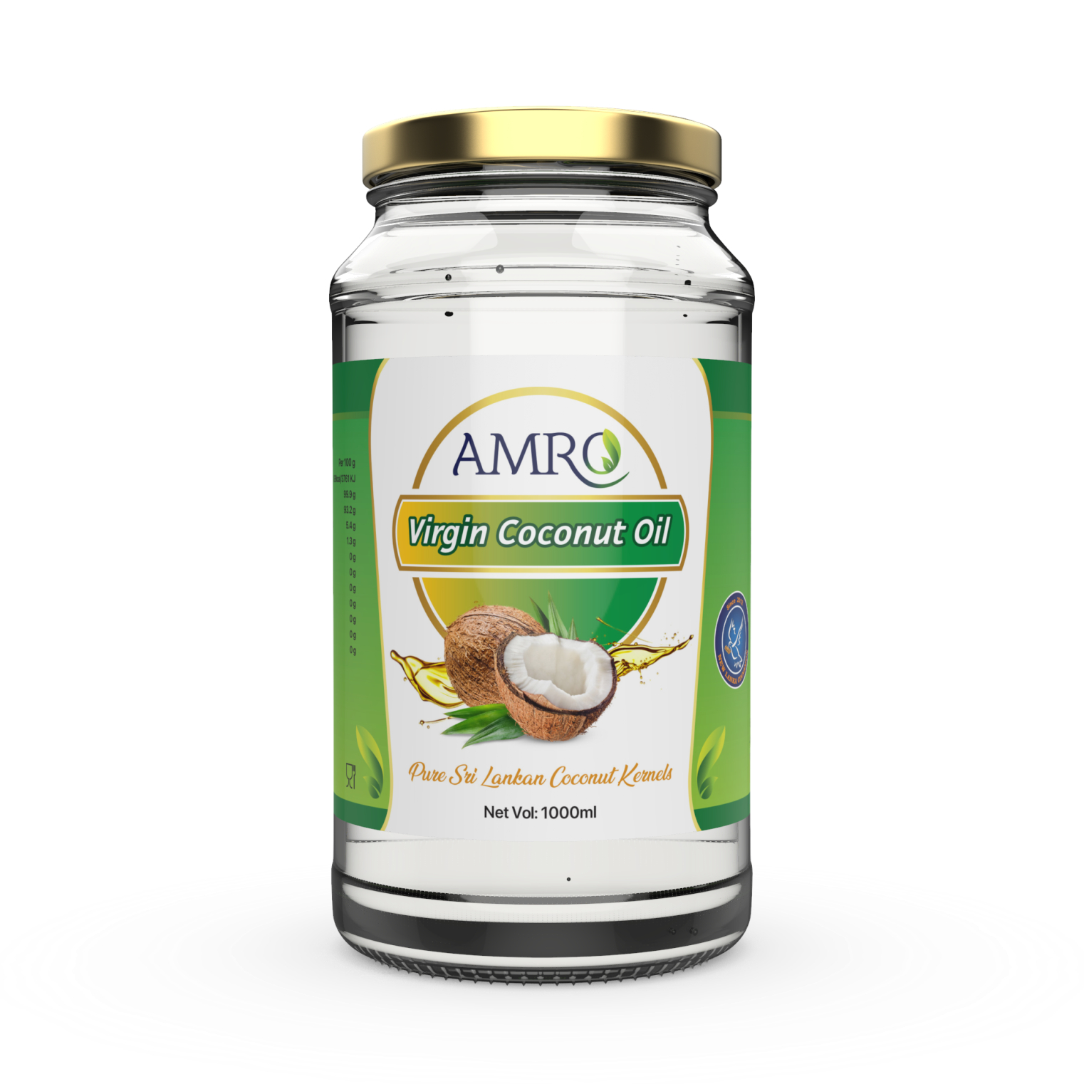
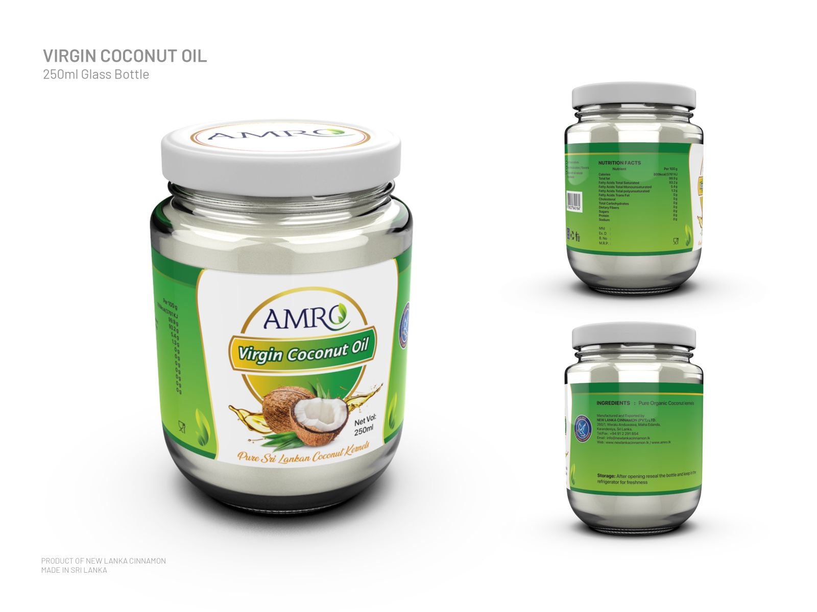
Virgin Coconut Oil

Slide 29
Certification
Process Certification
Organic Product Certification

Slide 30

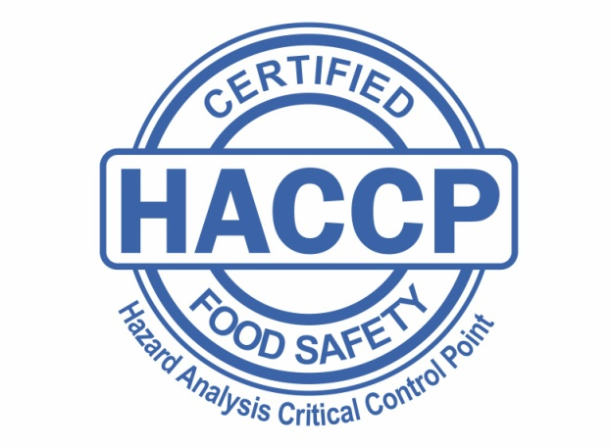
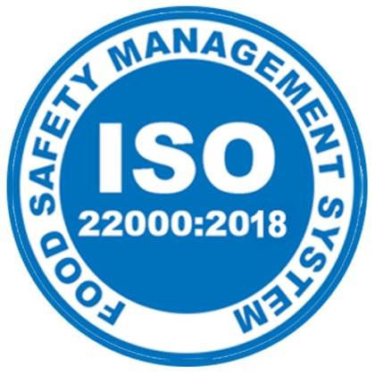


Process Certification
GMP
HACCP
ISO 22000 - 2018
FDA

Slide 31

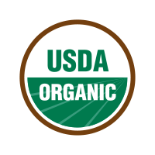

Organic Product Certification
USDA
EU
JAS

Slide 32
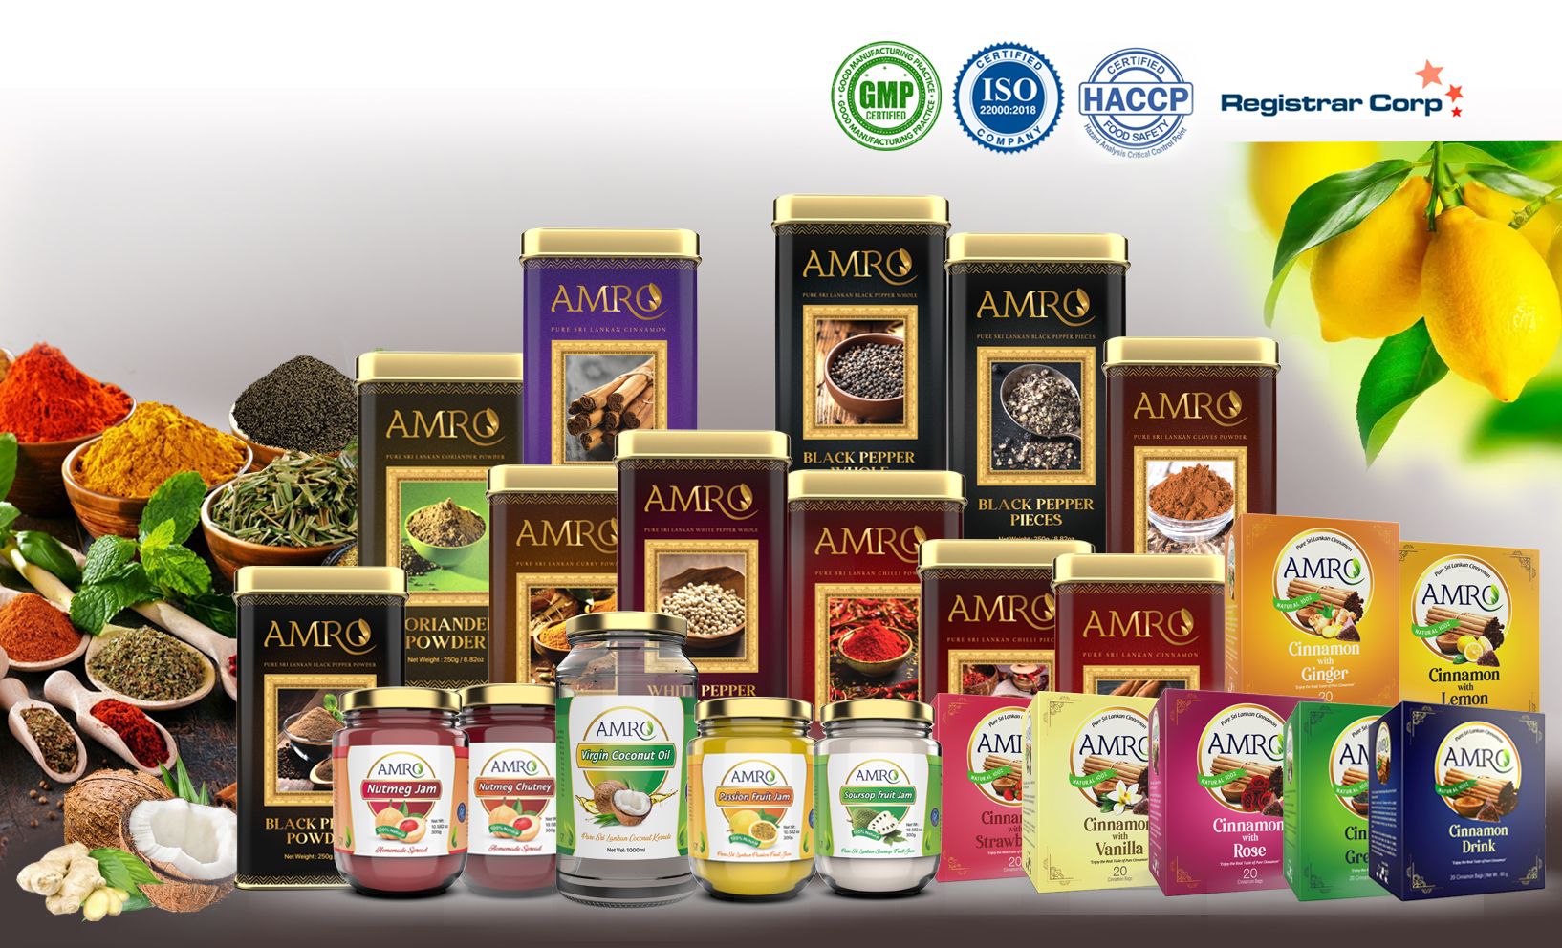
QUALITY OF THE PRODUCTS

Slide 33
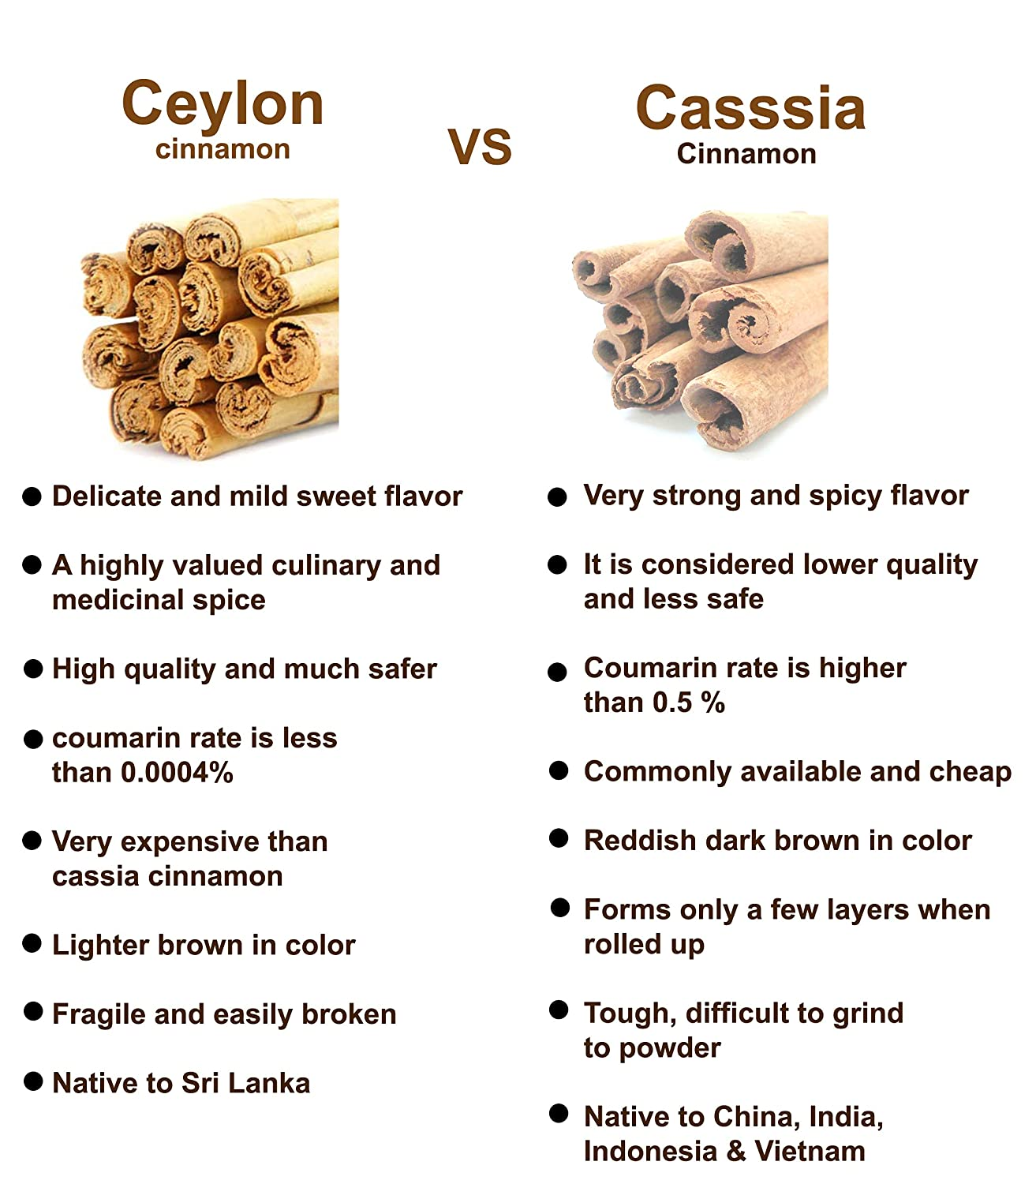
Ceylon Cinnamon/Sri Lankan Cinnamon

Slide 34
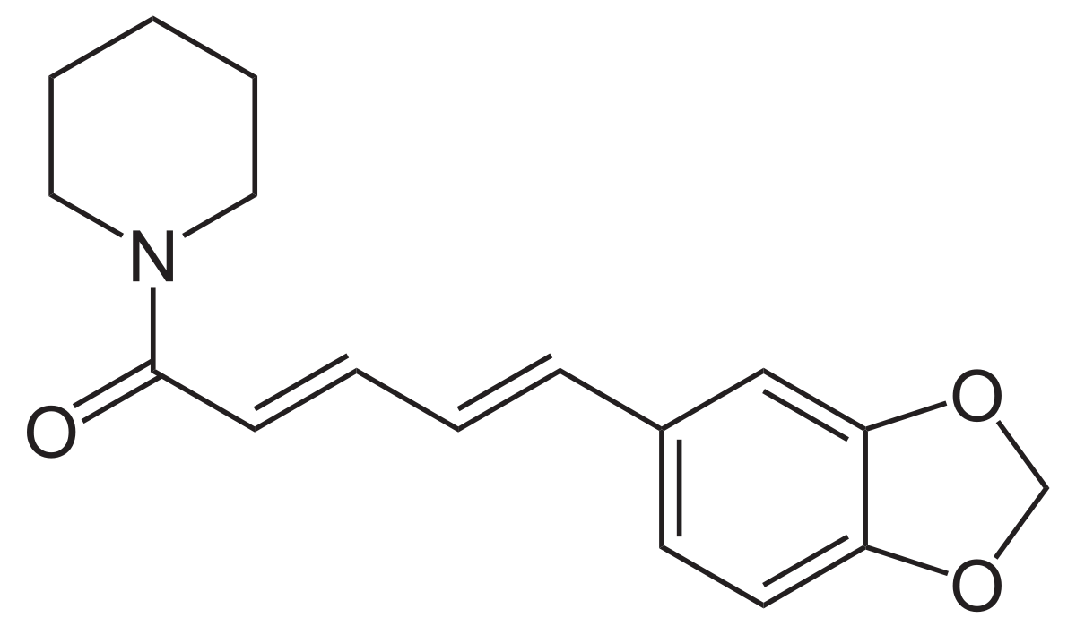
Black/White Pepper
Ceylon Pepper is particularly favoured worldwide as it is quite rich in piperine, the alkaloid which lends it a distinct pungency.
As a result, Ceylon Pepper from Sri Lanka fetches a premium price in the international spice market. Black pepper is widely used as a 'hot' cooking spice and seasoning.

Slide 35
Sri Lanka Cloves
Whole Sri Lankan cloves are the sweet, spicy, and aromatic unopened flower bud from a syzygium aromaticum tree - a member of the evergreen family. These cloves are selectively hand-picked and dried to preserve flavours.

Slide 36
Sri Lanka Virgin Coconut Oil
Mainly high FAT content and taste

Slide 37
JAM and CHUTNEY
Nut MEG - is a rich source of antioxidants, which help protect against the signs of aging and serious conditions such as cancer, heart disease, and liver disease
Passion Fruit - is low in calories and high in nutrients, fiber, and antioxidants
Soursop - is high in vitamin C, an antioxidant known to boost immune health. The vitamin strengthens your immune system

Slide 38
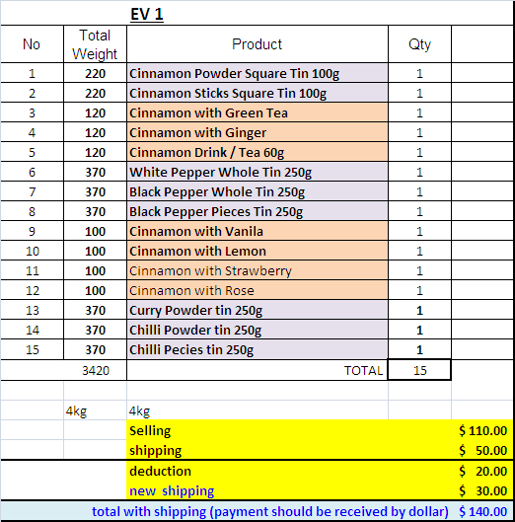
AMRO PACK / EV-1

Slide 39
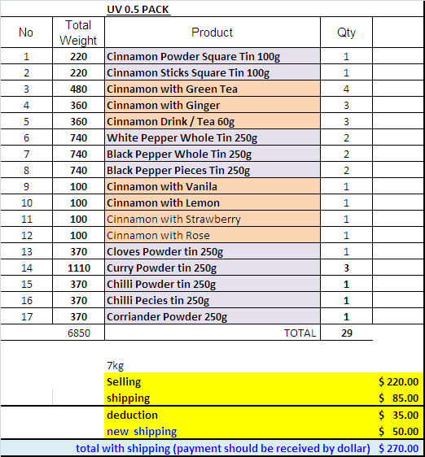
AMRO PACK UV-0.5

Slide 40
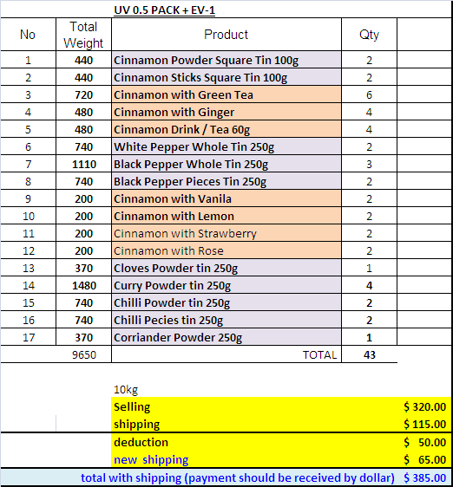
AMRO PACK EV-1 + UV-0.5

Slide 41
Thanks

