Slide 1
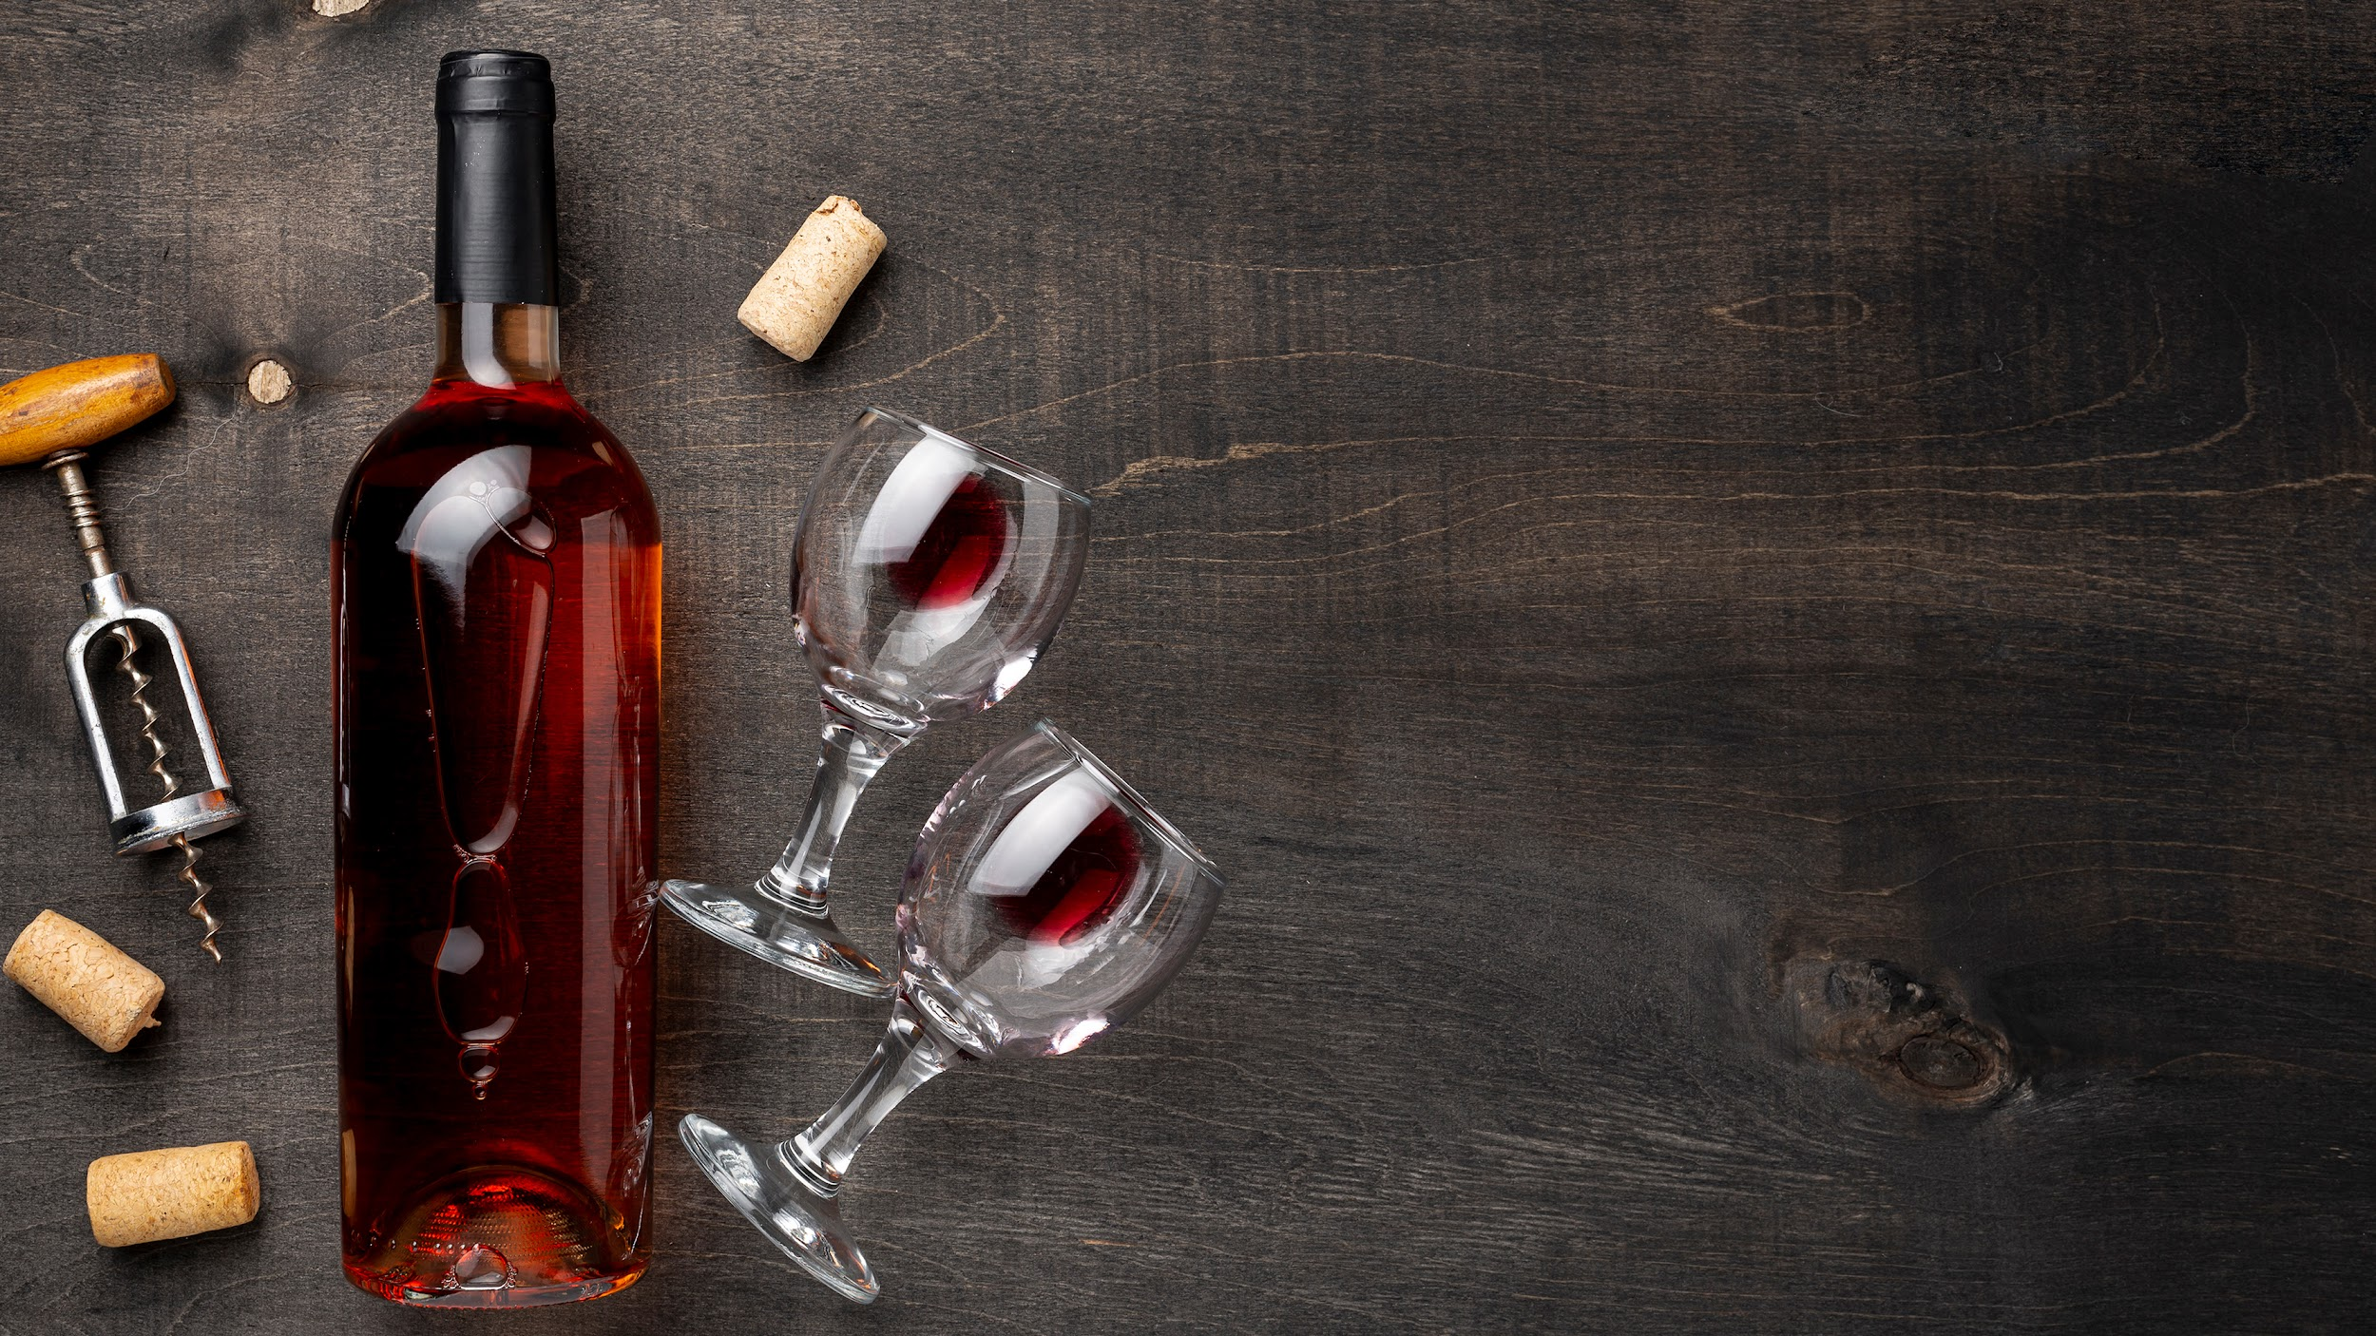
Investment opportunities
in viticulture and
wine industry
of the Republic of Uzbekistan
Ministry of Investment, Industry and Trade
of the Republic of Uzbekistan

Slide 2
01.
ABOUT
THE REPUBLIC
OF UZBEKISTAN

Slide 3

Republic of Uzbekistan
448,9K km
36,1 mln
A strategic position in the middle of Central Asia
Area
Population
11
~50%
Urbanization rate
International Airports
East Asia + Southern Europe
Through
China, Kyrgyzstan and
Uzbekistan

Slide 4




ECONOMIC GROWTH
GDP, current bln USD
Foreign trade turnover, bln USD
62,1
80,4
26,6
50,0
2017
2022
2017
2022
Inflation rate, %
Industrial production, bln USD
14,4
12,3
14,4
12,3
2017
2022
2017
2022

Slide 5




MEMBERS OF INTERNATIONAL ORGANIZATIONS
World Trade Organization
EAEU
Eurasian
Economic Union
GSP+
Under active accession to the World Trade Organization (WTO)
Observer State of the Eurasian Economic Union (EAEU)
Member of the CIS free trade zone with a population of more than 280 million people.
Beneficiary of the GSP+ system

Slide 6
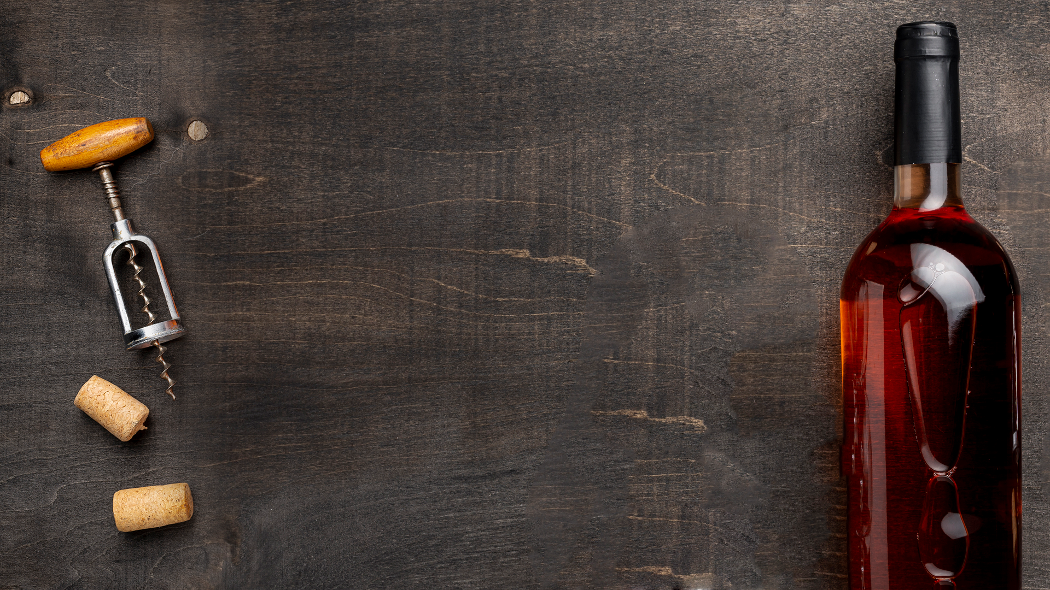
02.
HISTORY
OF VITICULTURE
AND WINE INDUSTRY

Slide 7
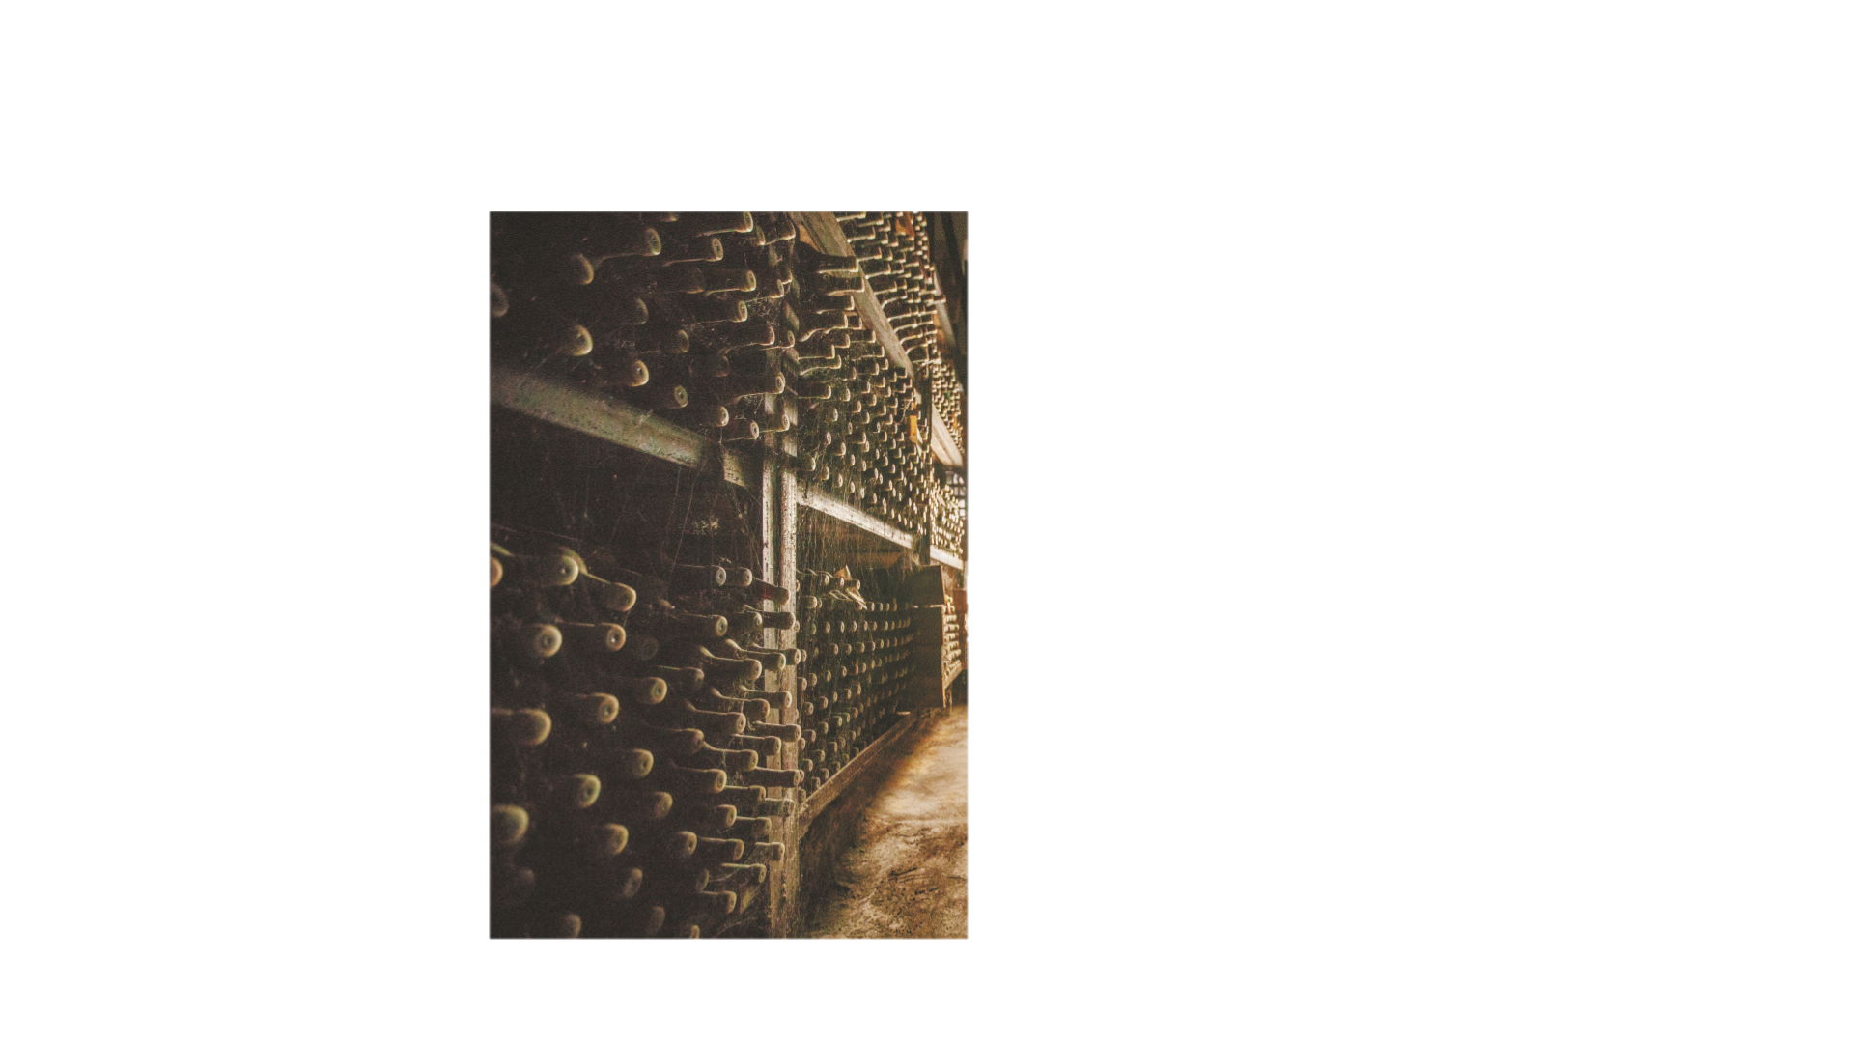
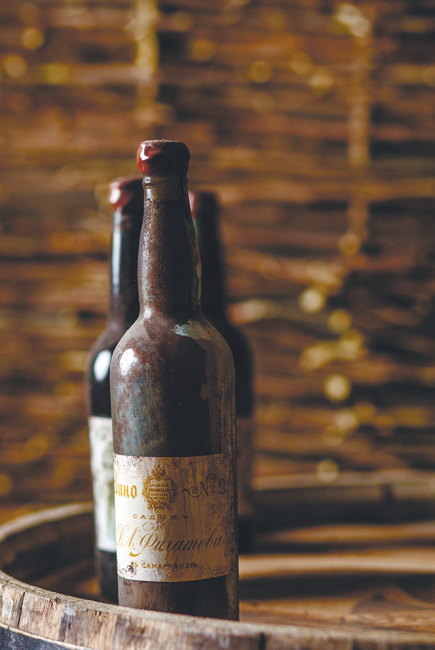
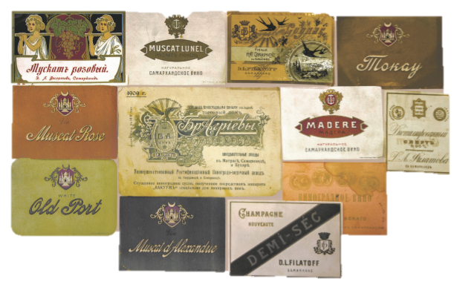
Brief history of the development of viticulture and winemaking in Uzbekistan
The culture of wine production on the territory of modern Uzbekistan began in ancient times.
It is assumed that grapes in Central Asia were cultivated about 6 thousand years ago
As a result of the campaigns of Alexander the Great, the Greco-Bactrian culture emerged on the territory of modern Uzbekistan, which contributed to the development of local viticulture and winemaking, as wine played a significant role in the life of the ancient Greeks.
The Venetian traveler Marco Polo wrote in his diary: "I had the opportunity to drink wine from the local population and it was wonderful for its excellent quality. I had never drunk anything like it before.
In the Soviet Union, Uzbekistan was one of the centers of winemaking. By 1980 Uzbekistan produced 13.6 million decaliters of grape wine, 58% of the total area of vineyards in the Central Asian region was concentrated in the Uzbekistan.
The area of technical and table varieties of vineyards was 250 thousand hectares.
However, the campaign against alcoholism, declared during the Soviet Union, caused great and irreparable damage to the wine industry. Huge areas of vineyards were cut down.
In 2021 the program of viticulture development for
2021-2024 was adopted. It is planned to increase the area of vine plantations, up to 150 thousand hectares, of which technical varieties up to 40 thousand hectares.

Slide 8
03.
ABOUT VITICULTURE
AND WINE INDUSTRY
IN UZBEKISTAN

Slide 9

Alcohol industry today
The alcohol and tobacco industries include:
44 enterprises for the production of wine and spirits
9 brewing company
7 ethanol producing companies
3 enterprises for the production of tobacco
Uzbekistan produces
161 kinds of grape wine
25 kinds of brandy
13 kinds of sparkling and carbonated wines
5 kinds of fruit wines
In 2022, 140 thousand tons of grapes processed, 20% annual growth in production

Slide 10

Export attractiveness of the industry
11th
The alcohol industry has a significant export potential, as today, most of the products produced are consumed within the country. While, among consumer countries, Kazakhstan dominates export volumes with 71% followed by Russia with 17% of the total volume of exports of alcoholic products
Export
destinations
in 2022
5th
The additional export potential of the industry is estimated to exceed $200 million.
The most promising destinations: the Russian Federation, China, Japan, South Korea
Other possible markets: India, Thailand and EU countries.
Place by area
of vineyards
Place by volume
of raisins exports

Slide 11
Investment benefits:
Enterprises are exempted from paying tax on income (profit), property tax, etc. on their main activity.
With the volume of direct private foreign investments:
From 300 k USD
to 3 mln USD
3 years
5 years
More than 3 mln USD up to 10 mln USD
More than 10 mln USD
7 years

Slide 12

The existing capacities of the industry make it possible to provide
200
thousand MT
4,76
mln dal
188
thousand dal
450
thousand dal
370,8
thousand dal
25,5
thousand dal
30,1
million dal
Industrial grape processing
wine
Sparkling and champagne wines
Brandy distillate
Brandy bottling
liqueur and vodka products
Beer

Slide 13

Thank you for attention
Rashid Tangriev
r.tangriev@miit.uz
+998 71 238 50 00 (dept. internal number / 194)
www.miit.uz
THE REPUBLIC OF UZBEKISTAN,
Tashkent, 100029
I.Karimov st., 1

