Slide 1
MODERN PRODUCTION TECHNOLOGIES
FOR RUBBER, RUBBER-metal
AND RUBBER-PLASTIC PRODUCTS

Slide 2

Grupa Sanok Rubber
1 172 mln PLN
3250 persons
EMPLOYMENT
(average employment as at 31.12.2021)
TURNOVER
(mln PLN in 2021 )
SANOK RC SA
OTHER SUBSIDIARIES
SANOK RC SA
OTHER SUBSIDIARIES

Slide 3
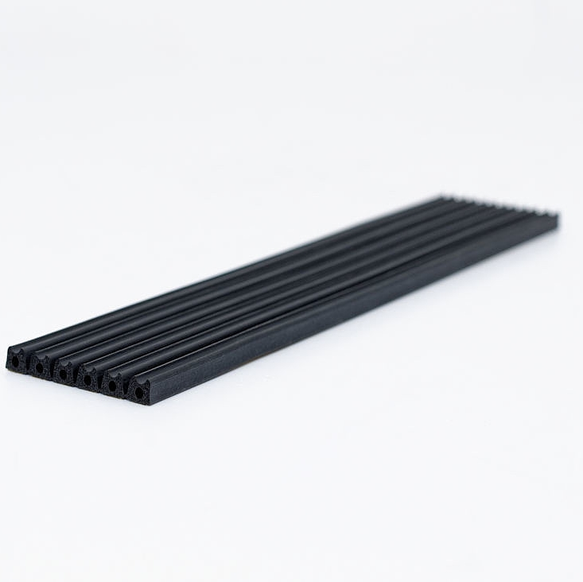
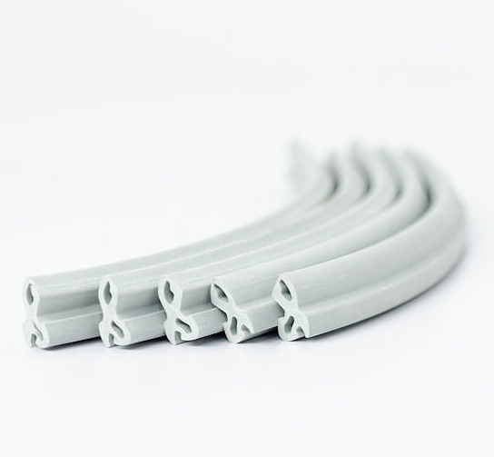
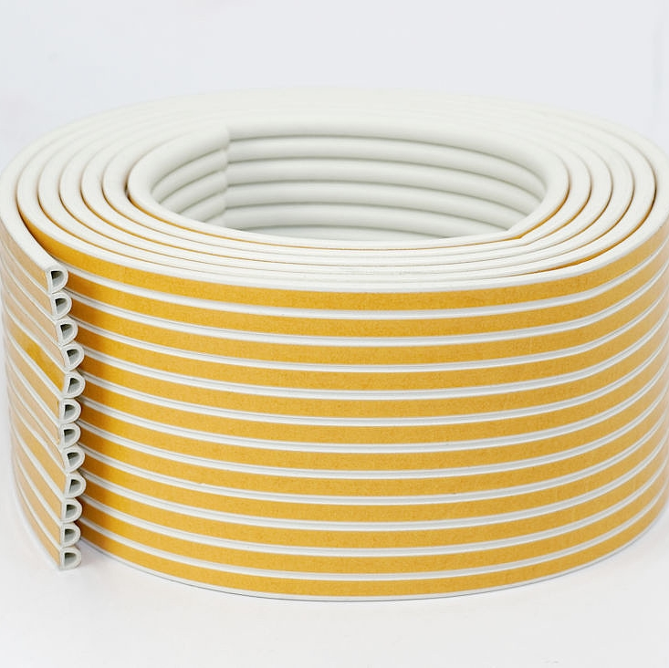
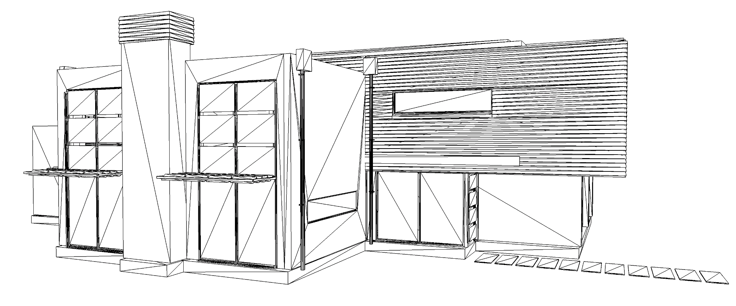
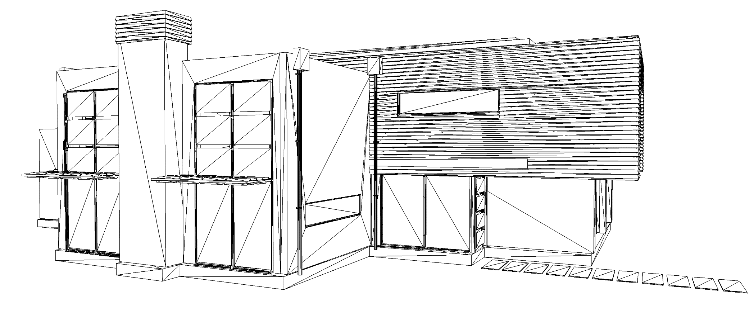

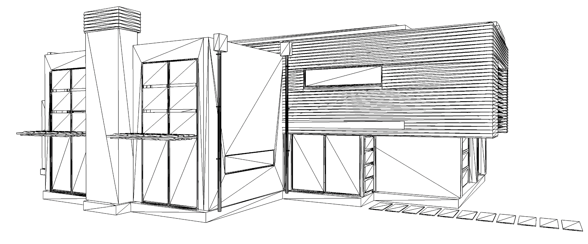
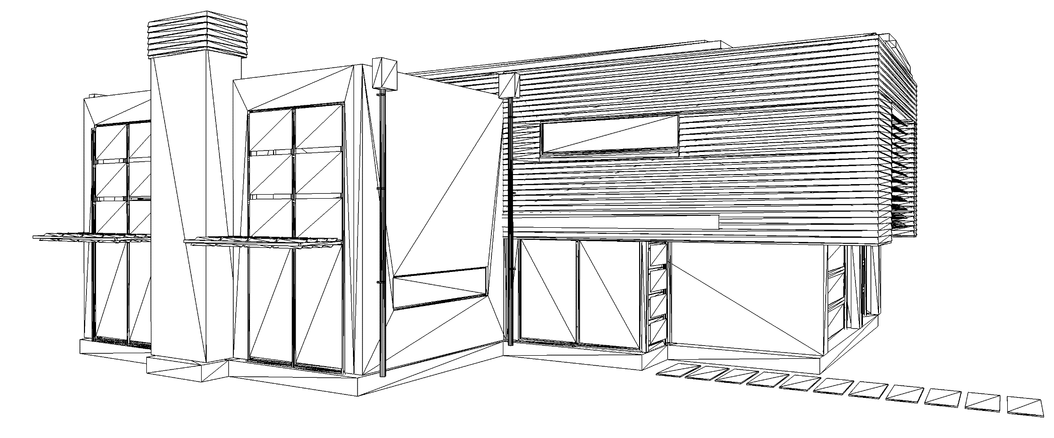
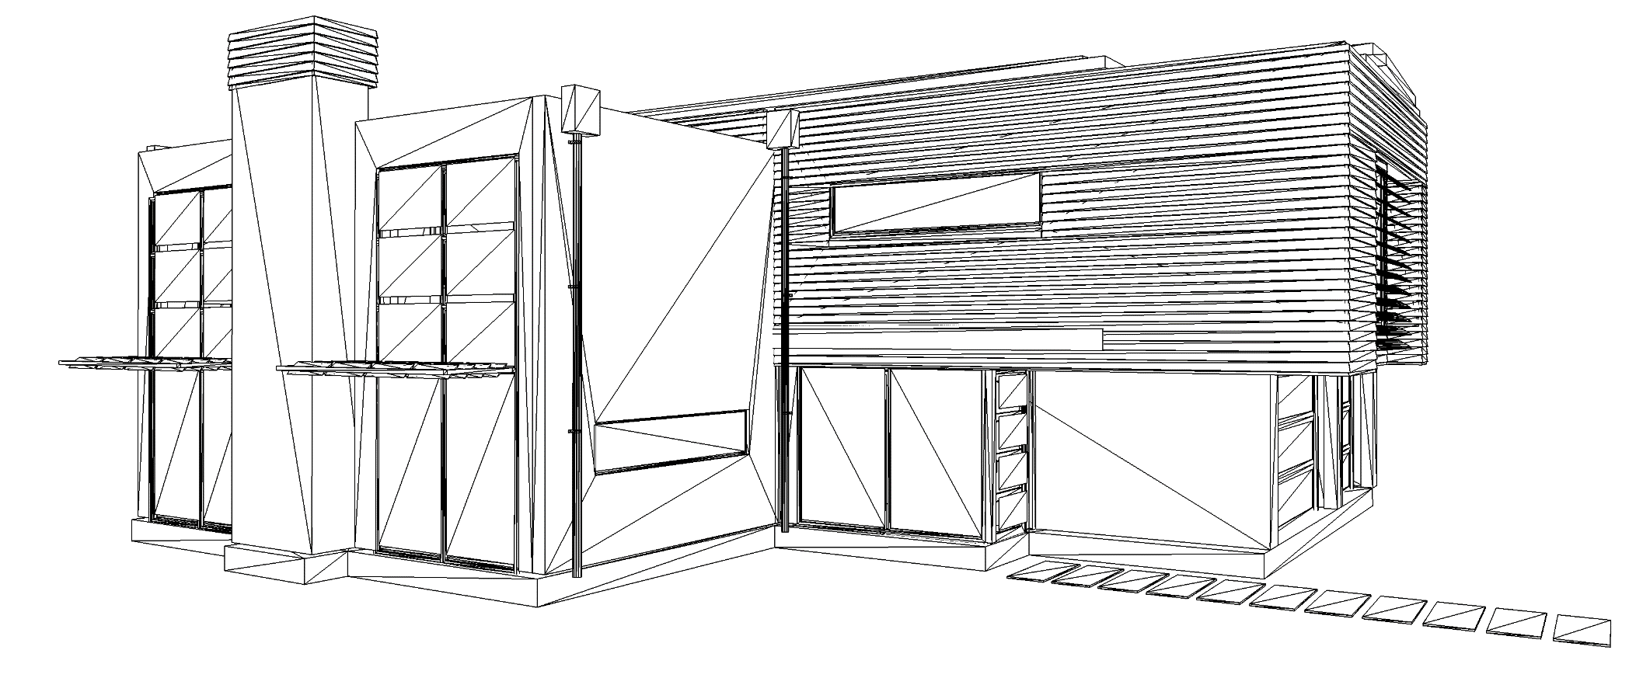

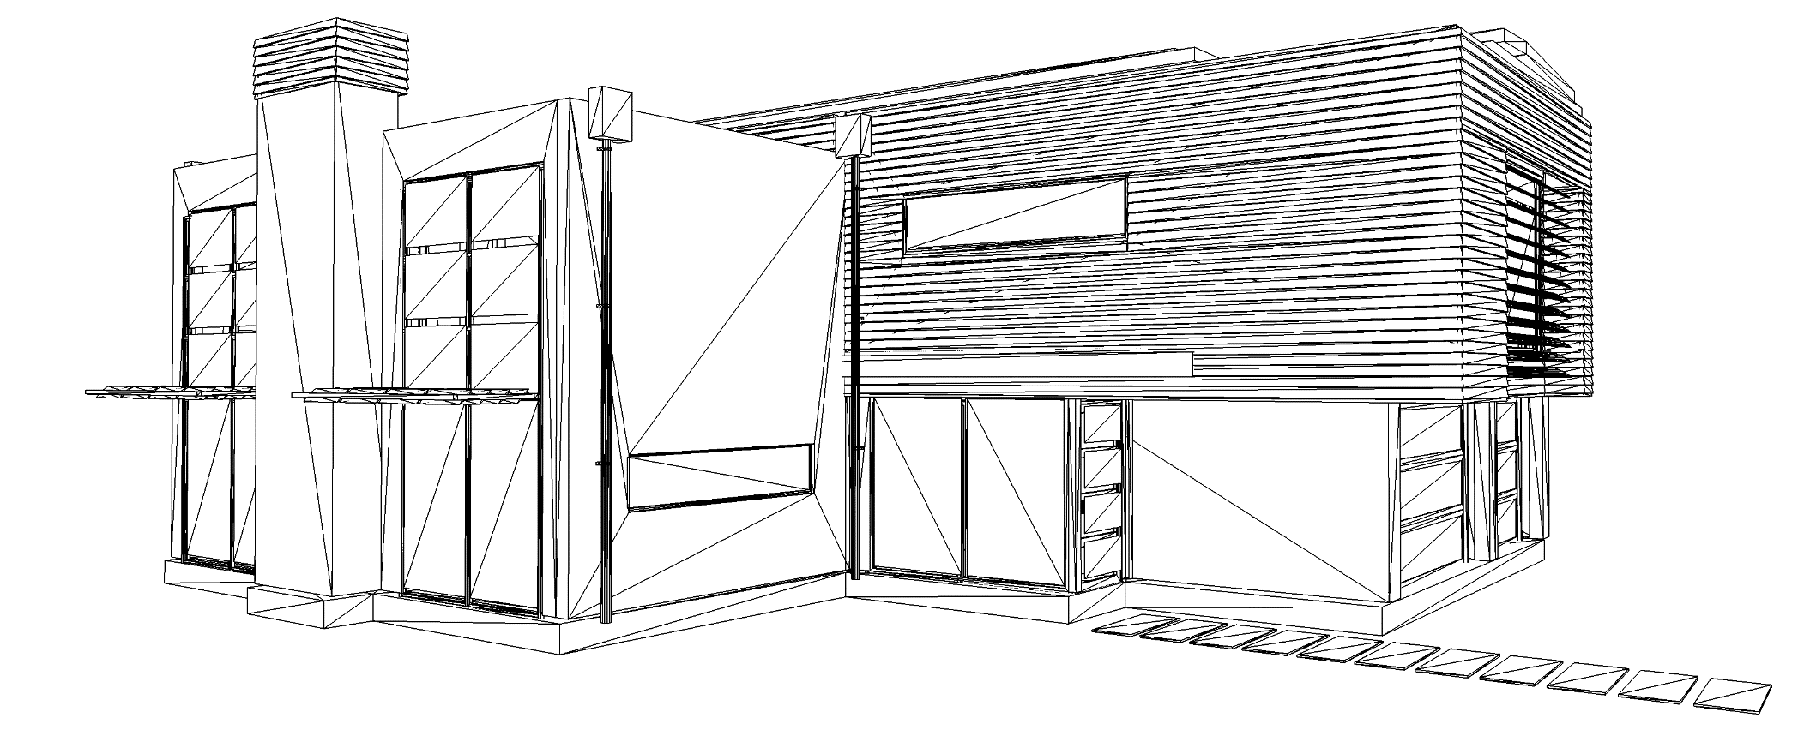
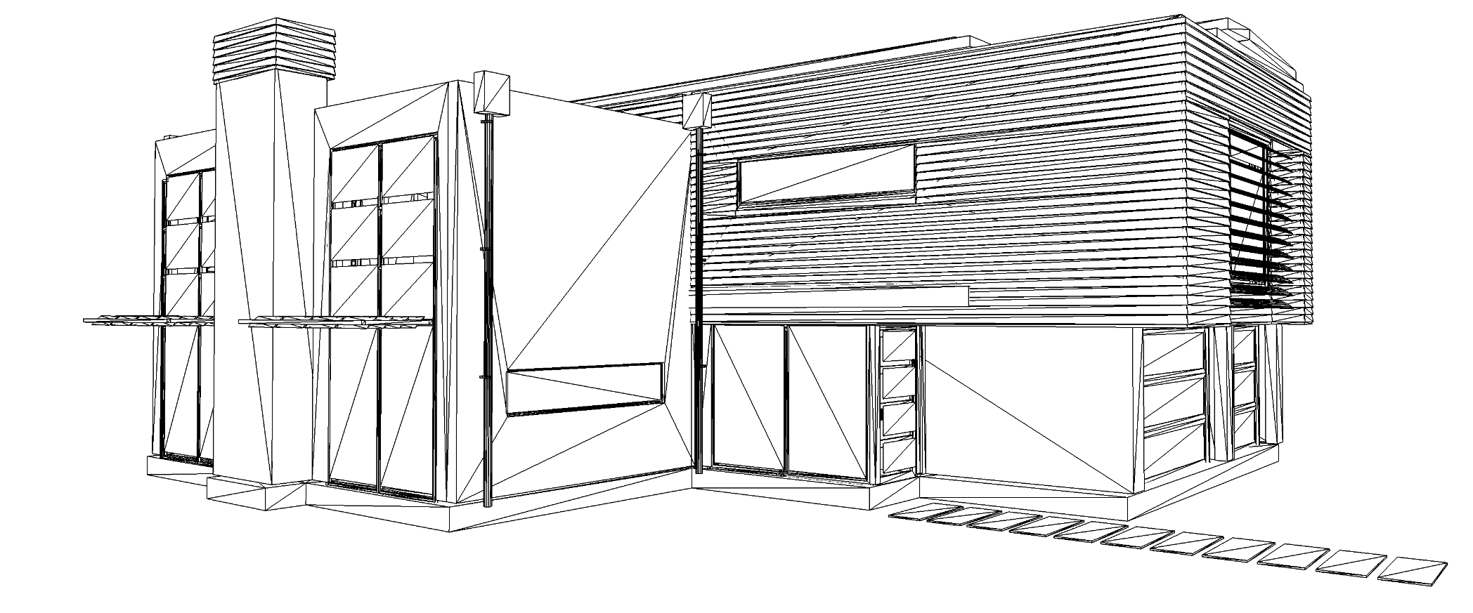
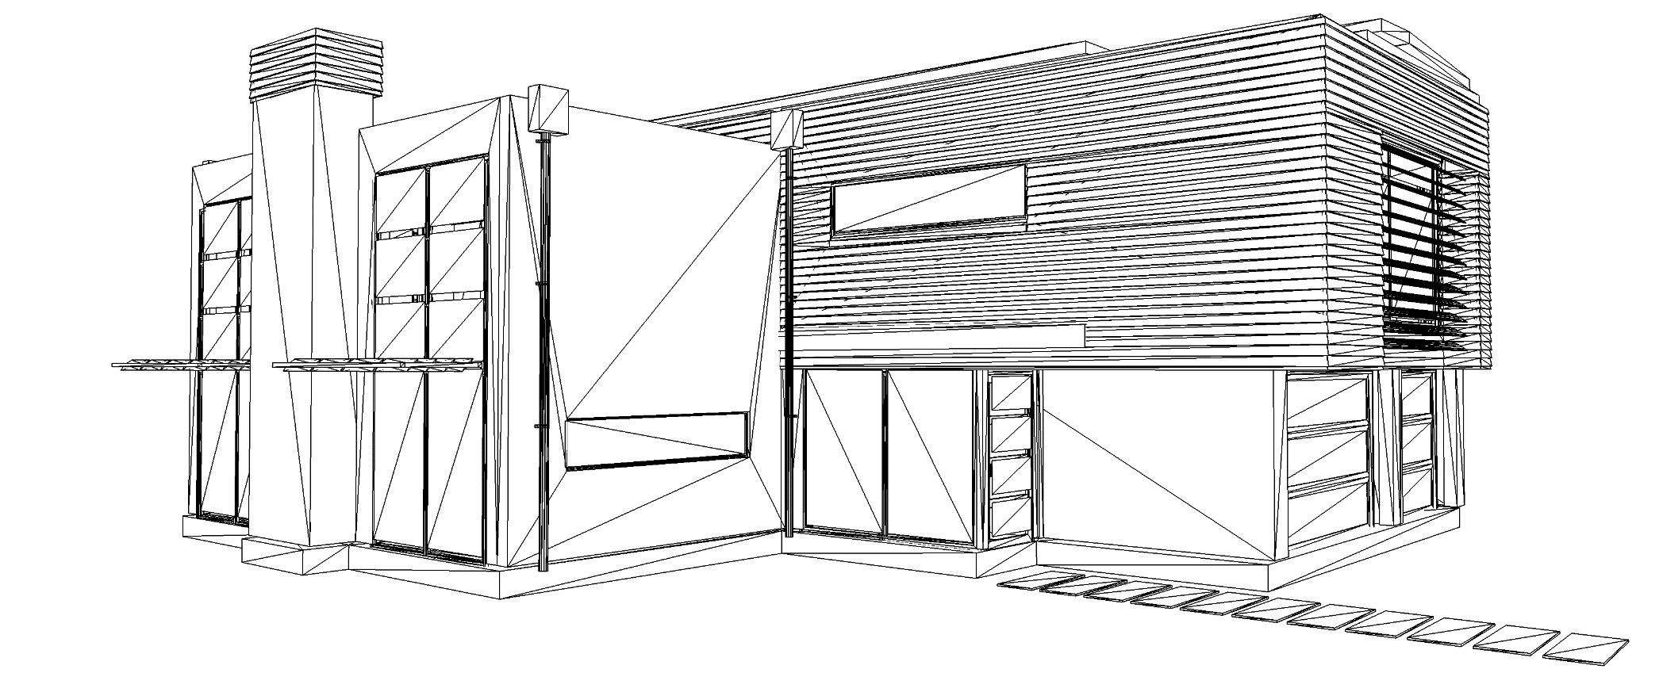
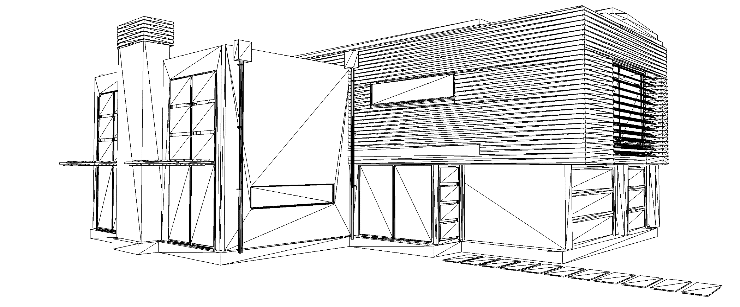
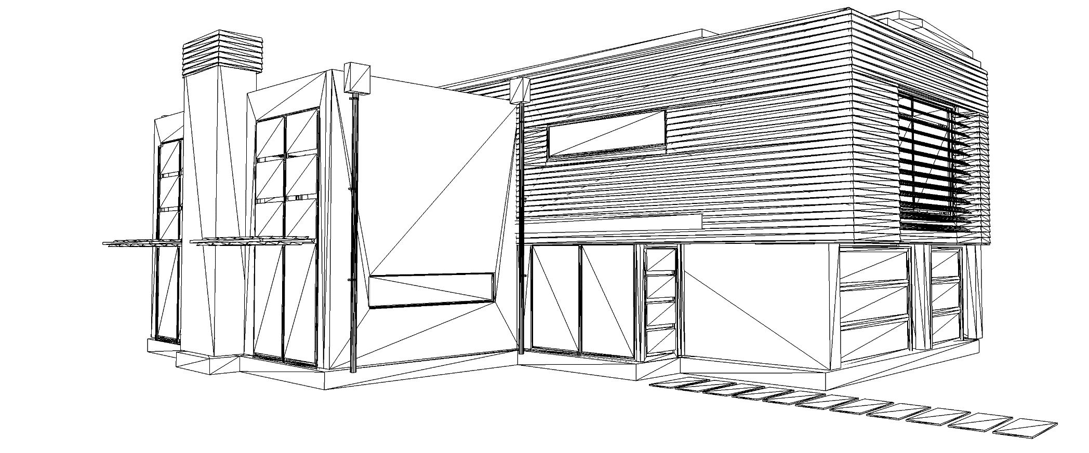
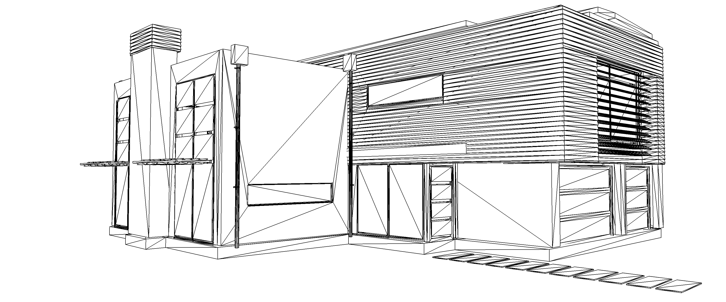
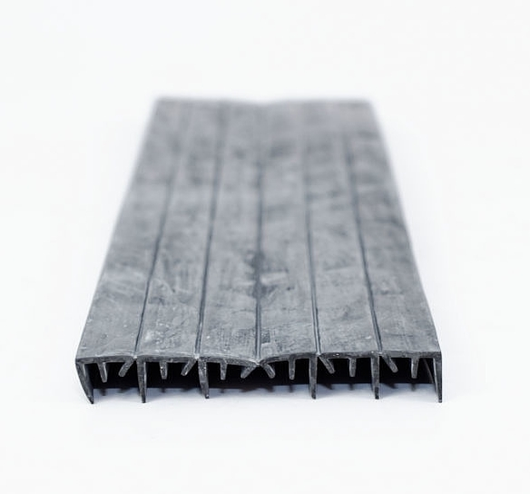

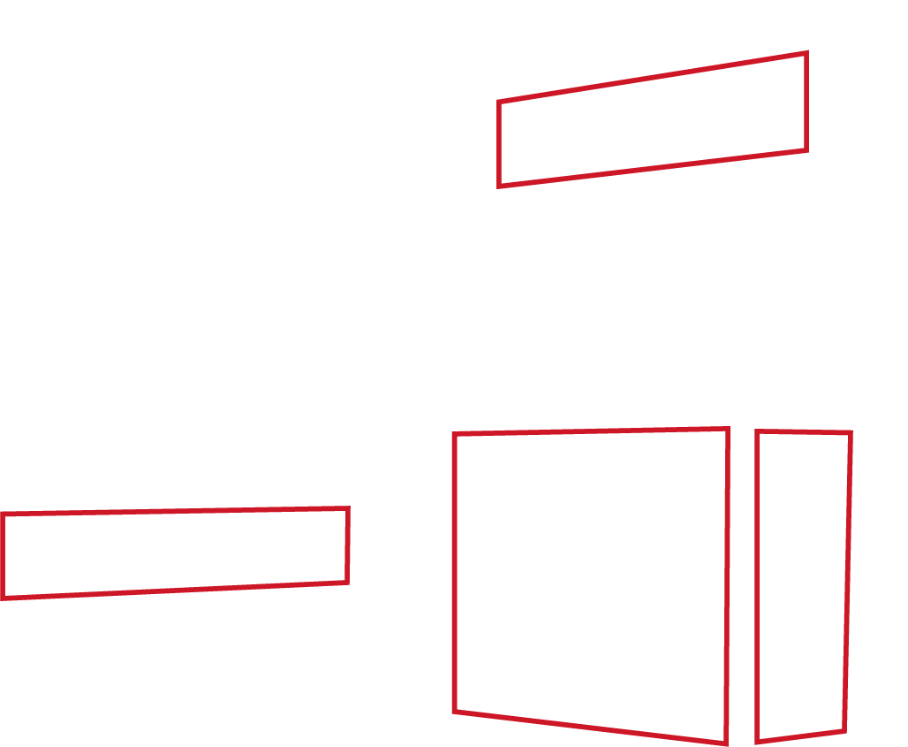


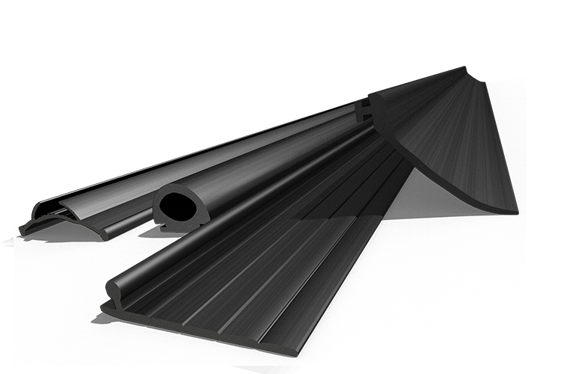
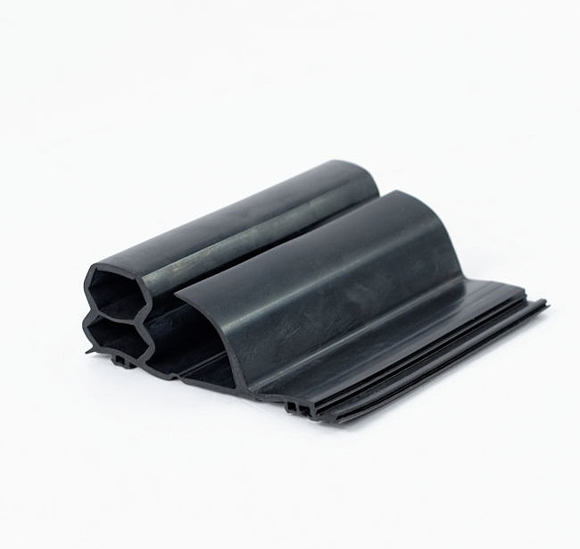

INFRASTRUCTURE
MAIN PRODUCTS:
1. Gaskets for PVC, aluminum and wooden windows
1
2. Self-adhesive gaskets for wood joinery
3
1
2
2
3. Gaskets for gutters
3
4. Gaskets for facade systems
4
5. Gaskets for ventilation systems
5
6. Gaskets for garage gates
6
5
6
4

Slide 4
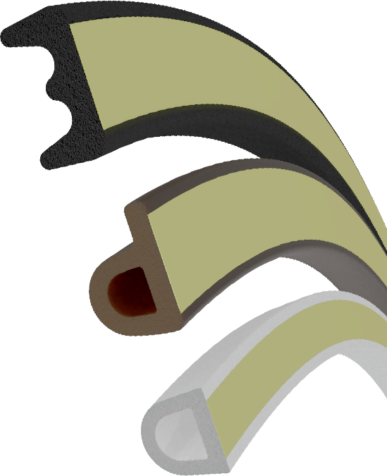
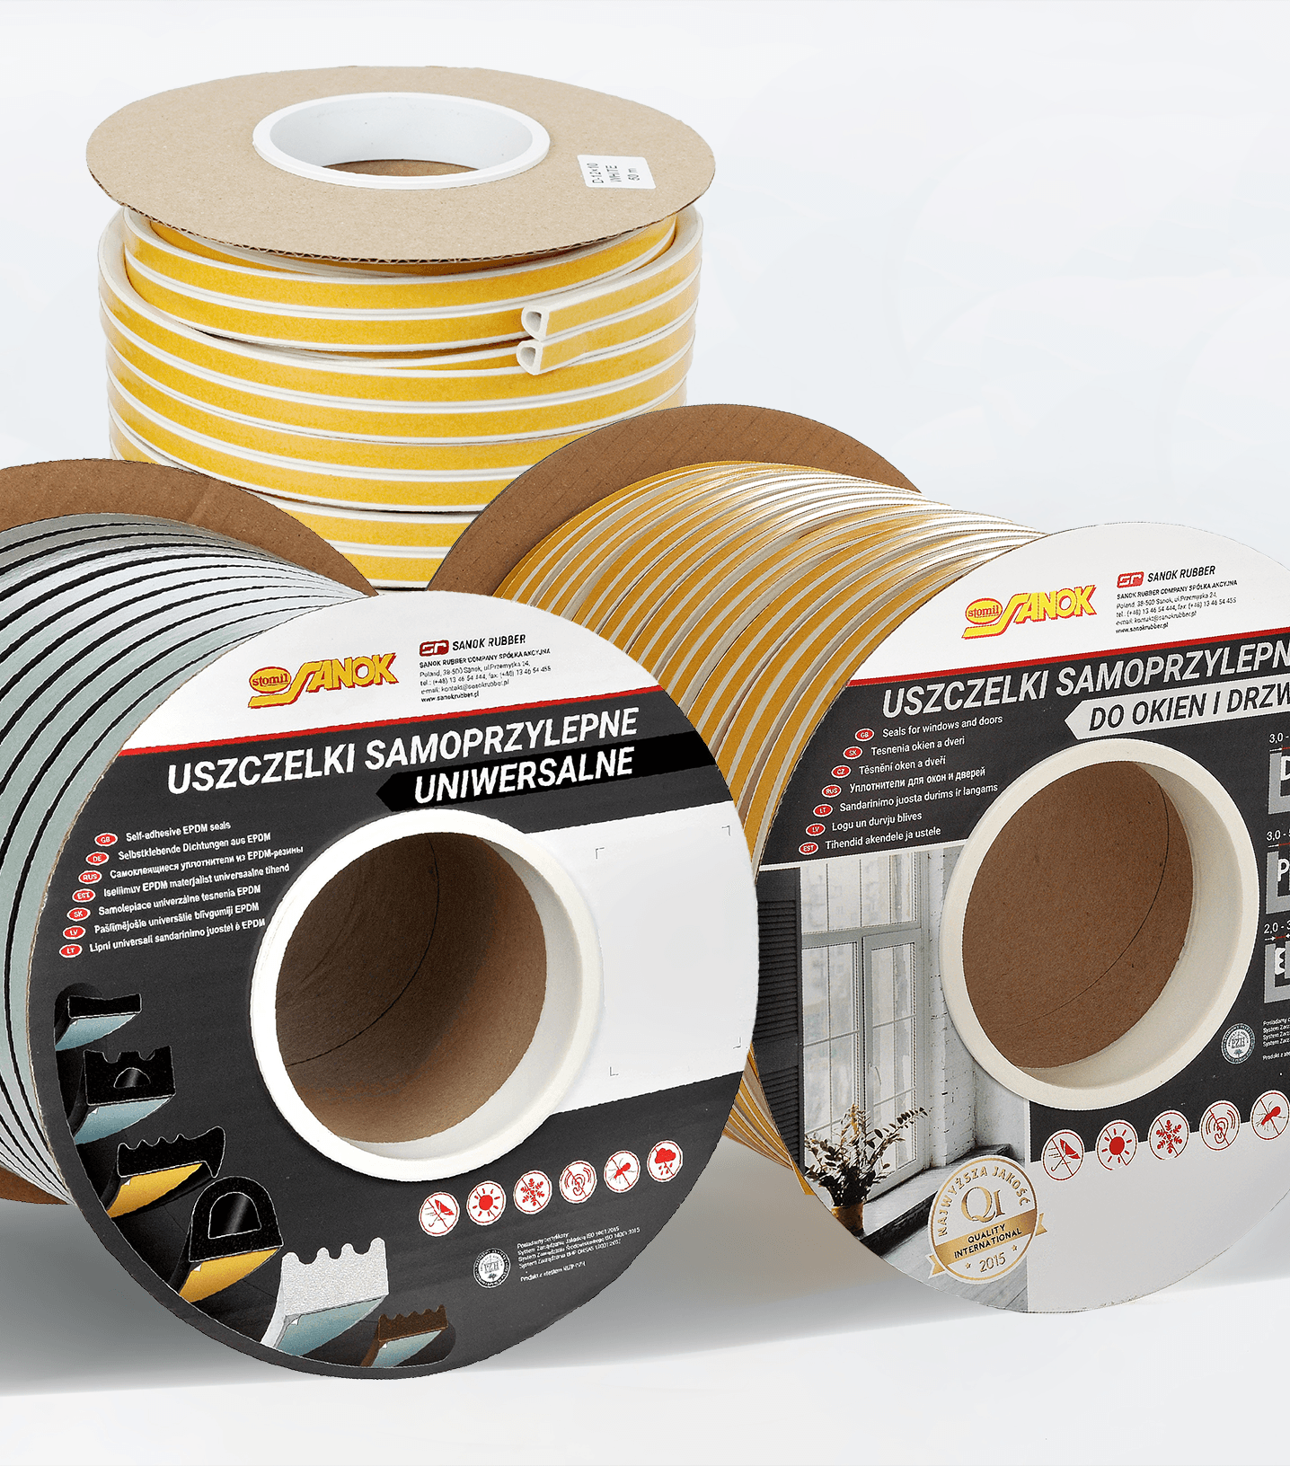
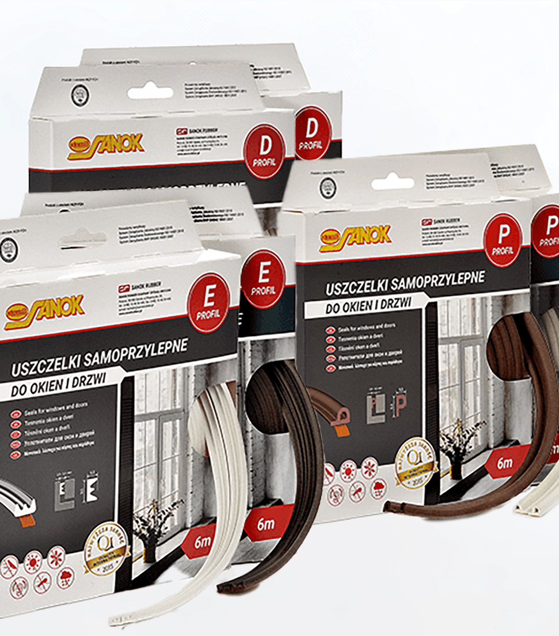
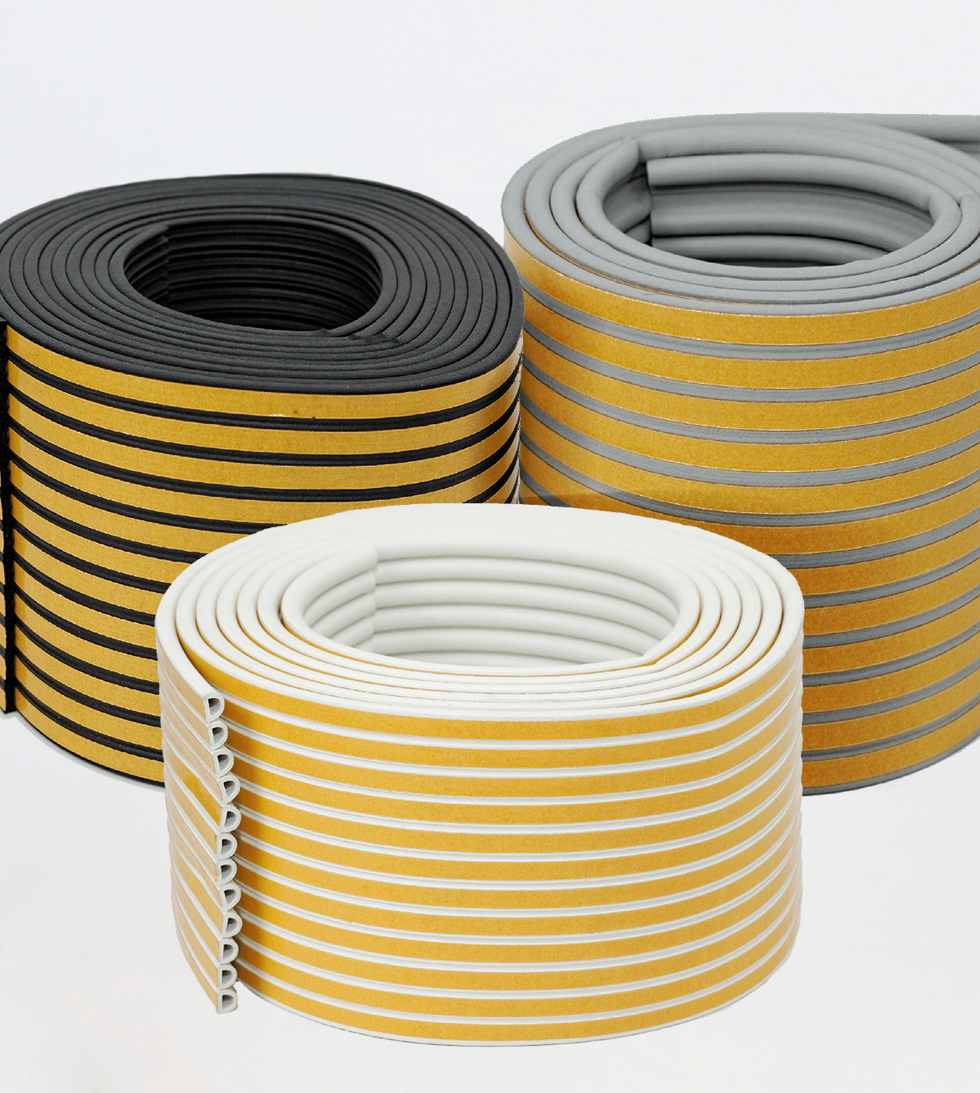
Possible packagings
ZZZZZ
BOBBINS
BOXES, BLISTERS & COILS
JUMBO ROLLS
Neutral and Branded bobbins in length range of 50m – 300m per piece. Packed in standard carton.
Customize Branded packagings in length range of 3m – 25m per piece. Packed in standard or pre-cuted carton.
Several outlets joined together by technological film wound on jumbo rolls and stacked one on another on pallet 1200mm x 1200mm

Slide 5
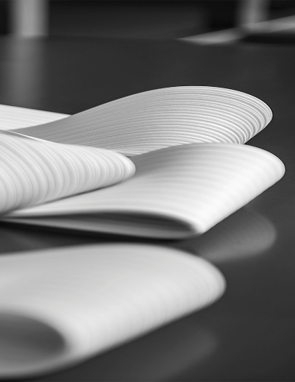


Thank you

