Slide 1

MINISTRY OF INDUSTRY AND CONSTRUCTION
OF THE REPUBLIC OF KAZAKHSTAN
INVESTMENT ATTRACTION
to the manufacturing industry
of the Republic of Kazakhstan
Astana, 2024

Slide 2
CURRENT STATE IN THE MANUFACTURING INDUSTRY
Potential for manufacturing industry development
financed from internal reserves
Supply potential
of processed goods
to the macroregion market
more than
$ 46.3
$ 294.7
billion
billion
(imports of the Republic of Kazakhstan for 2022)
(imports of other EAEU member countries for 2021)
Machinery | $ 19,9 billion
Chemical industry | $ 4,4 billion
Metallurgy | $ 3,3 billion
Light industry | $ 3,0 billion
Pharmaceuticals | $ 1,9 billion
Construction materials | $ 1,2 billion
Other industries | $ 12,6 billion
Machinery | $ 141,2 billion
Chemical industry | $ 27,9 billion
Metallurgy | $ 14,8 billion
Light industry | $ 20,5 billion
Pharmaceuticals | $ 16,5 billion
Construction materials | $ 4,5 billion
Other industries | $ 69,3 billion

Slide 3
MANUFACTURING INDUSTRIES
Manufacturing industries
have competitive advantages in attracting investments
1
Oil and gas engineering
2
Construction materials
3
Light industry
4
Agrochemistry
5
Steel industry
6
Aluminum industry
7
Copper industry
8
Lead industry
9
Rare and rare earth metals

Slide 4
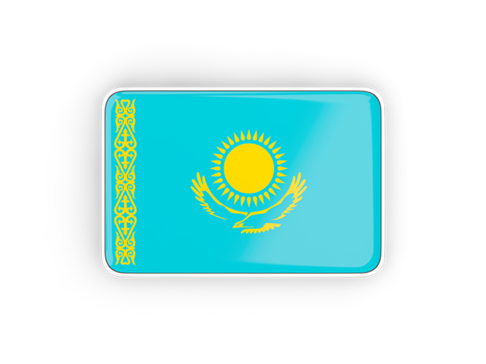


OIL AND GAS ENGINEERING
KEY INDICATORS FOR 2022
MACROREGION IMPORT*
PRODUCTION
KAZAKH IMPORT
$65
million
$955
million
$ 14 622
million
**imports of the machinery industry in the EAEU for 2021 - Russia, Belarus, Armenia, Kyrgyzstan

Slide 5
POTENTIAL INVESTMENT AREAS FOR OIL AND GAS ENGINEERING GOODS
products
Kazakh import
Import of Macroregion
(2021 г.)
$ million
thousand tons
$ million
thousand tons
1
FITTINGS for pipelines, boilers and tanks
279
25
2 101
164
2
PUMPS air or vacuum, gas compressors
200
7
735
63
3
MACHINERY AND MECHANICAL DEVICES
155
11
1 299
92
4
CENTRIFUGAL PUMPS
115
10
862
92
5
EQUIPMENT for water treatment and filtering
65
4
262
16
6
EQUIPMENT for sorting, screening and separation
74
9
103
12
7
PUMPS reciprocating positive displacement
52
8
303
14
8
EQUIPMENT for oil or fuel filtering in engines
60
7
379
39
9
MACHINERY AND UNITS for material processesing
43
3
1 051
70
10
POWER UNITS hydraulic engines (cylinders)
33
2
347
33

Slide 6
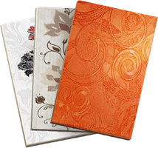
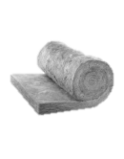
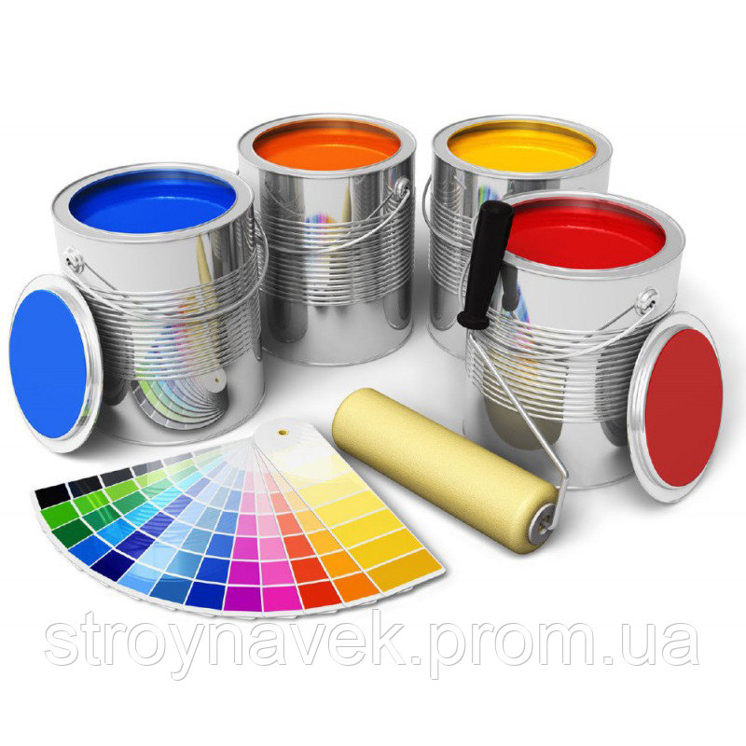
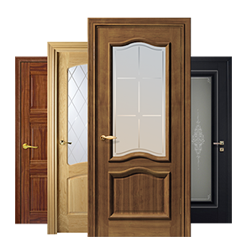
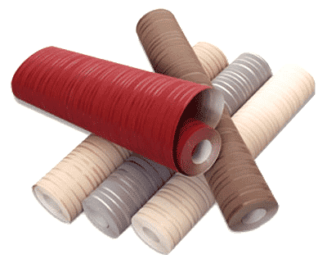

CONSTRUCTION INDUSTRY
DOMESTIC MARKET, 2022
IMPORT-DEPENDENT GOODS
$ 2.3 billion
Bathroom ceramics
Linoleum
Wallpaper
Soft roofing material
Ceramic tiles
Thermal insulating materials
$ 1.2 billion
Import 37%
Domestic manufacturers - 64%
MARKET DEMAND FOR PRODUCTS
HOUSING CONSTRUCTION 2023-2025
Ceramic tiles
Thermal insulating materials
Paints and varnishes
Interroom door units
Wallpaper
Bathroom ceramics
68
mln m ²
20.5
mln m ²
36
mln m ²
2.3
mln m ³
85.3
thousand tons
2.6
mln m ²
23.5
mln m ²
80
thousand pieces
2023
22.5
mln m ²
40
mln m ²
2.4
mln m ³
91.6
thousand tons
2.8
mln m ²
25.2
mln m ²
86
thousand pieces
2024
25
mln m ²
44
mln m ²
3.4
mln m ³
128.2
thousand tons
4.0
mln m ²
35.3
mln m ²
120
thousand pieces
2025

Slide 7
POTENTIAL INVESTMENT AREAS FOR CONSTRUCTION GOODS
products
Kazakh import
Import of Macroregion
(2021 г.)
$ million
thousand tons
$ million
thousand tons
1
CERAMIC TILES
143
433
548
1276
2
REFRACTORY BRICKS blocks, tiles and refractory ceramic building materials
81
79
114
91
3
WALLPAPERS AND WALL COVERINGS consisting of paper
64
17
162
44
4
BRICKS made of ceramics
64
1 002
32
327
5
SLAG WOOL, MINERAL SILICATE WOOL
in bulk, in sheets or rolls
58
73
53
83
6
LAMINATE
57
68
83
122
7
VINYL CHLORIDE POLYMER COATINGS FOR FLOOR , self-adhesive or non-self-adhesive (linoleum)
39
16
153
101
8
BATHROOM CERAMICS sinks, bathtubs, bidets, etc. from ceramics
35
30
83
39
9
REFRACTORY CEMENTS mortars and similar preparations
29
28
229
225

Slide 8
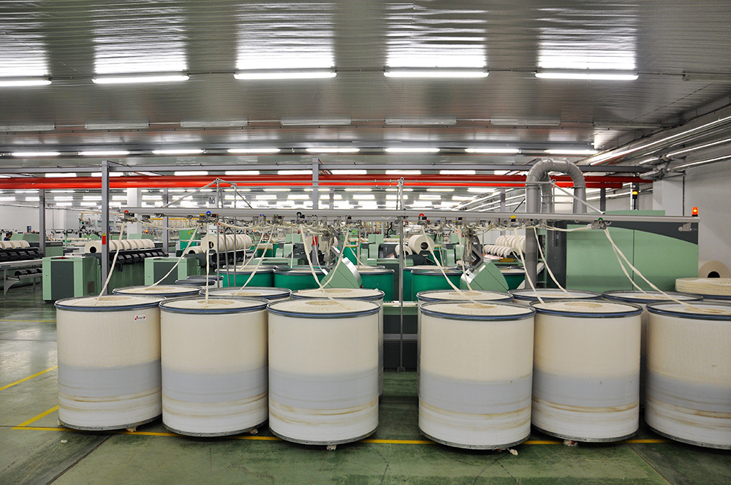
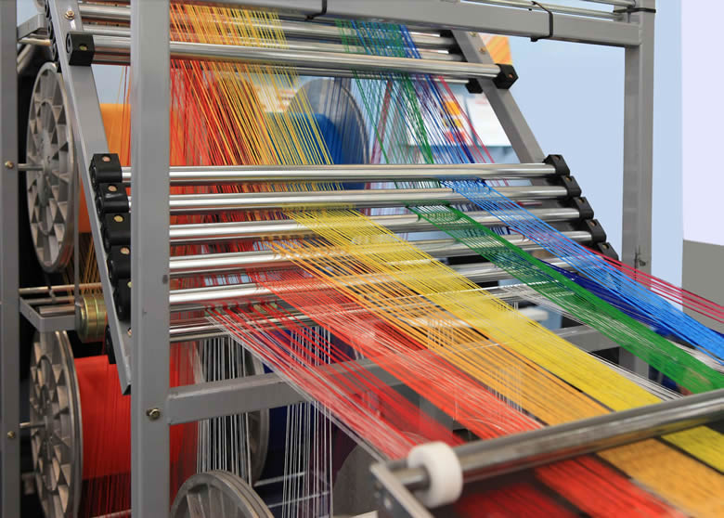
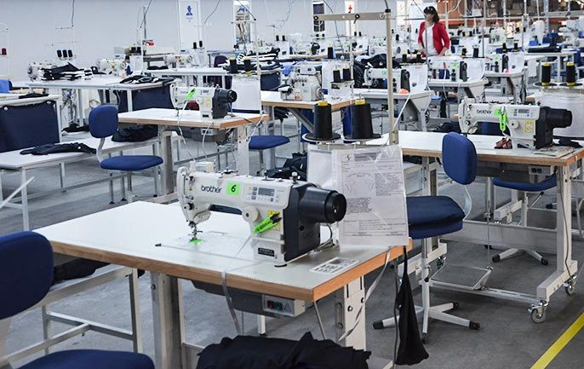
LIGHT INDUSTRY
Cotton fiber
Cotton yarn
Cotton fabric
Recycling
Production
Production
9
thousand tons
4
thousand tons
21
mln m2
55
thousand tons
Potential
Potential
Potential
46
thousand tons
40
thousand tons
165
mln m ²
Necessary
4
factory
Spinning mill
Textile factory
Garment factories

Slide 9
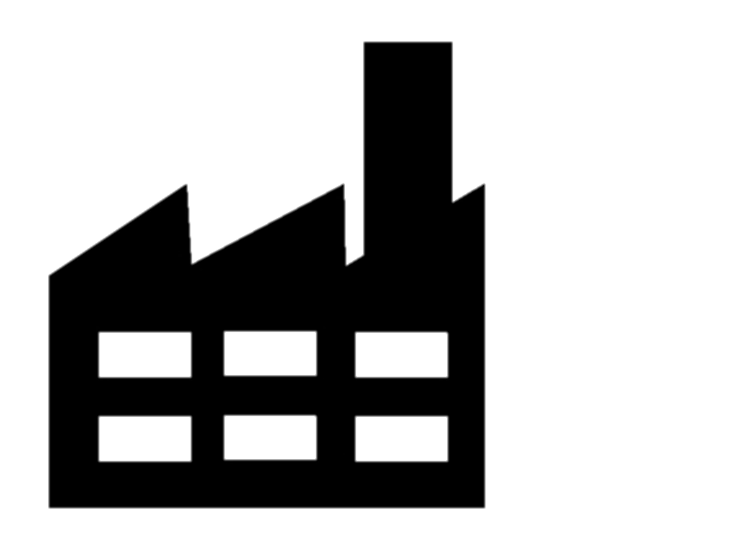
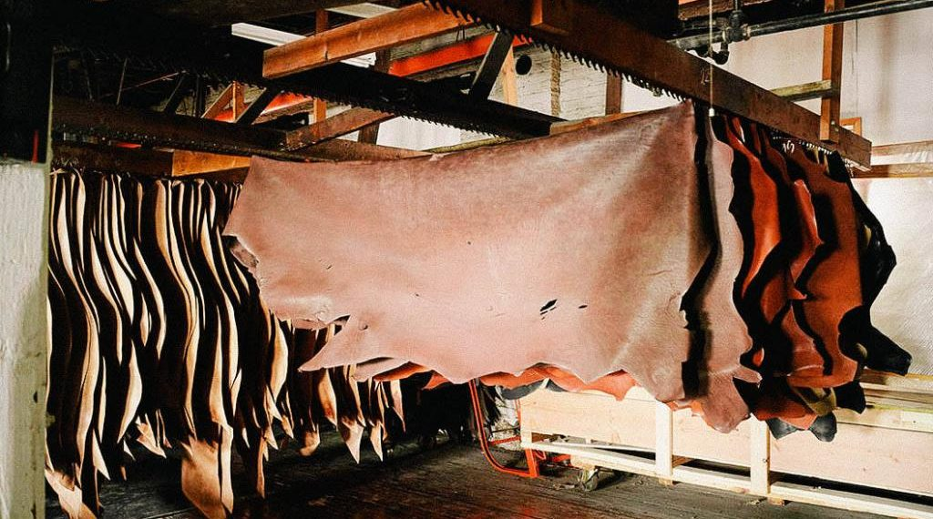
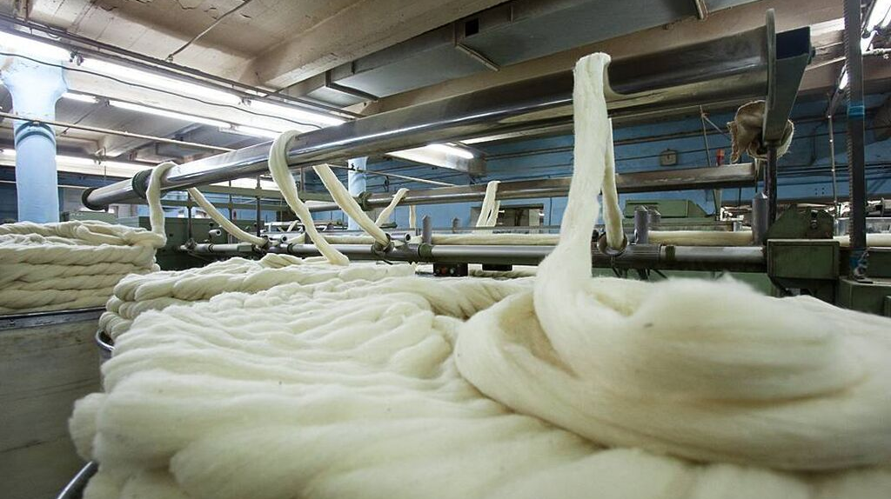
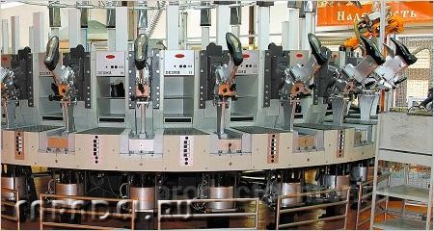
LIGHT INDUSTRY
Cattle skins
Wool
Recycling
For export
Recycling
516
thousand pieces
175
thousand pieces
15.2
thousand tons
3.4
million pieces
40.3
thousand tons
Potential
Potential
2.7
million pieces
25.1
thousand tons
currently
utilized
currently
utilized
Factories for construction
Factories
for leather dressing
Factories
for wool processing
Shoe factories

Slide 10
LIGHT INDUSTRY
SALES OF FINISHED PRODUCTS
State order
Subsoil users
State-linked sector
31,6
million tenge
35,8
million tenge
14,7
million tenge
82
bln. tenge
$178
million
Providing long-term orders in regulated procurements
on the terms of mutual obligations
$ 3 022
million
Retail market of the Republic of Kazakhstan
(import)
$ 23 495
million
20 473
million
Retail market of the macroregion (import)

Slide 11
POTENTIAL INVESTMENT AREAS IN LIGHT INDUSTRY
products
Kazakh import
Import of Macroregion
(2021 г.)
$ million
thousand tons
$ million
thousand tons
1
T-SHIRTS, SWEATSHIRTS WITH SLEEVES
of cotton yarn, crocheted or crocheted
106
9,3
642
40
2
FOOTWEAR with soles and uppers of rubber or plastics
102
12
478
67
3
PANTS, OVERALLS
breeches and shorts for women or girls, of cotton yarn
91
6
466
22
4
PANTS, OVERALLS
cotton breeches and shorts
85
4,4
420
21
5
HOSIERY AND FOOTLESS SHOES knitted/hand knitted from cotton yarn
81
16
224
33
6
SWEATERS, PULLOVERS, JUMPERS, VESTS
knitted/hand-knitted cotton yarn
73
3,3
567
27
7
FOOTWEAR with rubber or plastic soles
54
3,2
925
66
8
TOILET AND KITCHEN LINEN
from terry materials with cotton yarn
54
11
112
22
9
FOOTWEAR with soles of rubber, plastics, natural or composition leather, with uppers of natural leather
27
1
702
30

Slide 12
AGROCHEMISTRY
DEMANDED
FERTILIZERS
VOLUME
SHARE OTP
2022
Total production - 770,4 thousand tons
Ammonium nitrate
KazAzot JSC
310,9
62%
production
for the domestic market
493,6 thousand tons
50,5%
Ammophos (MAP/DAP)
Kazphosphate LLP
446,4
72%
Ammonium sulfate
AMT JSC, Talas Investment LLP
export
276,8 thousand tons
26
3%
CONSUMPTION
977
thousand tons
Urea
Not produced in the Republic of Kazakhstan
SHARE OF DOMESTIC MANIFACTURERS ON
DOMESTIC MARKET
0
0%
import
483 thousand tons
49,5%
Sulfoammophos
Not produced in the Republic of Kazakhstan
50,5 %
0
0%
(the share of the Russian Federation in imports is 77%)
Complex ( NPK )
Not produced in the Republic of Kazakhstan
0
0%

Slide 13
POTENTIAL INVESTMENT AREAS FOR AGROCHEMISTRY GOODS
Kazakh import
Import of Macroregion
(2021 г.)
products
$ million
thousand tons
$ million
thousand tons
1
HERBICIDES
anti-sprouting products and plant growth regulators
195,1
22,6
308
44
2
FUNGICIDES
36
2,6
321
28

Slide 14

IRON ORE PROCESSING
CURRENT STATE OF THE INDUSTRY
Processing
5,6
32,8
million tons
14
million tons
million tons
Potential
8,4
A plant is needed
million tons
Mining (iron ore)
Enrichment (concentrate)
NOW EXPORTED:
China – 5,6 million tons
Russia – 2,8 million tons
POTENTIAL
8,6
million tons per year
THE INDICATED VOLUME OF IRON ORE EXPORT IS THE POTENTIAL FOR THE IMPLEMENTATION OF THE PROJECT FOR THE PRODUCTION OF HOT BRIQUETTED IRON

Slide 15
POTENTIAL INVESTMENT AREAS FOR STEEL GOODS
Import of KZ
(2022)
Import of Macroregion
(2021 г.)
products
$ million
thousand tons
$ million
thousand tons
1
REBAR
538
734
698
978
2
FLAT-ROLLED PRODUCTS
500
533
1507
1 298
3
BILLETS of iron or non-alloy steel
420
678
8
12
4
PIPES welded and longitudinal
404
280
440
400
5
STRUCTURAL STEEL angles, channels, I-beams and wire rod
259
253
247
251
6
WIRE ROD
75
87
65
31

Slide 16
ALUMINUM INDUSTRY
CURRENT STATE OF THE INDUSTRY
Processing
Processing
486
thousand tons
42
thousand tons
1,3
million tons
Processing
249
thousand tons
Potential
Potential
918
thousand tons
207
thousand tons
An electrolysis plant is needed
A plant is needed
Enrichment (alumina)
Primary aluminum production
Production of finished goods
DEVELOPMENT POTENTIAL BY COMMODITY
ALUMINUM PRODUCTS
Aluminum unalloyed
Cylindrical containers
Cast products
Wire
Construction metal structures
Foil
$166
million

Slide 17
POTENTIAL INVESTMENT AREAS FOR ALUMINUM COMMODITIES
products
Import of KZ
(2022)
Import of Macroregion
(2021 г.)
$ million
thousand tons
$ million
thousand tons
1
PLATES, SHEETS, STRIPS OR RECTANGULAR TAPES
63
12
170
45
2
RODS AND PROFILES from aluminum alloys
25
6
107
21
3
ROD
18
6
102
38
4
HOLLOW PROFILES
15
3
183
38
5
FOIL
12
2
52
10
6
POWDERS aluminum
6
1
5
1

Slide 18
COPPER INDUSTRY
CURRENT STATE OF THE INDUSTRY
Processing
Processing
1,5
million tons
7,5
thousand tons
3
million tons
Processing
453
thousand tons
Potential
Potential
1,5
million tons
445,5
thousand tons
A copper smelter is needed
A plant is needed
copper concentrate
Production
copper cathode
Production of finished goods
DEVELOPMENT POTENTIAL BY COMMODITY
COPPER PRODUCTS
Fittings for pipes and tubes made of copper alloys
Plates, sheets and strips
Pipes and tubes
Wire
Foil
$74
million

Slide 19
POTENTIAL INVESTMENT AREAS FOR COPPER COMMODITIES
products
Import of KZ
(2022)
Import of Macroregion
(2021 г.)
$ million
thousand tons
$ million
thousand tons
1
ROD
30
4
147
15
2
FITTINGS FOR PIPES AND TUBES
15
1
244
18
3
PIPES AND PIPES
6
0,5
151
14
4
PLATES, SHEETS, STRIPS AND TAPES
6
2
11
1
5
RODS AND PROFILES
4
0,4
13
1

Slide 20
LEAD INDUSTRY
CURRENT STATE OF THE INDUSTRY
Production
Processing
69
thousand tons
20
thousand tons
109
thousand tons
Import
Potential
141
thousand tons
89
thousand tons
A plant is needed
Lead concentrate
Lead production
Production of finished products
DEVELOPMENT POTENTIAL
BY COMMODITY
Lead products
Lead, unwrought
Plates, sheets or strips
Powders and flakes
LEAD PRODUCTS

Slide 21



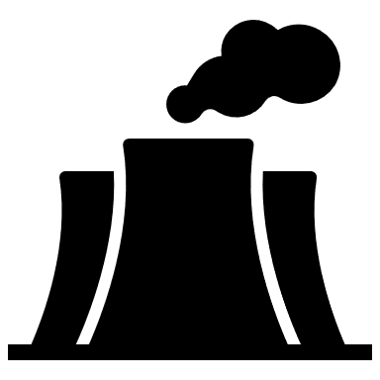
STATE PREFERENCES
GUARANTEED PURCHASE
1
OFFTAKE CONTRACTS
long-term, guaranteed purchase of processed goods
Customers
Government agencies
are the subject of collateral for lending in the STB and DBK;
it is not allowed to unilaterally make changes in terms of reducing the price or reducing the volume of the purchase;
in cases of refusal to redeem goods (not through the fault of the supplier), a penalty is provided
Subjects of the state and quasi-public sector
2
CONTRACT PROCUREMENT (OFFSET)
in addition to the purchase of manufacturing goods, conditions are provided for the investment of funds in the economy of the Republic of Kazakhstan
direct investments;
Investment in R&D;
creation of production;
construction of training centers;
infrastructure development;
technology transfer, etc.
Subsoil users engaged in non-renewal exploitation

Slide 22


GOVERNMENT FUNDING
AMOUNT OF FINANCING BY DEVELOPMENT INSTITUTIONS
DEVELOPMENT BANK OF KAZAKHSTAN
INDUSTRIAL
DEVELOPMENT FUND
QAZAQSTAN
INVESTMENT
CORPORATION
$1,3
bln
$0,2
billion
$1,05
billion
$0,07
billion
PRIORITY INCENTIVE SECTORS:
Light industry
Production of building materials
Mechanical engineering (manufacture of household appliances and elevators)
Metallurgy and metalworking
Development of mass production by creating small industrial parks in the regions
Development of SMEs

Slide 23


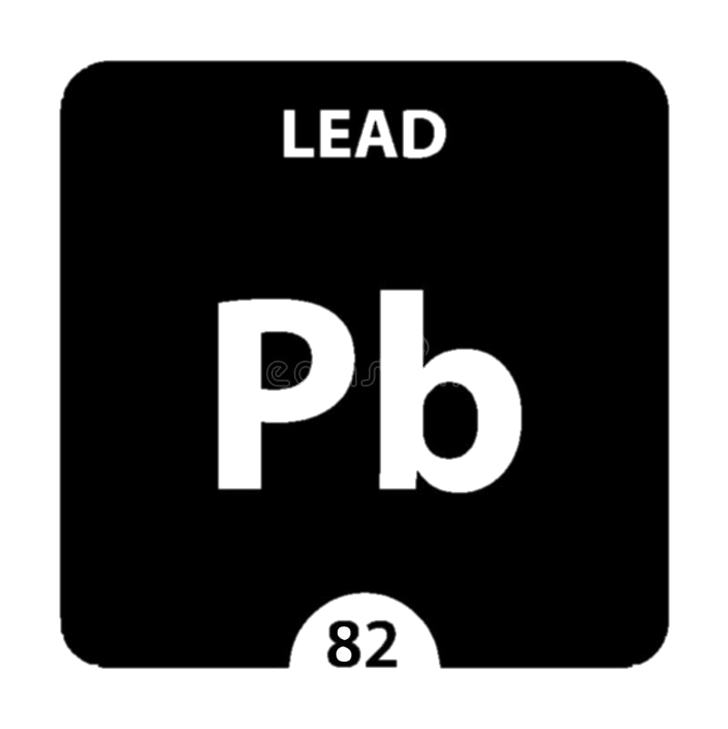

LIST OF NECESSARY PERSPECTIVE PLANTS FOR DEVELOPMENT IN KAZAKHSTAN
CURRENTLY BEING EXPORTED
CONSTRUCTION IS NEEDED
IORM
8,6
million tons per year
STEELMAKING PLANT
ALUMINA
830
thousand tons per year
ELECTROLYSIS PLANT
LEAD
FACTORIES FOR THE PRODUCTION OF FINISHED LEAD PRODUCTS
84
thousand tons per year

Slide 24
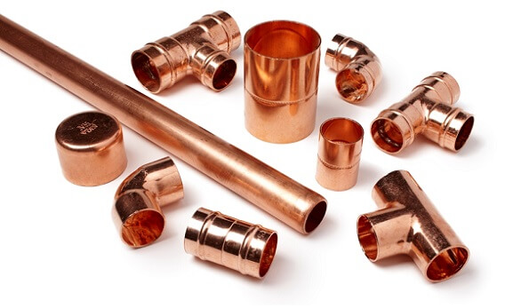
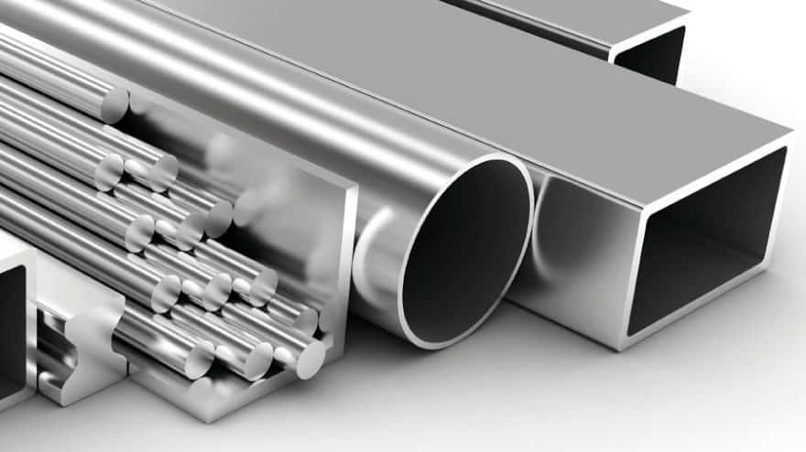
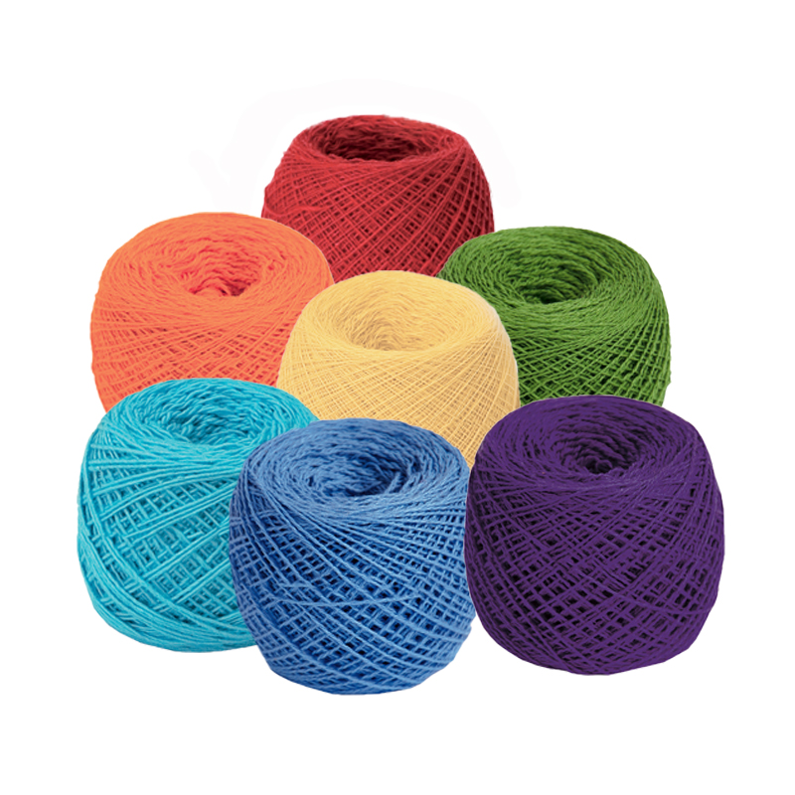
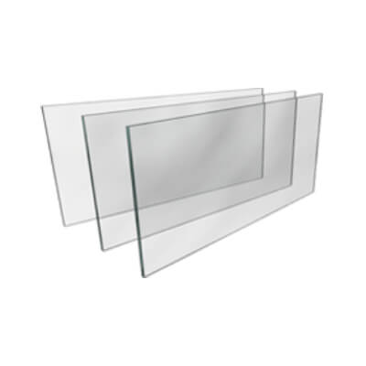
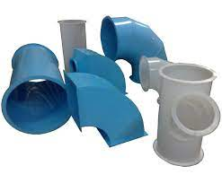
LIST OF NECESSARY PERSPECTIVE PLANTS FOR DEVELOPMENT IN KAZAKHSTAN
CURRENTLY BEING PRODUCED
thousand tons
DEEPENING OF PROCESSING
CATHODE COPPER
Pipe and tube fittings, plates, sheets and strips, pipes and tubes
453
PRIMARY ALUMINUM
Cylindrical containers, cast products, wire
and foil
249
COTTON FIBER
Yarn, textiles and ready-to-wear
55
SHEET GLASS
Glass containers, glass wool, glassware, auto glass and thin glass
197
POLYPROPYLENE
Geosynthetic fabrics, bags, big bags, plastic windows, pipes, tableware and furniture
500

Slide 25
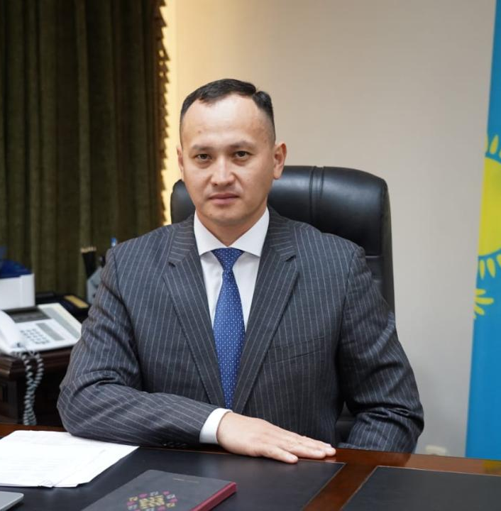


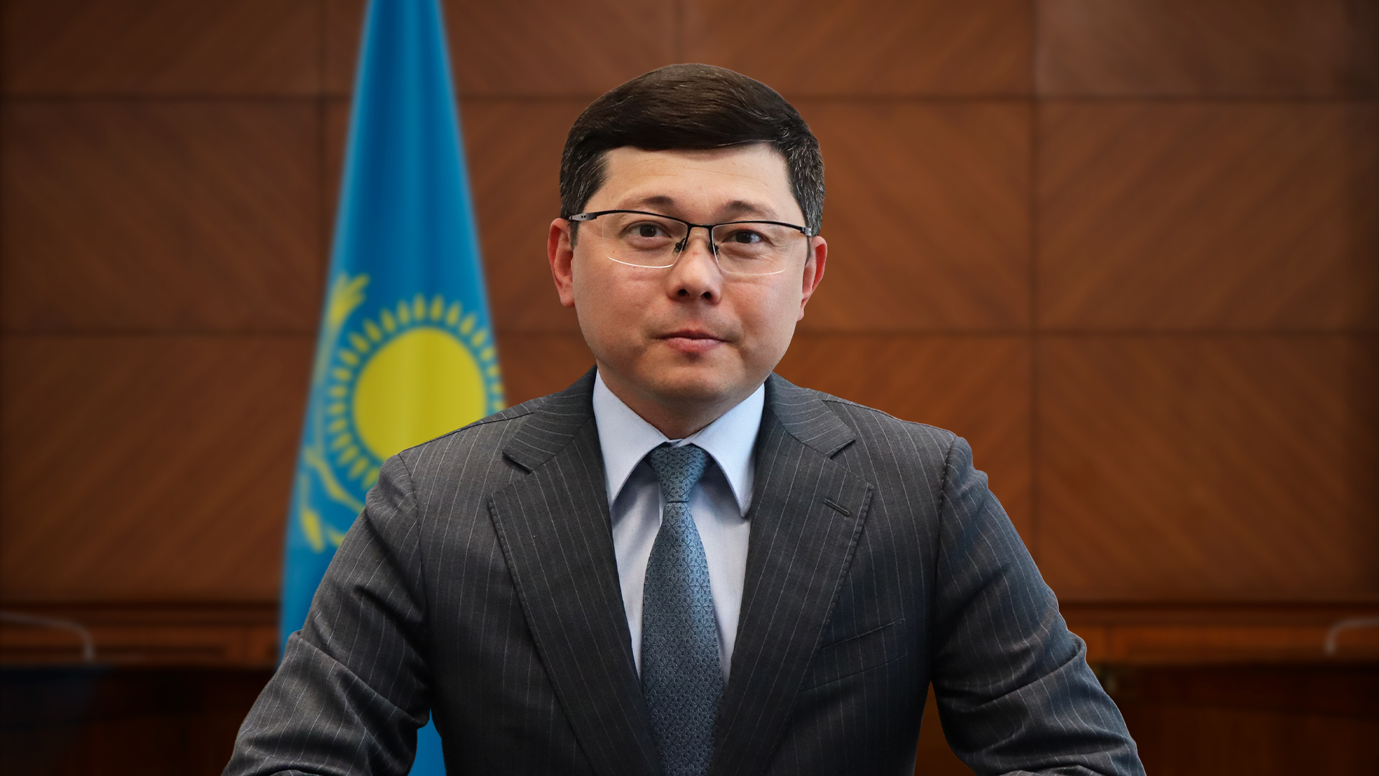
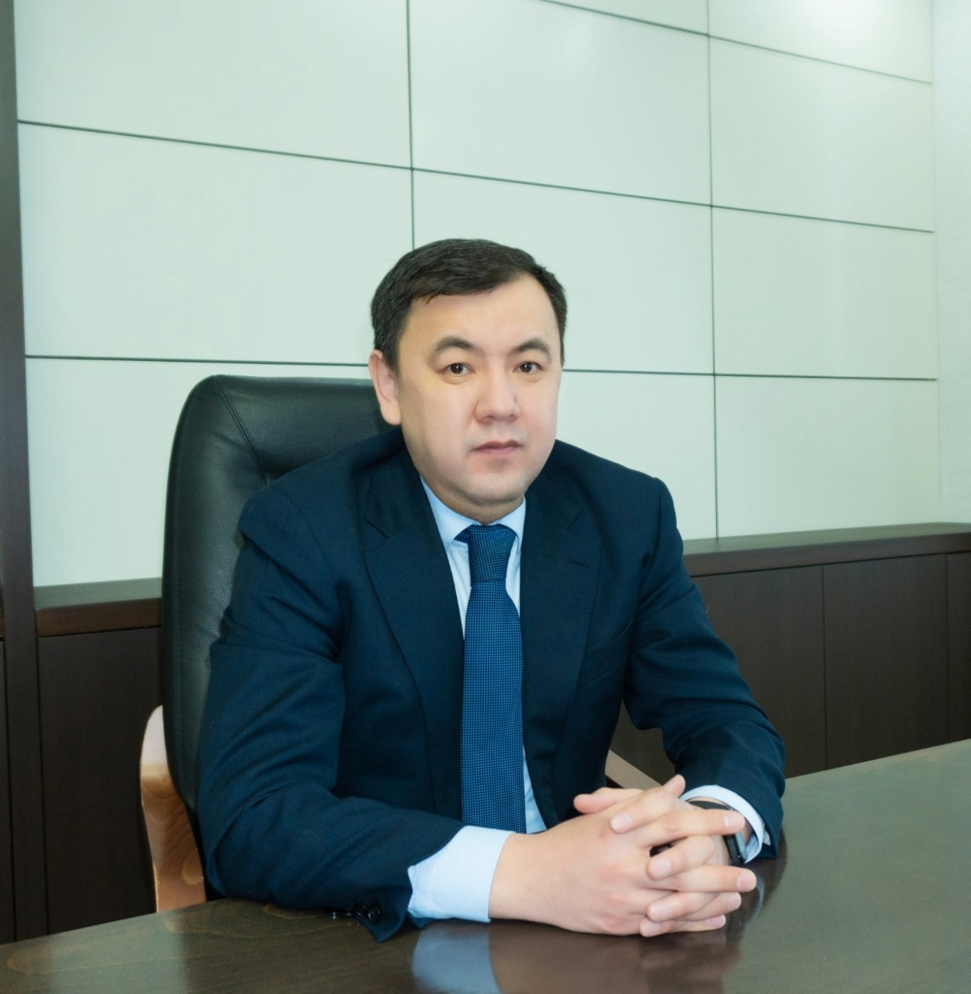
COOPERATION CONTACTS
Ministry of Industry and Construction of the Republic of Kazakhstan (MIC RK)
Vice-Minister - Ilyas Ospanov
+7 +7 701 513 95 83
i.ospanov@miid.gov.kz
Industrial Committee of the MIC RK
Chairman – Azamat Panbaev
+7 701 998 8743
a.panbaev@miid.gov.kz
Kazakhstan Center of Industry and Export "QazIndustry" JSC
Chairman of the Management Board - Berik Bekenov
+7 701 512 06 68
b.bekenov@qazindustry.gov.kz
Industrial Committee of the MIC RK
Head of the Department of Projects of the manufacturing industry – Doszhan Alibekov
+7 775 333 33 66
d.alibekov@miid.gov.kz

