Slide 1
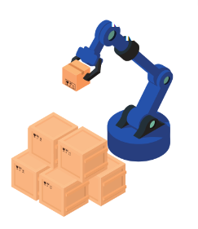
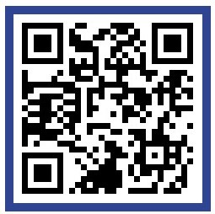



한-스 스마트 팩토리
글로벌 파트너링 포럼•상담회
날짜 | (오프라인) | 2024년 11월 12일(화) 포럼 | 09:30 – 12:00 (스위스시간)
 |  | 2024년 11월 12~13일(수) 스마트팩토리 견학, 1:1 대면상담 | 09:30 – 17:00 (스위스시간)
 | (온∙오프라인) | 2024년 11월 4일(월) – 29일(금) | 16:00 – 18:00 (한국시간*) *온라인 진행 시
장소 | Swiss Smart Factory, Swiss Innovation Park Biel/Bienne
프로그램 | 포럼 : | 한-스위스 스마트 산업 소개 및 사례 발표
 | 상담회 : | 1:1 비즈니스 상담회
문의 | 김성종 대리 | (sj.kim@kotra.ch / 전화번호 : +41 44 503 5307)

Slide 2
KOREA SWITZERLAND
SMART INDUSTRY DAY 2024
Date | (Offline) | 12 Nov 2024 (Tue) – Forum | 09:30 – 12:00 (Swiss time)
 | (Offline) | 12-13 Nov 2024 (Tue-Wed) Smart Factory Tour, 1:1 Business Meetings | 09:30 – 17:00 (Swiss time)
 | (On/Offline) | 4-29 Nov 2024 | 16:00 – 18:00 (Korean time) *For online meetings
Venue | Swiss Smart Factory, Swiss Innovation Park Biel/Bienne
Program | Forum | Korea-Switzerland Smart Industry Introduction
 | 1:1 Business meeting | 1:1 Meeting with Korean companies
Contact | Sungjong Kim | sj.kim@kotra.ch / Tel : +41 44 503 5307)
Registration | https://forms.gle/kHst2Pfq9GZDNMHU8

Slide 3
Mission
Enhancing Korean economy through trade promotion, foreign investment, and tech cooperation between Korean & foreign companies
Role
Organization
  Serves as a Global Business Platform
  Supports business partnerships between global enterprises and outstanding Korean SMEs
  Provides all types of foreign investment support in Korea
  Executes Government-Approved Projects
  Headquarters
- (Seoul) 6 divisions 33 departments 3 centers
- (Korea) 12 KOTRA support Centers, 1 Airport office
  Overseas
- 10 regional headquarters, 127 Overseas Trade Centers
(84 countries), 24 offices including KOTRA Zurich

Slide 4


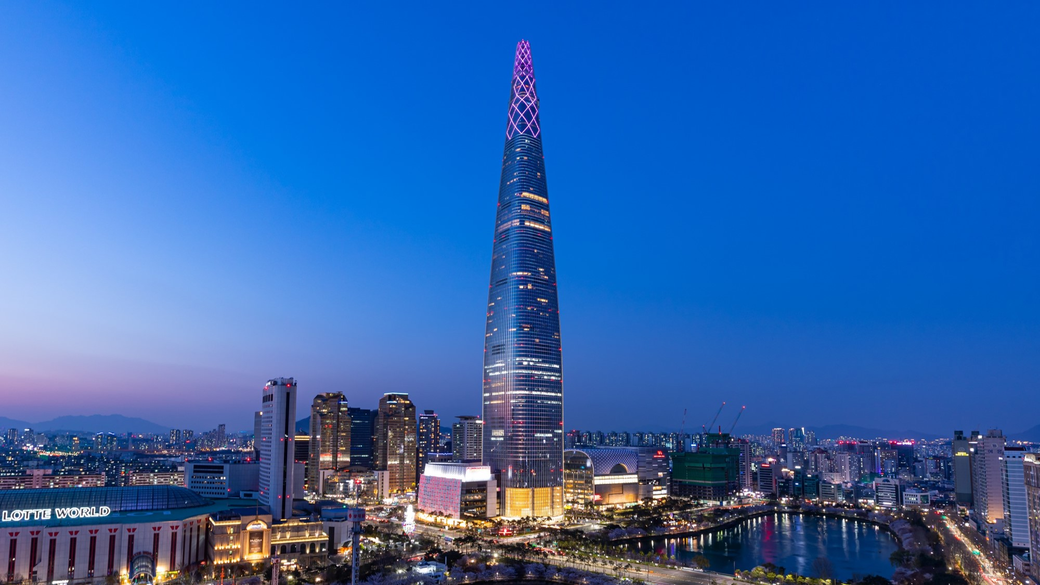

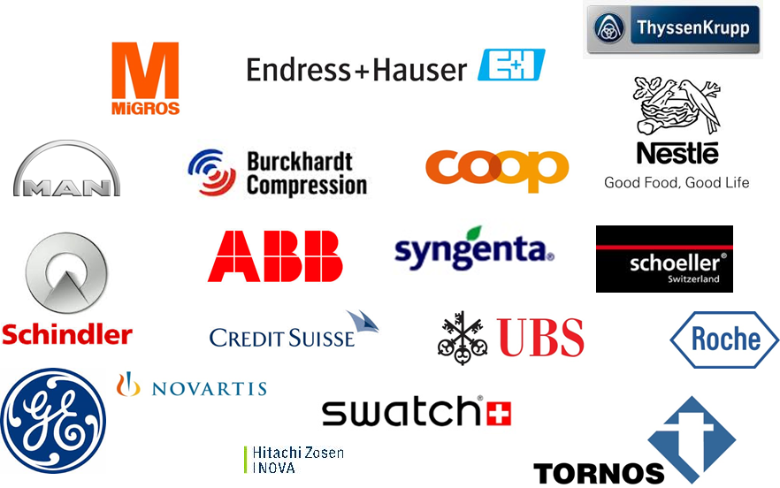
KOTRA Zürich
1
About Us
2
Business
3
Partners
4
Contact
Since 1972, Switzerland
9 Employees, Zürich
1. +1,000 Swiss Marketing
2. +100 Global Partnering
: R&D, Supply Product
3. Exhibition
: VITA FOOD, Baselworld, Worlddidac
4. In-outbound Investment
Website: KOTRA
KOTRA Zürich: +41 44 202 1232
sj.kim@kotra.ch

Slide 5

Global Partners
1. Purchasing from Korea
2. Joint R&D project
Assistance in finding new suppliers in Korea for outsourcing of specific parts, components or materials according to customer needs
Development of various cooperative projects between your company and Korean companies in the R&D field based on your procurement demand.
Notes:
KOTRA finds the ideal partners for you to build a global value chain.
We have a special program named ‘global partnering’ for it. This open innovation model is implemented in forming business partnerships between global and Korean companies. Partnerships in R&D and the development of parts/materials lead to mutual business partnerships involving technological cooperation, product sourcing and equity investment.
Main industry for this program is automobile, construction equipment etc.
Also KOTRA holds ‘Global Project Plaza’ which are combinations of project seminars and business consultations for overseas public projects such as civil engineering, construction, transportation infrastructure, energy and power plants. And KOTRA helps outstanding Korean SMEs participate in the global procurement market.

Slide 6


DEMAND
MATCHING
MEETING
FOLLOW UP
Identify
Your company’s
demand in detail
Recommend
potential
partners using
industrial map
database
Organize a
tailored business
meeting
Provide
solution
for global
company’s
requirement

Slide 7
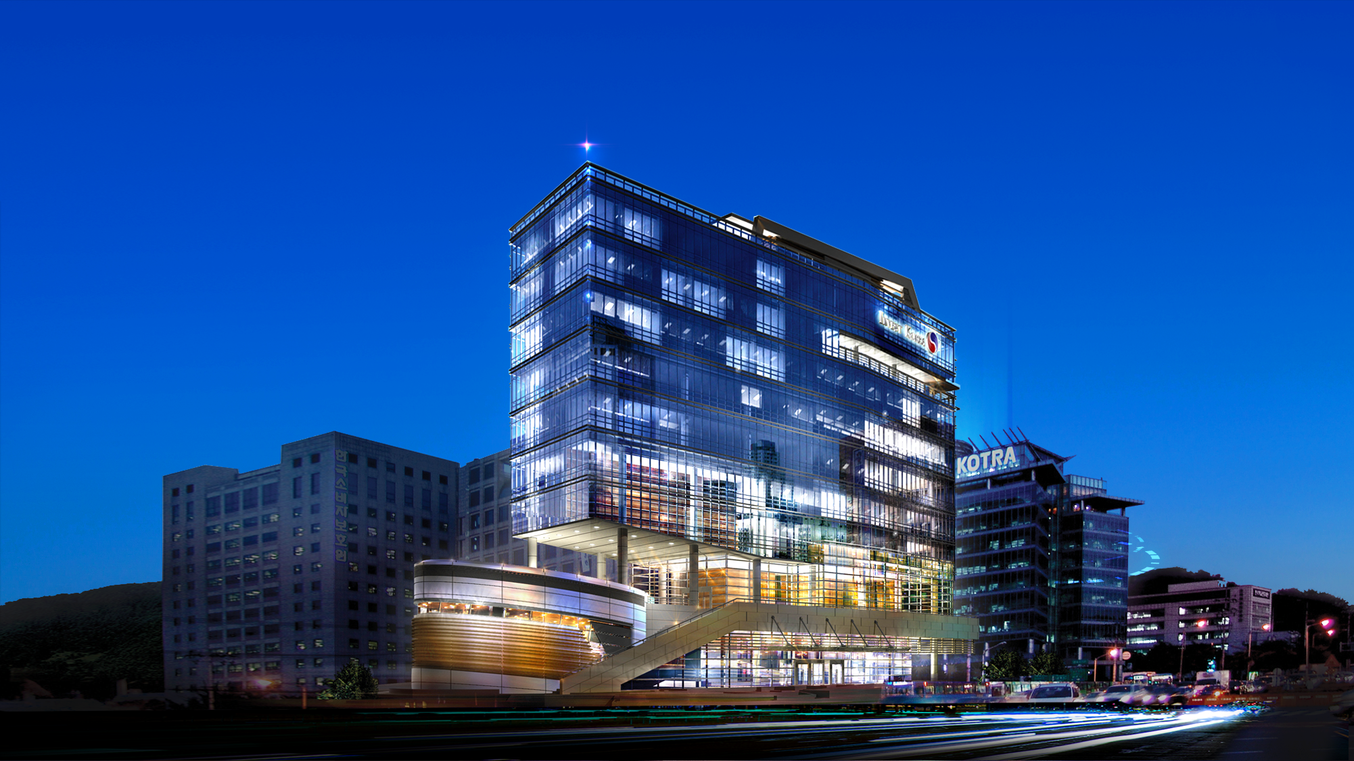


Thank you
Homepage
https://www.kotra.or.kr/english/index.do
Linkedin
https://www.linkedin.com/company/kotra/
KOTRA Zürich
Mr. Kim +41 44 503 5307 sj.kim@kotra.ch

