Slide 1

MFGIC, S.A. DE C.V.

Slide 2
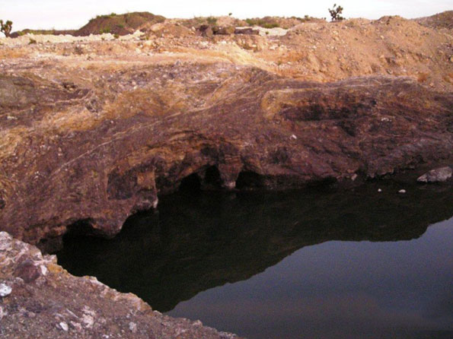
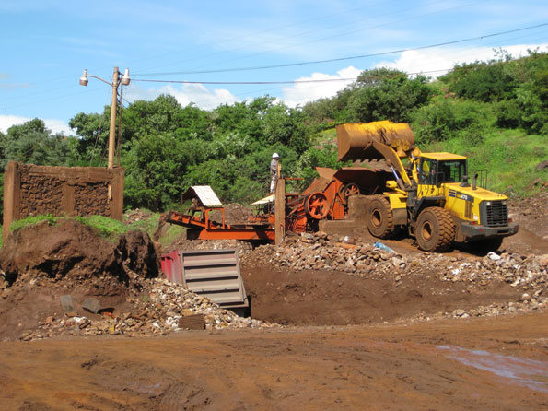
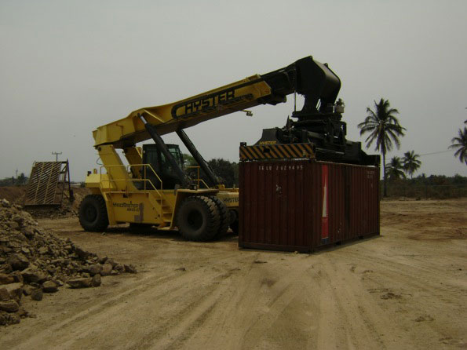
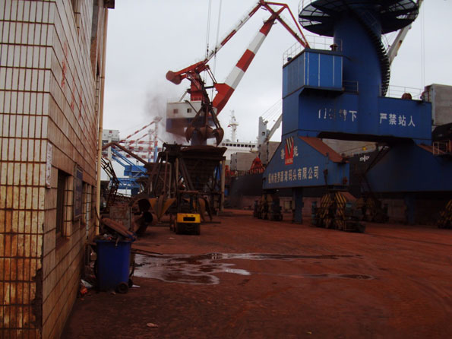
MEXFER

Slide 3
Agenda
Who we are
The Mining Industry
Mexfer’s Mines
Mexfer’s Enterprise
Summary

Slide 4
Who We Are
MEXFER – MFGIC S.A. de C.V.

Slide 5
About Mexfer
Mexfer is a growing Mexican company in the business of exploration, extraction and commercialization of mineral resources.
Mexfer owns the rights to two mines in the state of San Luis Potosi, covering 3526 hectares and containing more than seven million metric tons of Manganese and other commodities.

Slide 6
Professional Team
Fernando Fernández, President & CEO
  Exclusive Mexican Representative to Mexico and America of CHINALIGHT IMPO & EXPO RESOURCES. (Chinese Governmental Corp)
  Expert in Logistics, Imp-Expo (Commodities to Asia),
  Former Army Captain, (16 years) Office of the President (10 years)
  B.A, Studies (EBC), Lawyer Studies, (UNITEC).
Germán Fernández Aguirre, Legal Advisor
  Legal Advisor to the Federal Executive
  Law Degree, UNAM Law School
Scott Globus, Operations Manager
  Intelligent Capital, Merger & Acquisition Advisor
  Founder, online media company
  BS Physics, MIT (Massachusetts Institute of Technology)
Mexfer values: honesty, integrity, loyaty and quality of service

Slide 7
Advisory Team
Act. Enrique Vilatela Riba,
  Former Chief Director of BANCOMEXT
Jesus Herrera
  Geological Advisor
Roberto Charvel, Financial Advisor
  Founder, Vander Capital Partners
  VP of Business Development, Prudential Real Estate Investors Latin America
  MBA, Harvard Business School
Dr. Daniel Barba Lopez, Taxation Advisor
  Managing Partner of Tax Consultants—Barba, Morales & Associates, SC
  Chair Professor of Accounting and Finance, Department of the Tecnologico de Monterrey, Guadalajara Campus
  Ph.D. Finance, Instituto de Especialización para Ejecutivos SC
Mexfer values: honesty, integrity, loyaty and quality of service

Slide 8
Key Relationships
Asociación de Ingenieros de Minas Metalurgistas y Geologos de México
Cámara Nacional de Minería
Coordinación General de Minas
Fomento para la Inversión Pública y Privada en la Propiedad Rural (FIPP)
Instituto Internacional de Manganeso
International Chamber of Commerce (ICC)
Mexfer’s extensive relationships enable us to do business quickly

Slide 9
Key Relationships
Mayor Municipality of Villa de Ramos in San Luis Potosí
MexCham
ProMéxico
Secretaría de la Reforma Agraria
Servicio Geológico Mexicano
Mexfer’s extensive relationships enable us to do business quickly

Slide 10
The mining industry
MEXFER – MFGIC S.A. de C.V.

Slide 11
The Mining Industry in México
Mexico is mineral rich with deposits of Gold, Zinc, Silver, Lead, Copper & Iron
Ranks as the 9th largest mineral producer worldwide, 5% of the total consumption
Ranks as the 4th largest mineral producer in Latin America
Over 700 active mining operations and attracts investments from Canada & USA
Exports to USA, Japan, Peru, Canada, Switzerland, Dominican Republic
In 2009 Mexico exported 119 million tons of minerals
8th largest producer of Manganese worldwide

Slide 12
Manganese Production in Mexico
1 million metric tons of Mn were produced in 2008
Minera Autlan is the country’s largest Manganese mine in operation since 1953
3 Australian exploration projects underway
Mexfer is actively developing 2 mines, El Pachon & San Jorge
Mexfer has notarized agreements in place with other untapped mining claims

Slide 13
Manganese
Major producers are:
  China
  Australia
  South Africa
  Gabon, Brazil
  India
  Mexico
  Soviet Republics.
Manganese is used in the production of steel, aluminum & batteries.
(source: International Institute of Manganese)

Slide 14
Manganese
Worldwide demand has grown over the following years that we have data for:
2006 10,895 million metric tons
2007 12,397 million metric tons
2008 13,290 million metric tons
The value of ferro-alloy lump Mn ranges from: $185-$280 USD per metric ton, FOB
(source: International Institute of Manganese)

Slide 15
Mexfer’s mines
MEXFER – MFGIC S.A. de C.V.

Slide 16
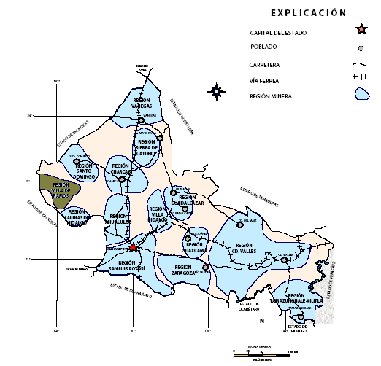
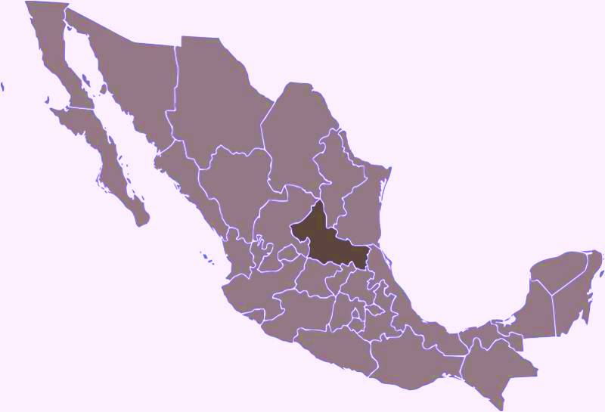
Location of Mexfer’s Mines
MEXFER owns the rights to 2 lots, El Pachón and San Jorge, located in the Villa de Ramos county of the State of San Luis Potosí.
These mines were designated to be in a mining
region by the Geological
Mexican Service.
VILLA DE RAMOS

Slide 17
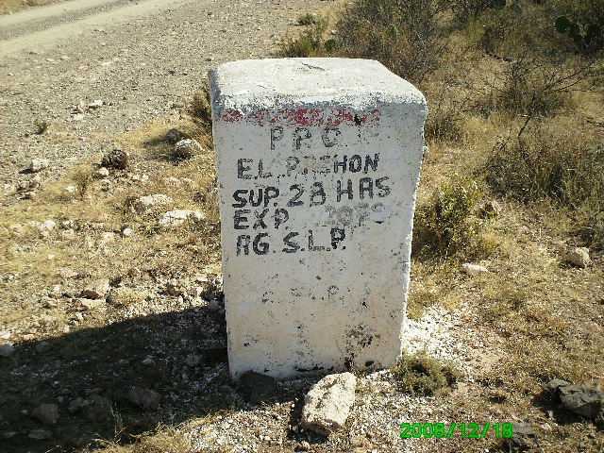
Mexfer’s Mines
Mexfer’s lots have been certified by the
Mexican Geodesic System

Slide 18
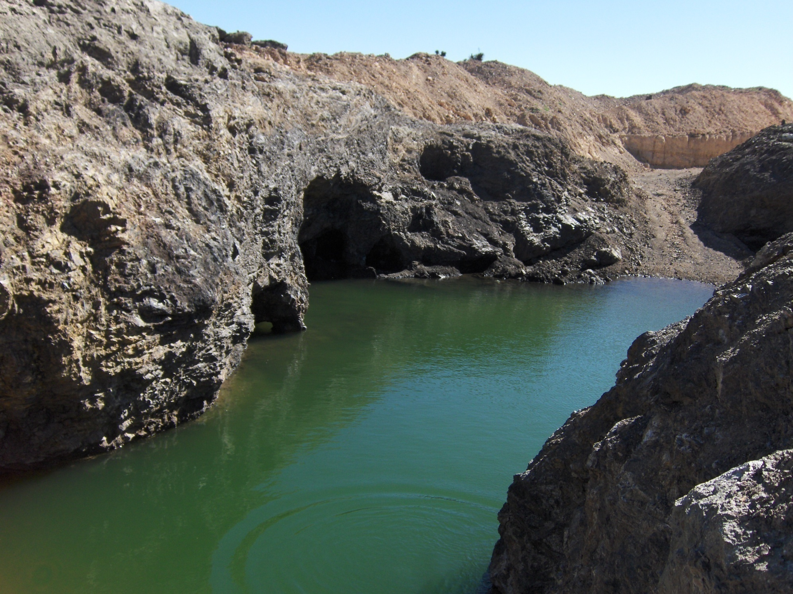
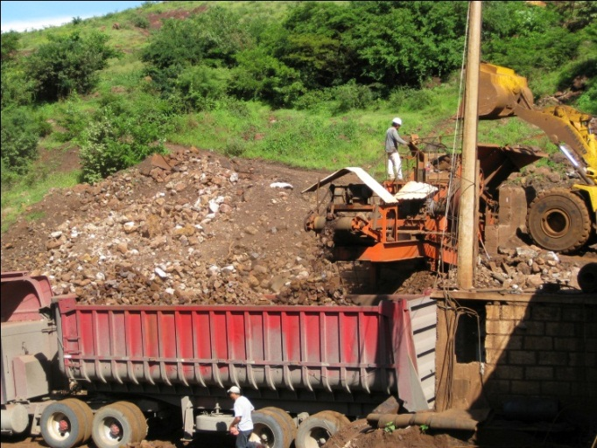
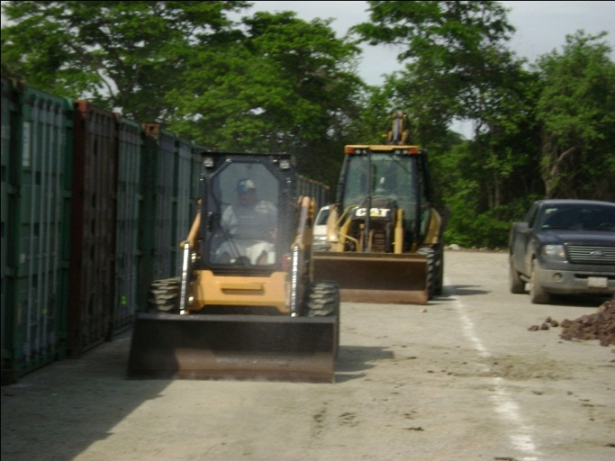
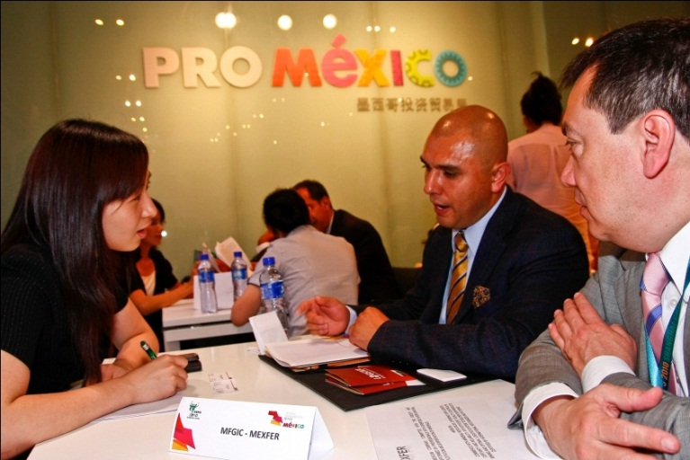
Mexfer’s Mines

Slide 19
Specifications of Mines
DEPOSITS | EL PACHON and SAN JORGE
COUNTY | Villa de Ramos, San Luis Potosí
MINERALS | Manganese 30% al 52% Gold: 3 to 4 gr / Ton Silver 50 gr / Ton According to SGM Key Document 2486VAMA0001
LOCATION | The mine is located near the San Rafael town, access is off-road. From Villa de Santo Domingo to San Rafael, you shall pass San Antonio del Mezquite, at an approximate distance of 40 Km..
ACCESS | The access starts from the city of San Luis Potosí. The mine is 174 kms from SLP, including 10.5 kms of dirt roads in good condition
SURFACE | EL PACHÓN 28.0000 HAS. SAN JORGE 3,498.2321 HAS TOTAL 3,526.2321 HAS.
POTENTIAL | The evidence is of 2P of Manganese, greater than 7,000,000 tons. (Geological Mexican Service)

Slide 20
Specifications of Mines
Area [hectares] | El Pachón 30.000 | San Jorge 3,498.2321
Shape & Dimensions | Andesite and sandstone-shale | Sandstone & shale
Shape & Dimensions | Gap Stockwork Thickness: 4-8m Length: 250-1000m | Gaps, Horses, Streaks Thickness: 5-10m Length: 20-1000m
Mineralogy | Jasper Jasperoid Cryptocrystalline silica | Silica Jasperoid Sulfides de Pb, Ag, Zn
Alterations | Silicified Oxidation | Silicified Oxidation Argilization
Genesis | Epithermal | Hydrothermal Epithermal
Potential | 5-10,000,000 TON | Unknown Depth
UTM Coordinates | PP X 205 171 Y 2 553 112 | PP X 205 171 Y 2 553 112

Slide 21
Comparison of Mines in the Region
Source | Año | La Margarita (Norte) | El Pachón (Noreste) | La Manga (este) | Montaña Manganeso (Suroeste) | Santa Ana (oeste)
Engineer Ricardo Ramos, et. al. | 1981 | 28 | 35 | - | 32 | 35
SGM (PAC#) | 1986 | - | 35.8 | - | 32 | 35
SGM | 1986 | - | 35 | 35 | - | -
SGM | 2009 | 38 | - | 38.2 | 43 | -
(M#7) | Ene 2010 | - | 50.88 | - | - | -
Muestra 2 Blanca | Ene 2010 | - | 51 | - | - | -
Average |  | 33 | 41.5 | 36.6 | 35.6 | 35

Slide 22
Mexfer’s ENTERPRISE
MEXFER – MFGIC S.A. de C.V.

Slide 23
Our Process
Exploration
Preparation
Extraction
Lotification
Ground
Transportation
Consolidation and dispatch
Ocean shipping
KNOWLEDGE AND DOMAIN OF PROJECT PROCESS
MEXFER
Commercial agreement with MAQUIRSA
INTEGRAL LOGISTIC AND TRANSPORTATION agreement
Agreement with customs agent
Commercial agreement with China Shipping
– Logistics control and SGS certification
Commercial agreement with HSBC for Letter-of-credit confirmations, irevocable and in plain sight
INTERNATIONAL QUALITY OF CONTROL STANDARDS (SGS) TESTED IN THE LABORATORIES OWNED BY MEXFER
Integral Management System and Logistics-Operation
Mine Plan Management
Maneuver
Control
Statistic Composition
Logistic Control
Permanent Transportation
Monitoring
Dispatch
Management

Slide 24
Strategic Alliances
Exploracion, Geology Team
El Ejido, Local Agrarian Community
Maquirsa, Equipment Supplier
Logistica Integral en Transportacion, Transportation Partner
China Shipping Company

Slide 25

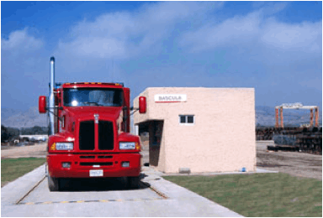
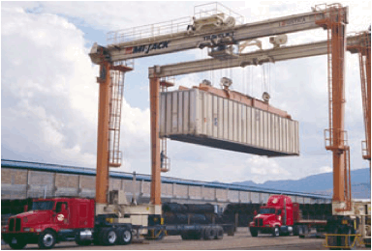
Logística Integral en Transportación
Strategically located close to mine
in San Luis Potosi
Capacity includes transport by truck & railroad and will provide storage facility
Provided strategic investment in laboratory to provide compositional analysis
Owns 3 terminals and has relationships with national & international ports

Slide 26
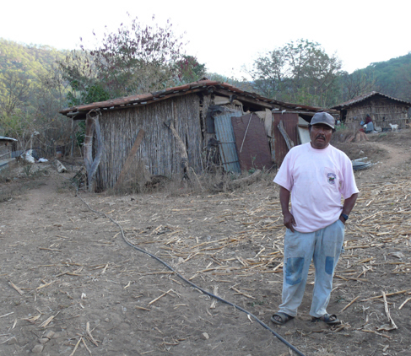

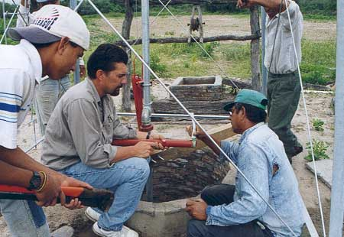
El Ejido, Local Agrarian
Community
Local people support Mexfer’s use of the land
The mining operation will provide jobs for the community
Mexfer will build infrastructure that will enhance the community & support the operation
The Mexfer Foundation, a US non-profit foundation, will ensure long term development of the region

Slide 27
Business Development
Company | Stage
CHINALIGHT Resources Imp. & Exp., Corp. | Signed agreement for 50,000 tons
Kotra-Korea Trade Investment Promotion Agency | Signed Letter of Intent
Tianjin Binhai Harbor Port Group Co., Ltd | Signed Letter of Intent
Shenzhen FeiMa Int’l Supply Chain Co., Ltd | Signed Letter of Intent
New World Resources Group Ltd | Signed Letter of Intent
Wuhang Steel | Terms under discussion
Hainan Zhonghai Mining Industry Co., Ltd | Terms under discussion
AT&M Int’l Trading Co., Ltd | Terms under discussion
Wuhan Iron & Steel (Group) Co. | Terms under discussion

Slide 28
Summary
MEXFER – MFGIC S.A. de C.V.

Slide 29
Summary
Competent Core Team
Knowledge of Mining Process & International Trade
Clear Rights to Develop the Mines & Commercialize the Minerals
Excellent Strategic Relationships
Strong, Steady Worldwide Demand for Manganese

Slide 30


